Slide 1
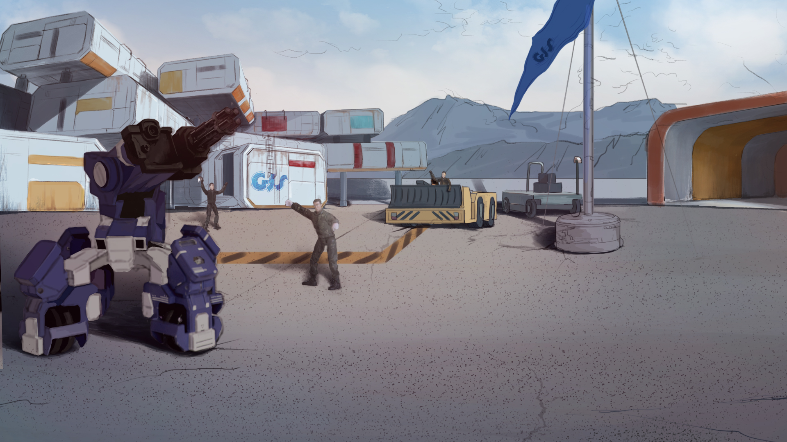

How to Become A GEIO Pilot？
Lesson 2: Don’t Fall Over

Slide 2

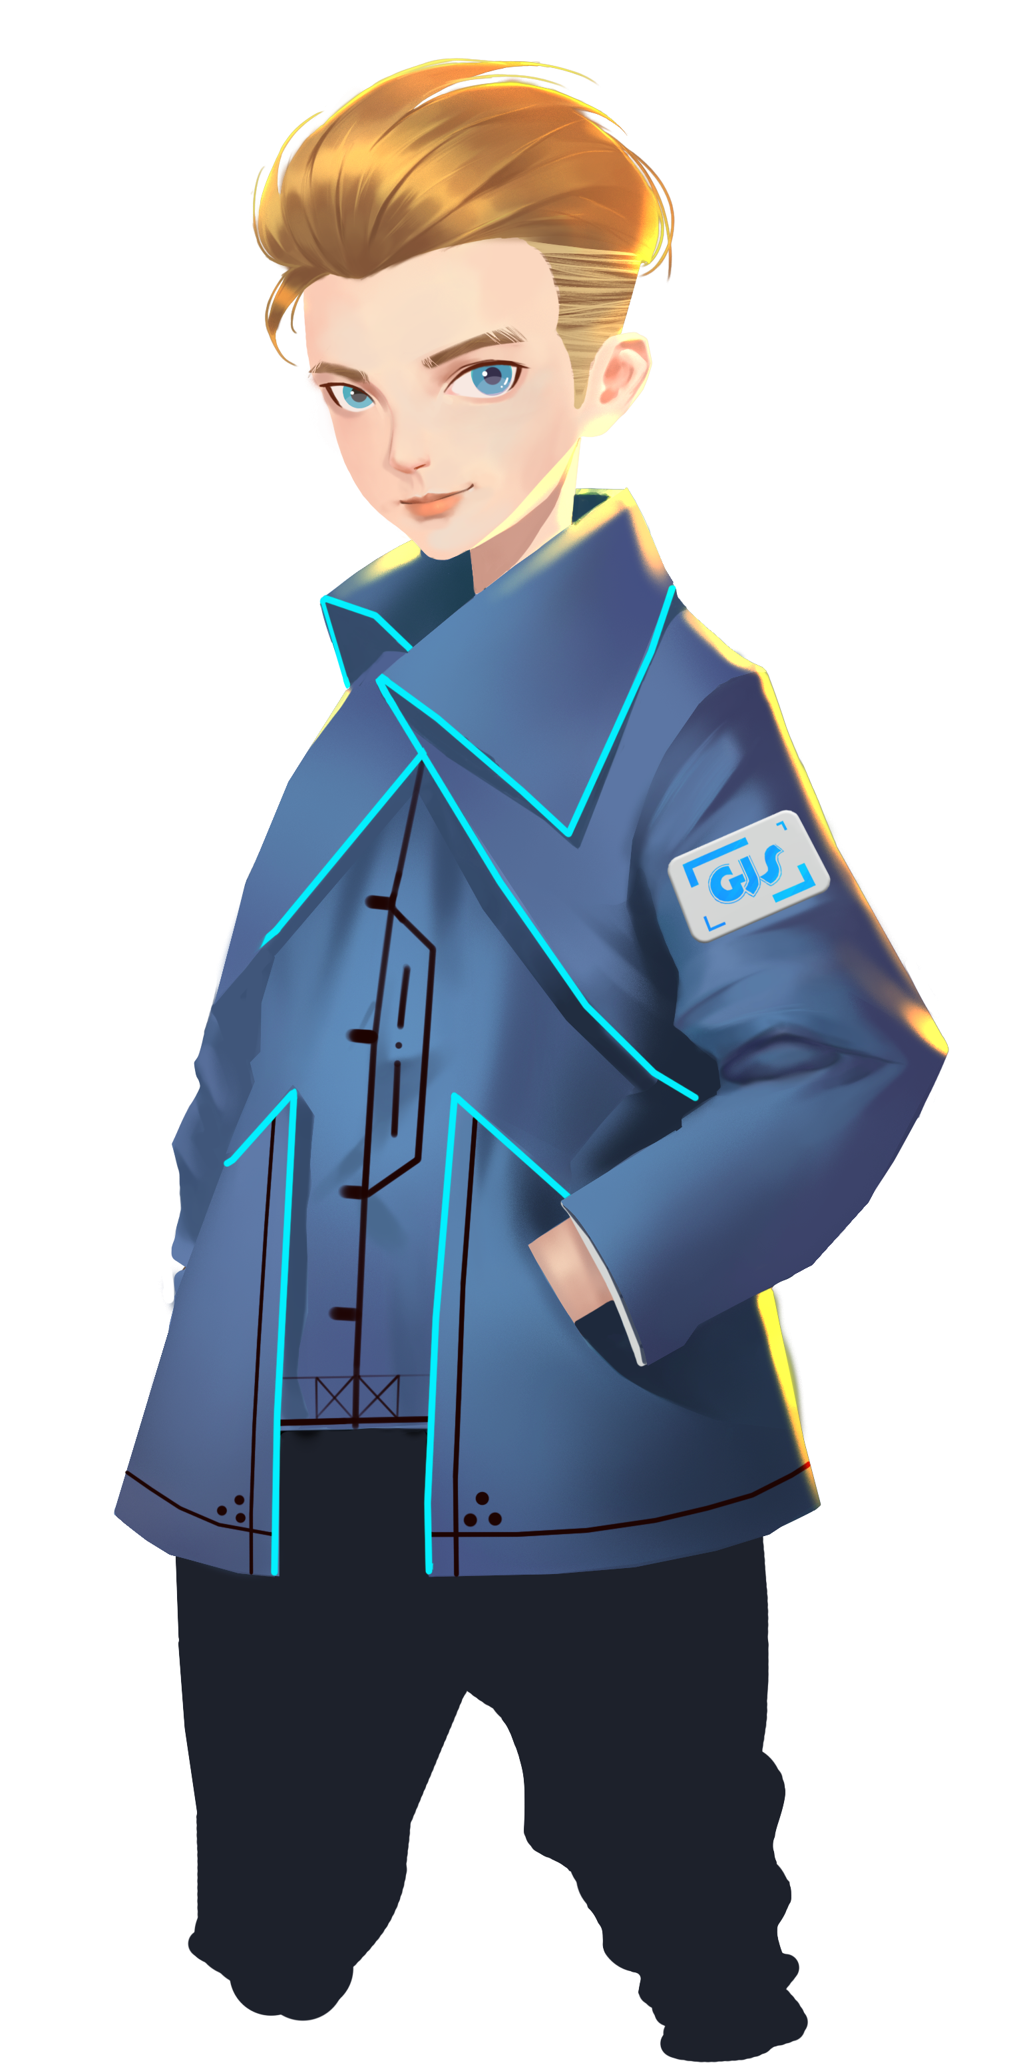

What is a robot? What can it do for us?
What does a robot consist of?
How to measure the speed of an object?
Good! Let’s continue our training.
Welcome back fellow pilots! I am Sam. Do you still remember what we have learnt last time?

Slide 3
Briefing

Slide 4

Topic
“Don’t Fall Over”
Basic Knowledge
Inertia and Friction
Training
GEIO’s moving and turning actions
Challenge
Parcel Delivery
In the Briefing section, let’s see what we are going to learn today.

Slide 5
Basic Knowledge

Slide 6
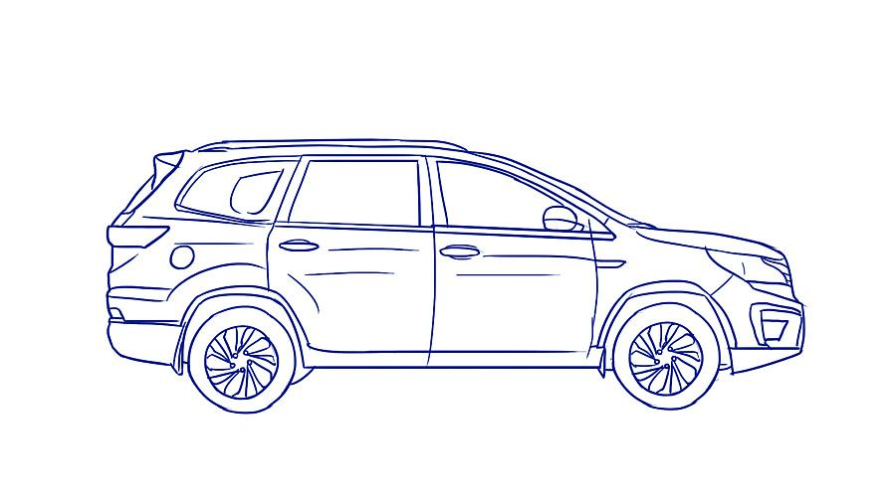
Inertia is the resistance of an object to any change to its position and its state of motion.
In this example, when the car starts, inertia makes our body try to fight against moving forward and remain still. Thus we can feel the pushing force from the back.
This is a funny phenomenon when we are travelling by cars.
As the car starts to accelerate, we can feel a force pushing us from the back.
Actually, this is called inertia.

Slide 7
The car begins to accelerate and is getting faster, but with nothing to support from the back, we will remain relatively static. As a result, we will fall over from the car top.
Imagine what would happen if we are standing on top of the car when it starts out.

Slide 8
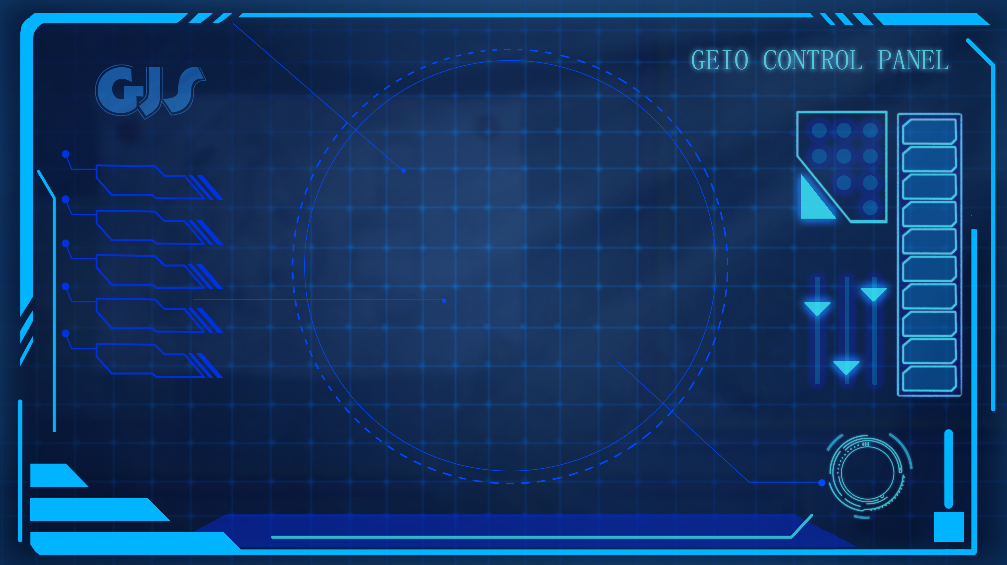
100KG
F
This is because of the effect of friction (the red arrows)—the force that hinder the motion of objects. The bigger and heavier the object is, the greater friction the object will have, and the less likely it will be moved.
Sometimes we need to carry things and put them on top of the car.
How to prevent them from falling over when the car is moving?
Let’s make an experiment. Imagine a little box on top of the car.
It is too light and small that if you push it, it will definitely fall over.
What if we change the box to something bigger and heavier?
Let’s have a test on GEIO.

Slide 9
Training

Slide 10
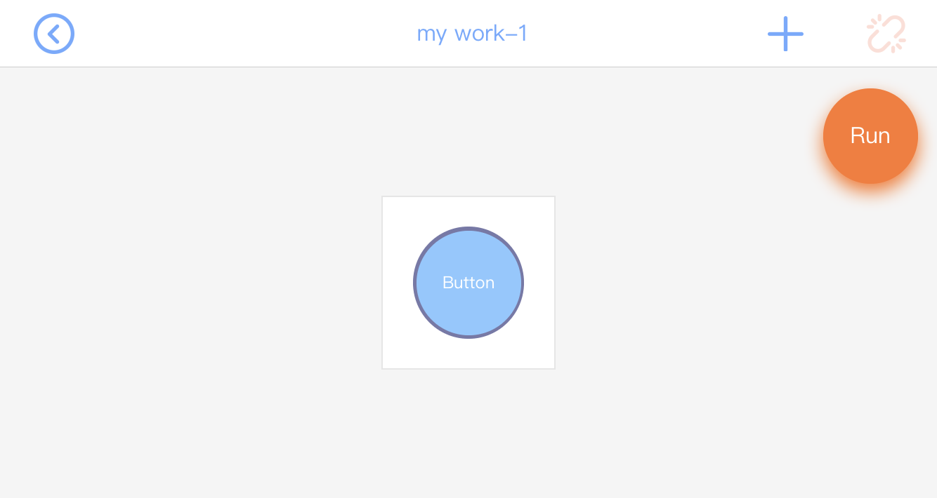
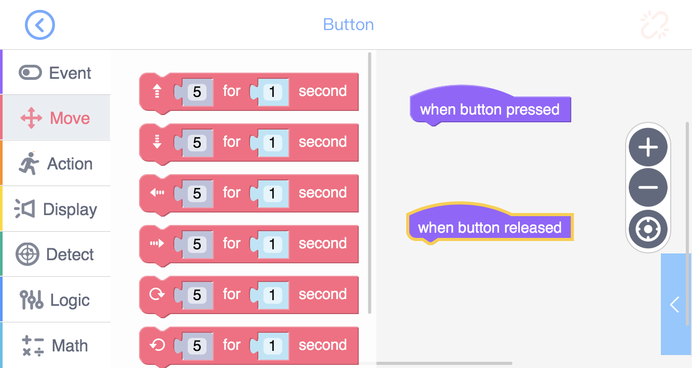
Let’s programme GEIO to observe its performance when moving in different directions.

Slide 11
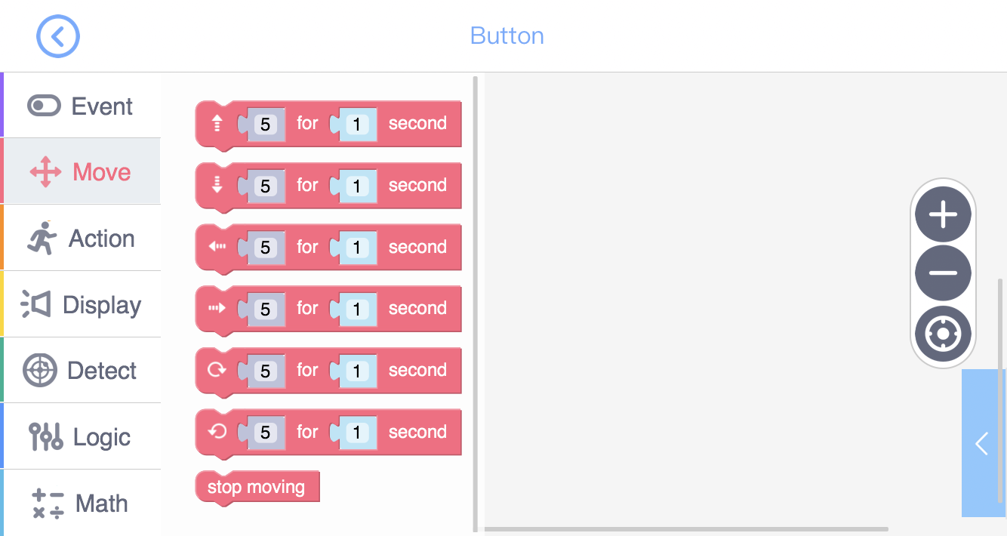
Forward at certain speed for certain time
Move Backward
Move to the left
Move to the right
Turn right
Turn left
Stop moving actions

Slide 12
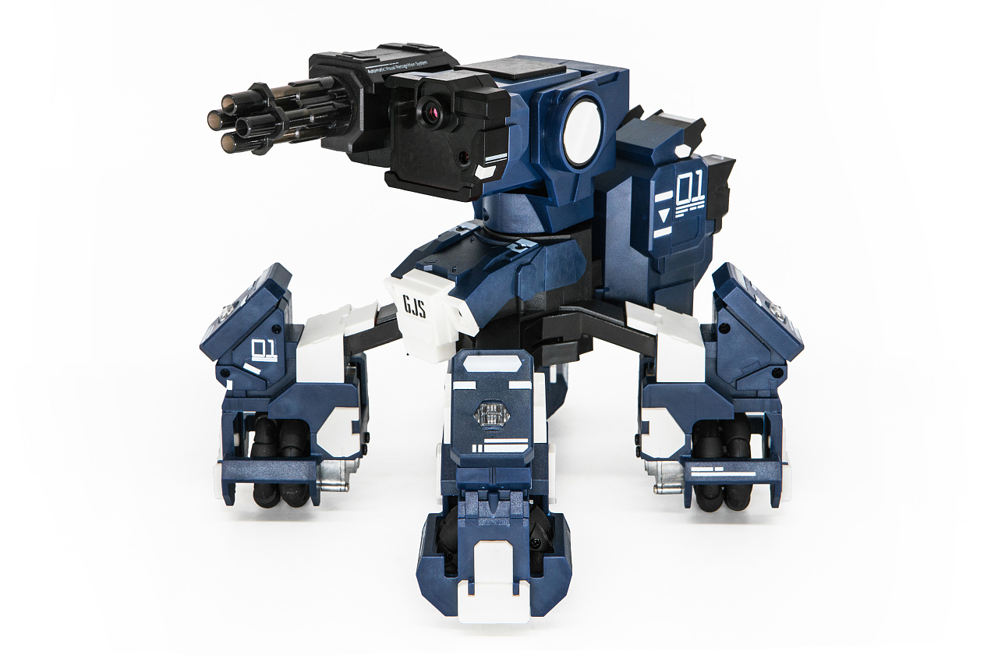
Secondly, Put an empty box on top of GEIO, and programme GEIO to move in each directions. Find out that at what speed the box could remain on the top.
Then gradually increase the weight of the box by adding things into it.
Will the result be different?

Slide 13
Challenges

Slide 14
Now we are familiar with the principle of inertia and friction.
It is then the time for a match: Parcel Delivery!

Slide 15
S
D
Your job here is to programme your GEIO to carry the box, and move from S point all the way to D point without hitting any obstacle (the blue boxes) or losing the box. The one that finishes the job with the shortest time duration wins the match!
Look over here. This is our training ground, on which there are 40 squares, each of the size 30cm*30cm. Additionally, each square is divided into 9 small squares of the size 10cm*10cm.
Let the match begin!

Slide 16
What is inertia?
What is friction? What features does it have?
How to prevent things from falling over
when GEIO is moving?
Bravo! You are making progress. I look forward to the day that you become qualified GEIO pilots!
Before we dismiss, I’d like to ask some questions.
This is the end of this class. See you next time!

