Slide 1
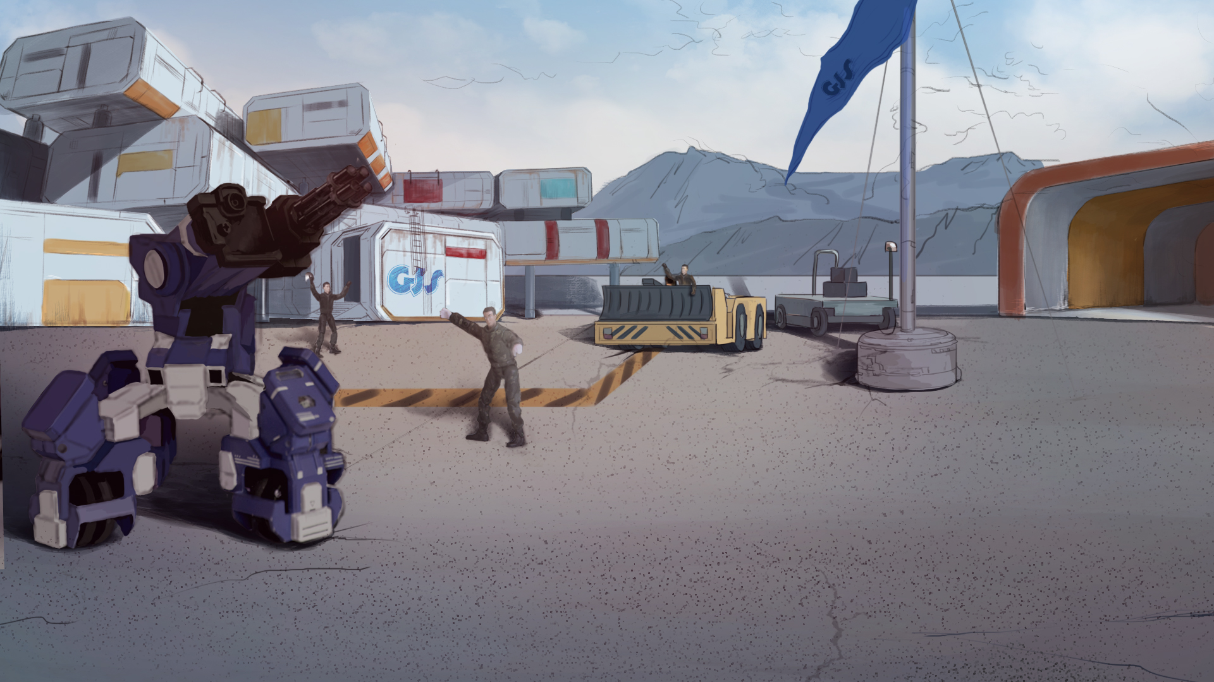
How to Become A GEIO Pilot？
Lesson 15: Destroy Enemy Armoury

Slide 2

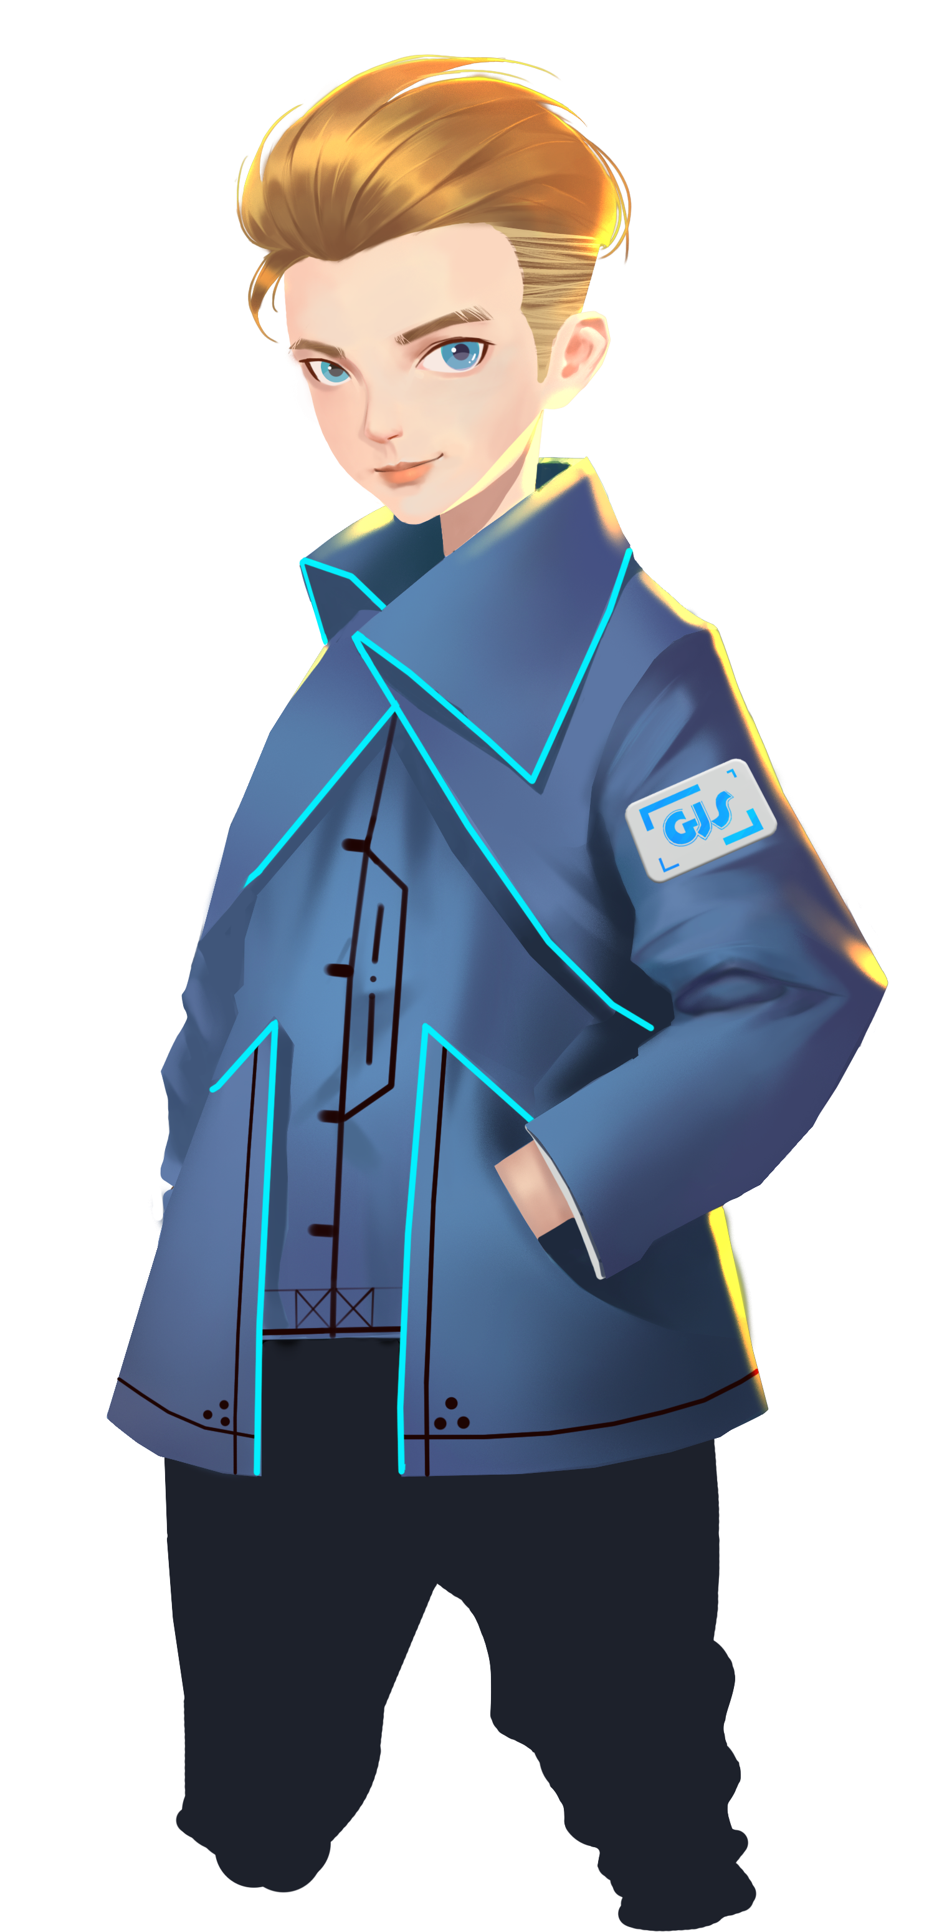

How to limit GEIO’s ammunition?
How to commence melee attacks?
How to accurately control GEIO’s motion?
After the last battle, we took back the city. On the other hand, we also endured heavy casualty due to enemy’s great firepower. In order to weaken the enemy, we are to find and destroy their armoury.
Welcome back fellow pilots! I am Sam. Do you still remember what we have done last time?

Slide 3
Briefing

Slide 4
Topic
“Destroy Enemy Armoury”
Basic Knowledge
Logo recognition system
Training
Create log recognition system
Challenge
Locate enemy armoury
In the Briefing section, let’s see what we are going to do today.

Slide 5
Basic Knowledge

Slide 6
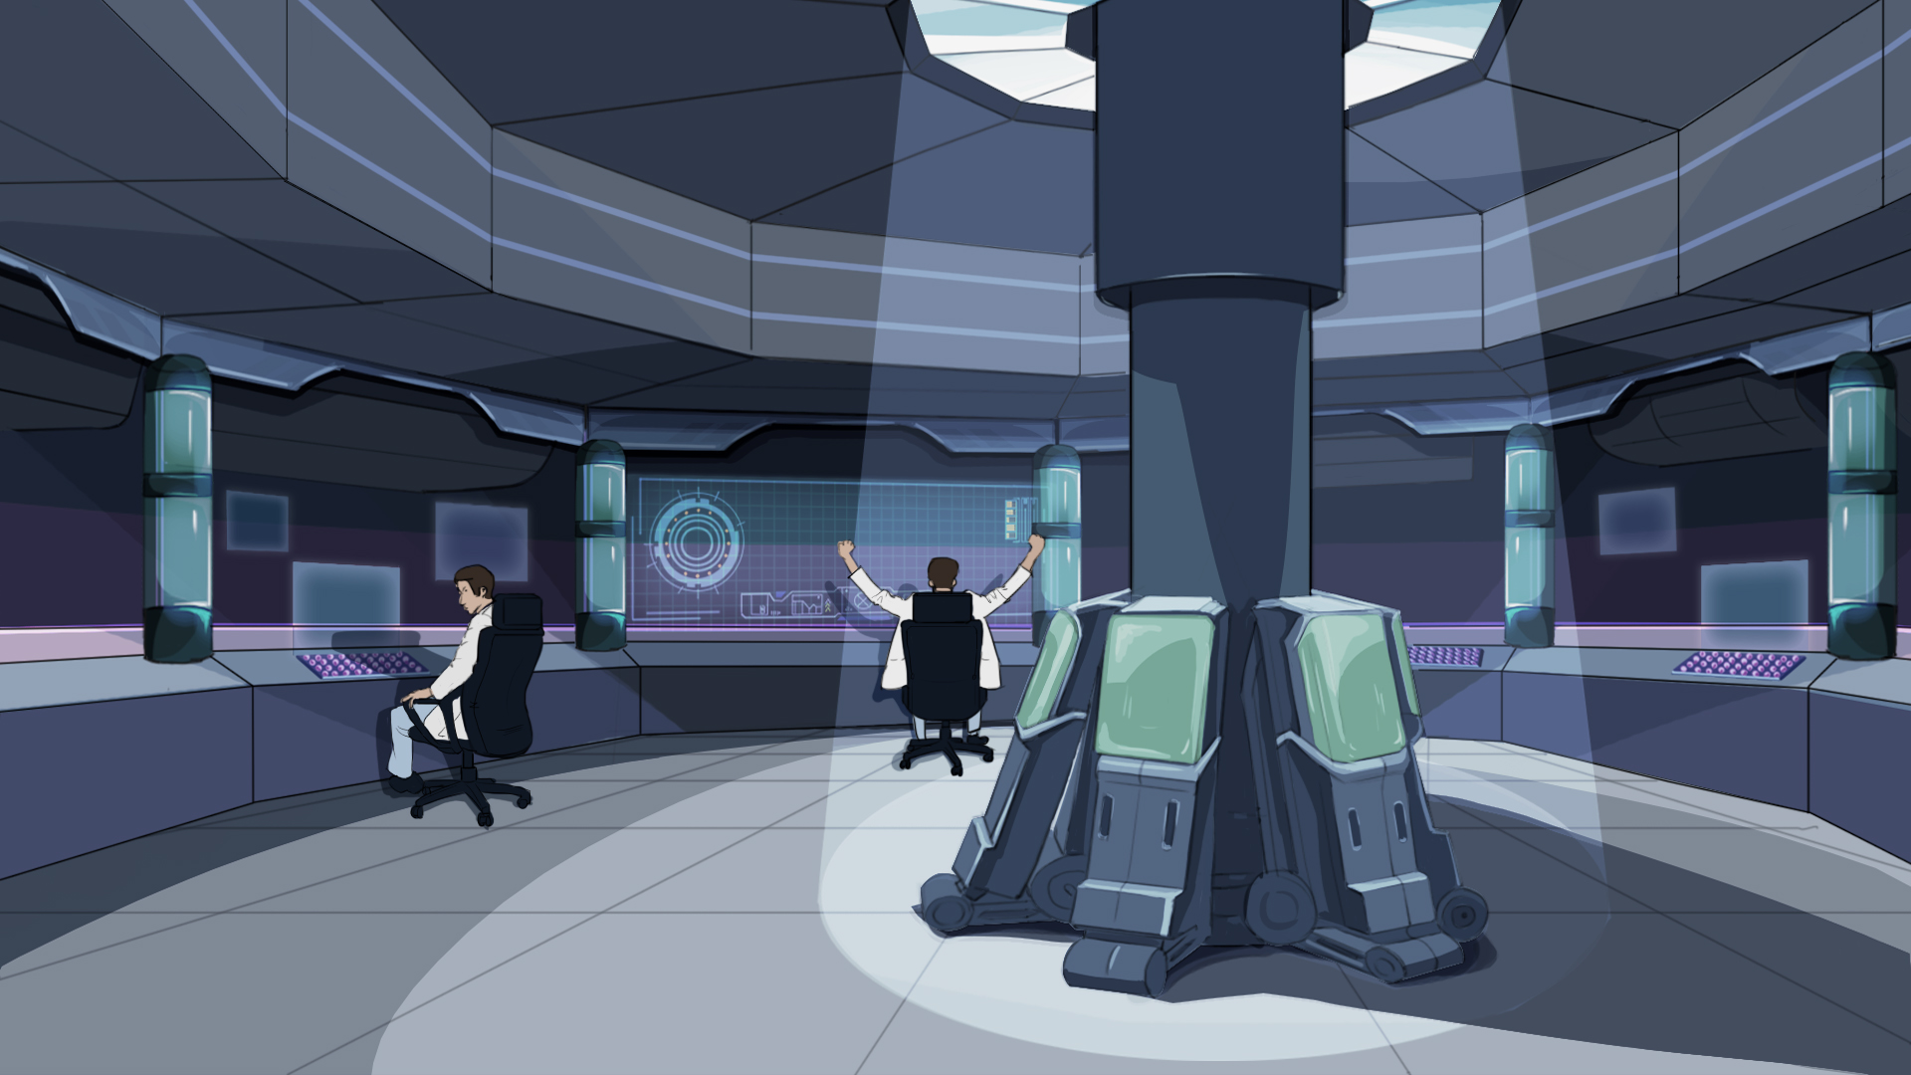
Alright, we have arrived at our destination. Fenrir’s armoury is somewhere in this desert. Our mission is to find out the exact location of the armoury, so that our bombers could destroy it.
The armoury is carefully disguised and concealed. But the Fenrir soldiers left logos in order to find it themselves. So as long as we find the right logo, we find the armoury.
Let’s have a review of GEIO’s logo system

Slide 7




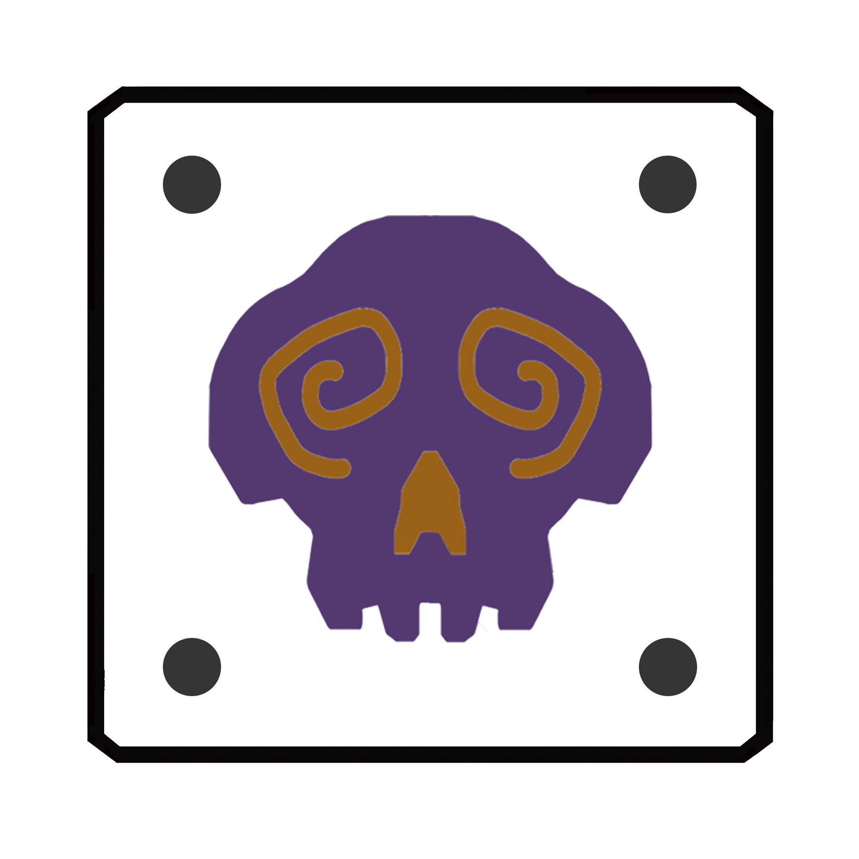






Actually, when GEIO recognised a certain logo, it will feedback a special number to the system. By reading this number, it is possible for us to know which the recognised logo is.
We know that there are 10 logos that can be recognised by GEIO. They are as shown above.
But how can we read this feedback number?

Slide 8
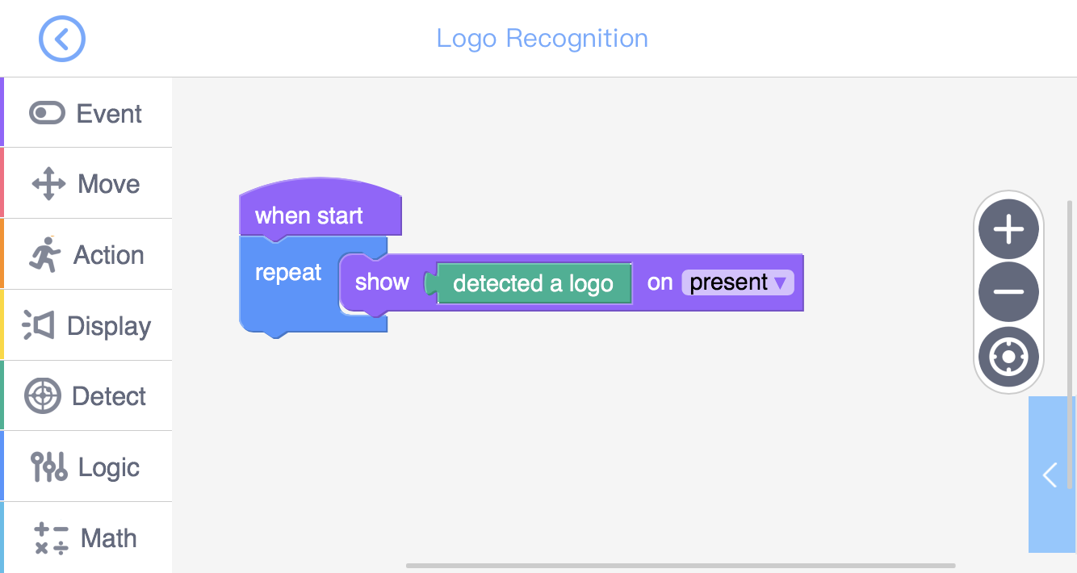
The above image shows the programme of displaying the logo number
using “Digital Display”. This could help us read the feedback number.

Slide 9
Training

Slide 10
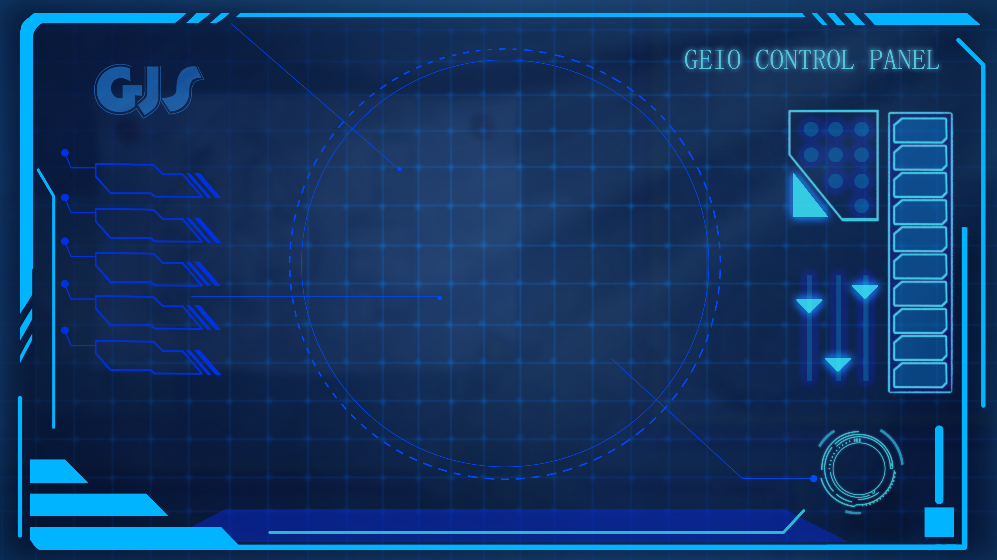
Training task 1: Use the programme we just saw to identify
each of the logo by record their feedback numbers.

Slide 11
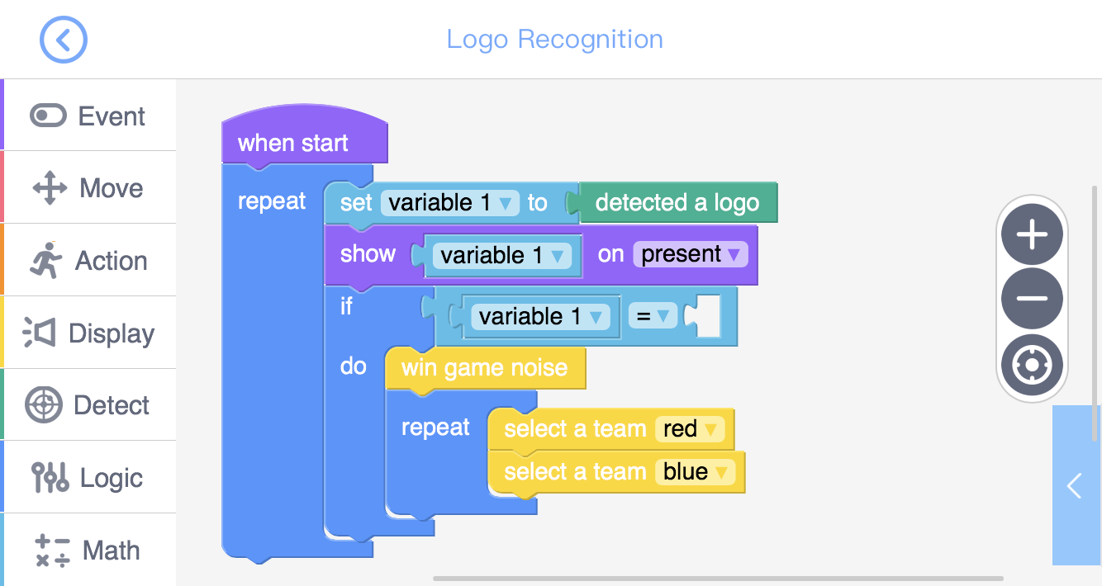
？
Training task 2: Create totem recognition system. When GEIO recognise the logo “House”, it would give the “Win Game Noise” and flashing the red and blue lights. Otherwise it would do nothing.

Slide 12
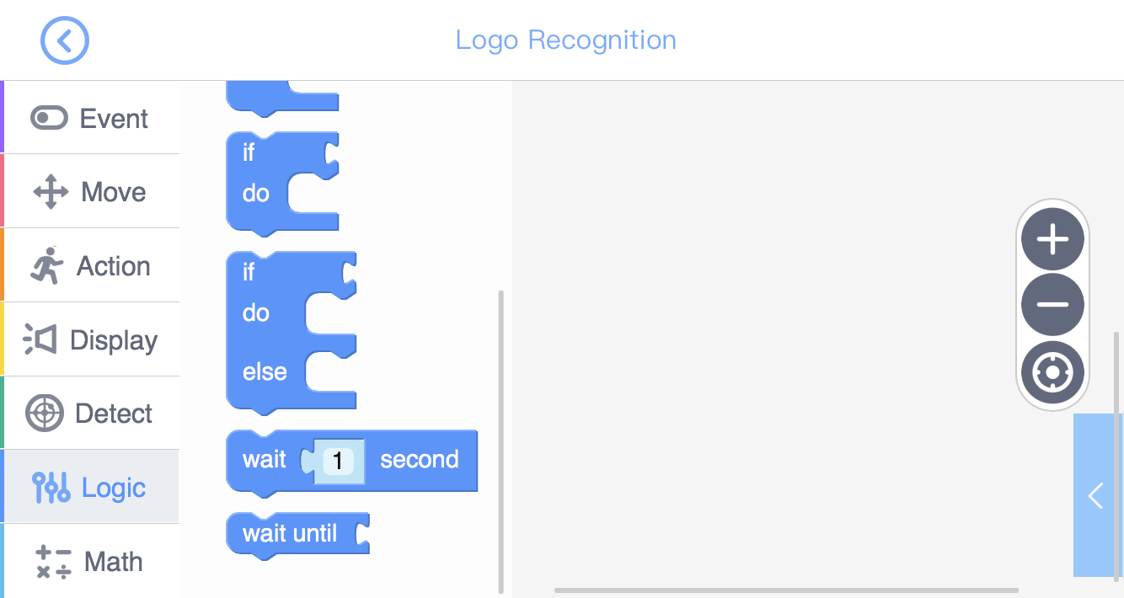
1
2
Another similar code “If…Else” is slightly different. When we use “If…Else”, the system will execute the codes in slot 1 if the condition is fulfilled, otherwise the system will execute codes in slot 2 (Else).
In last training task, we came across a new code “If”. This code is used to determine whether to execute the codes contained in it. If the condition is fulfilled, execute; if not, skip.
After the training, we should now start our mission: Find and locate Fenrir’s armoury.

Slide 13
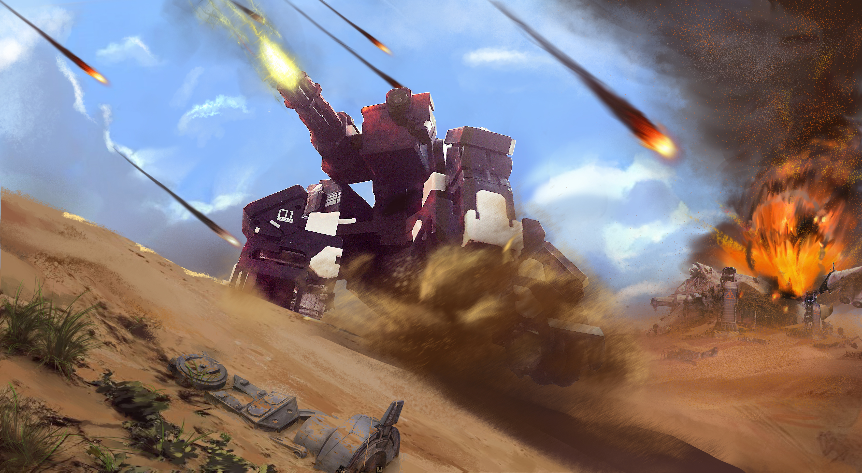
Challenge

Slide 14
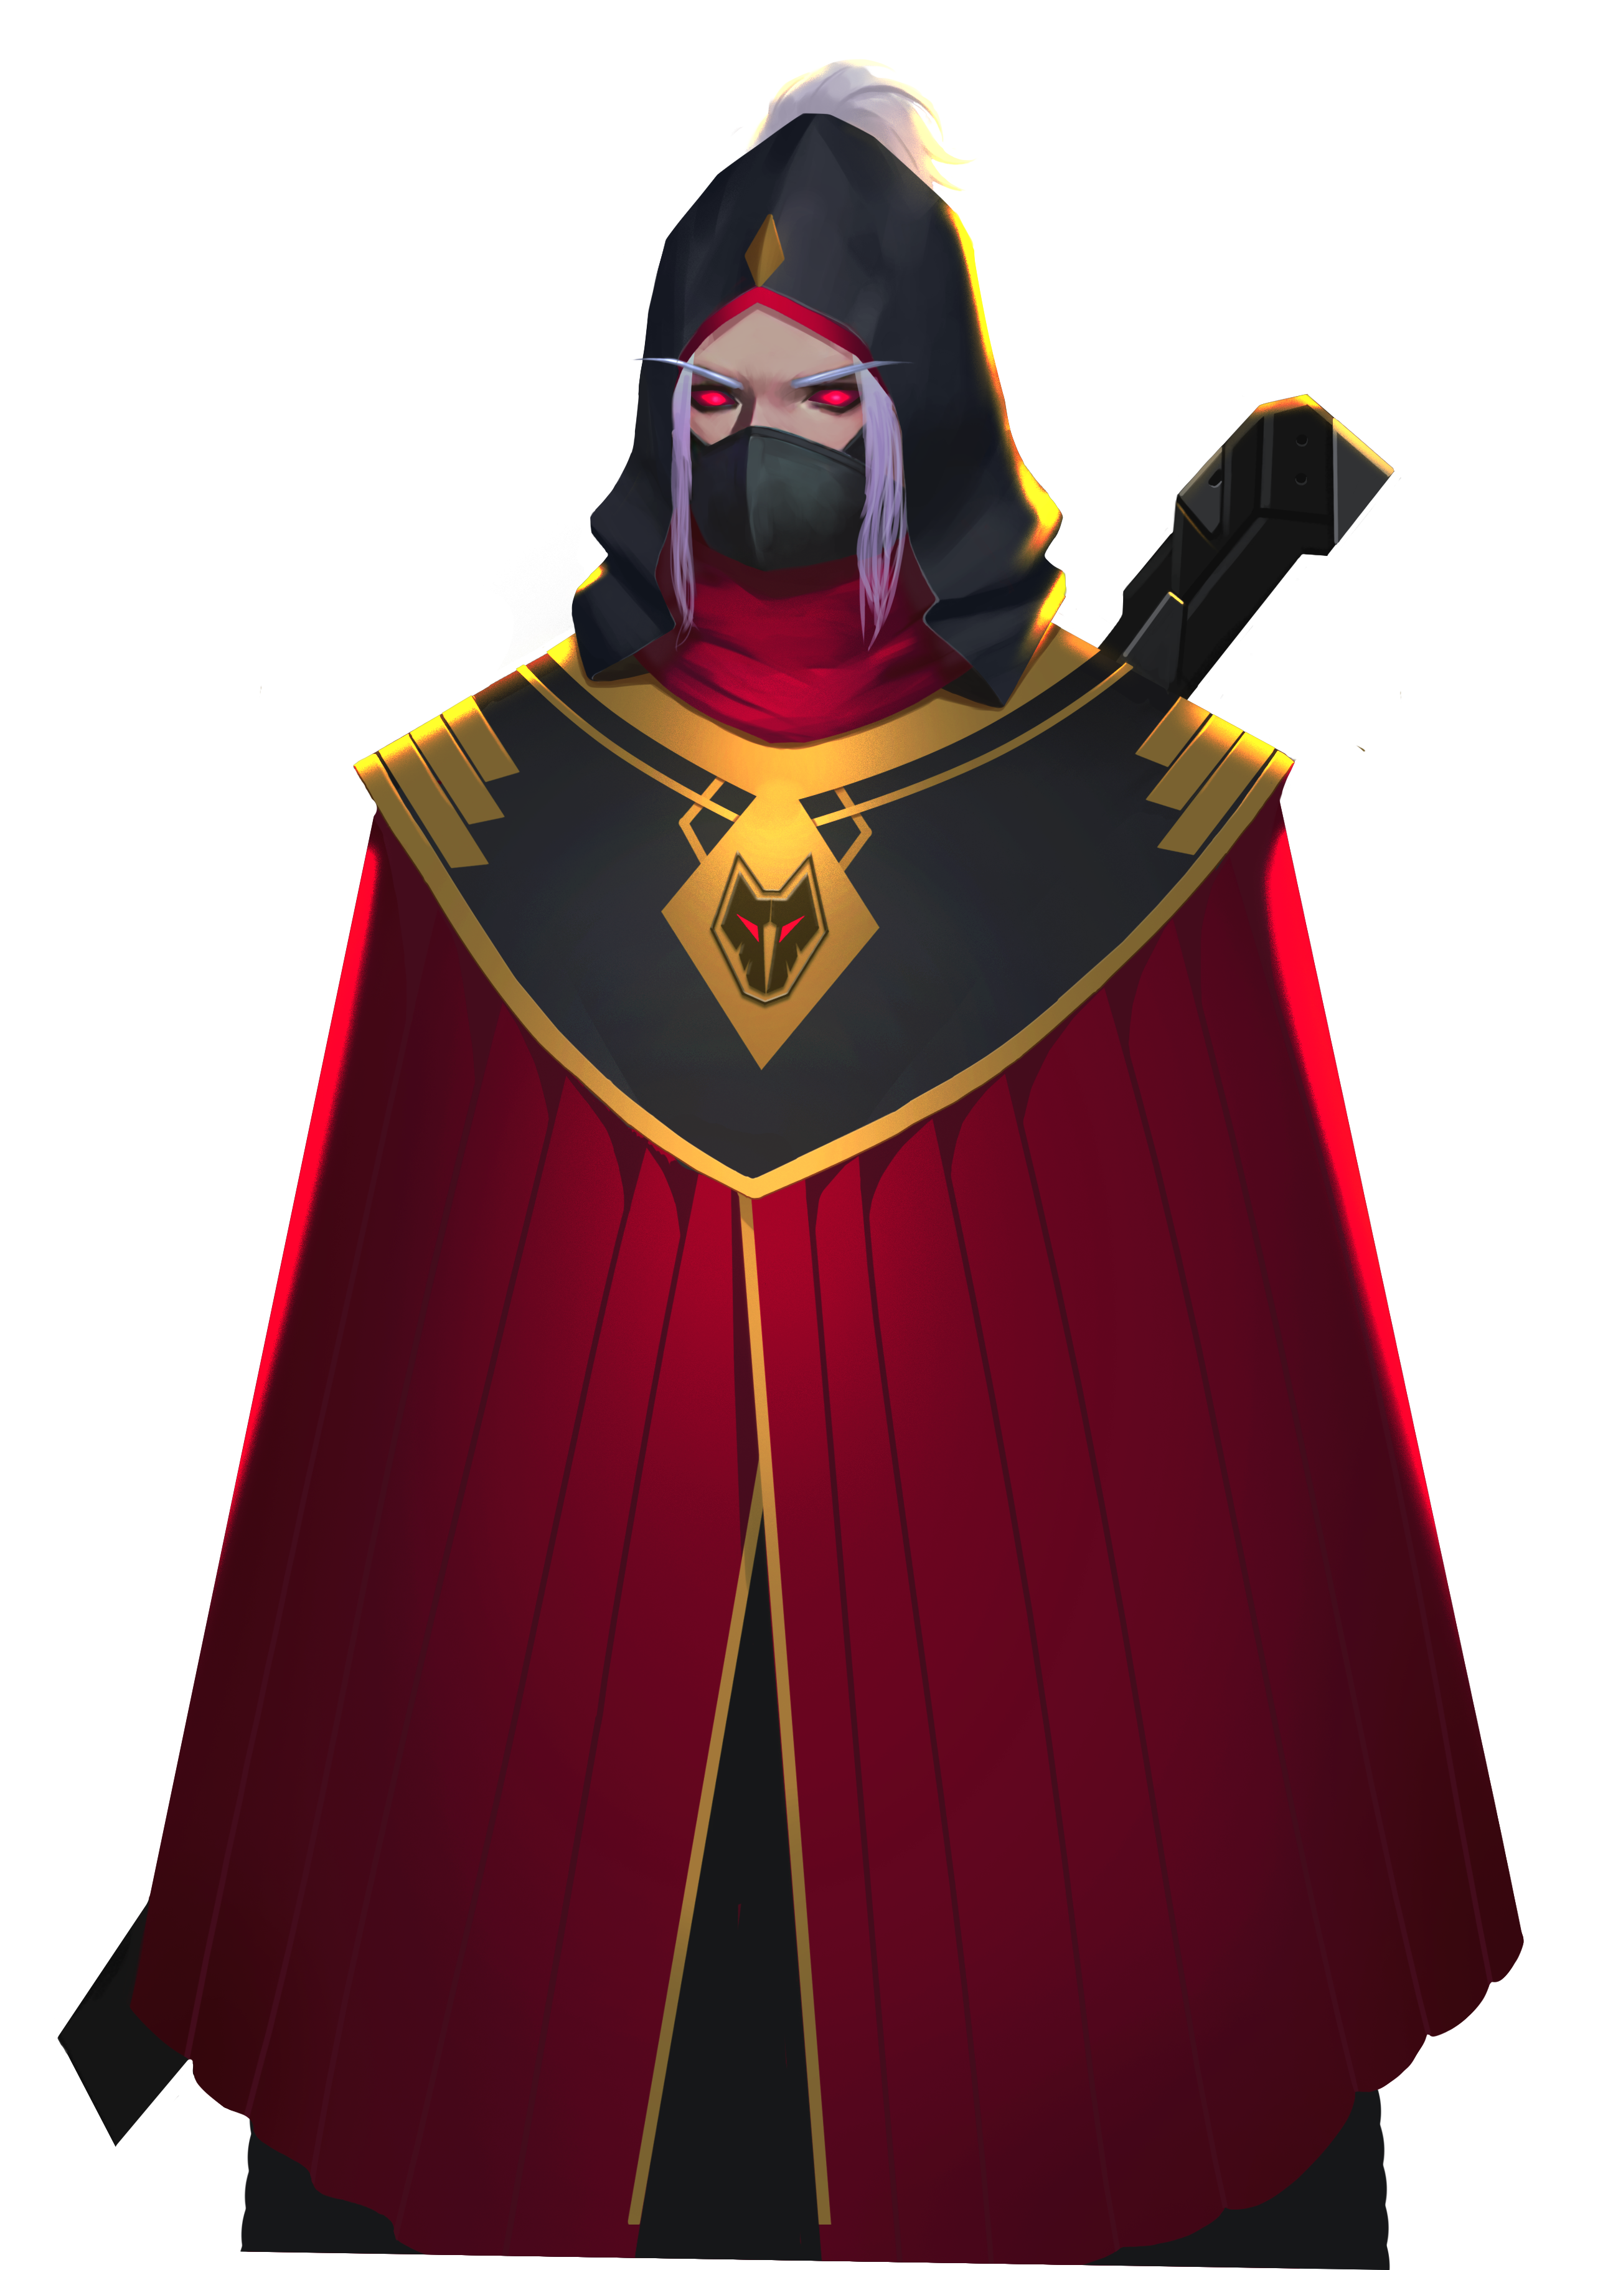
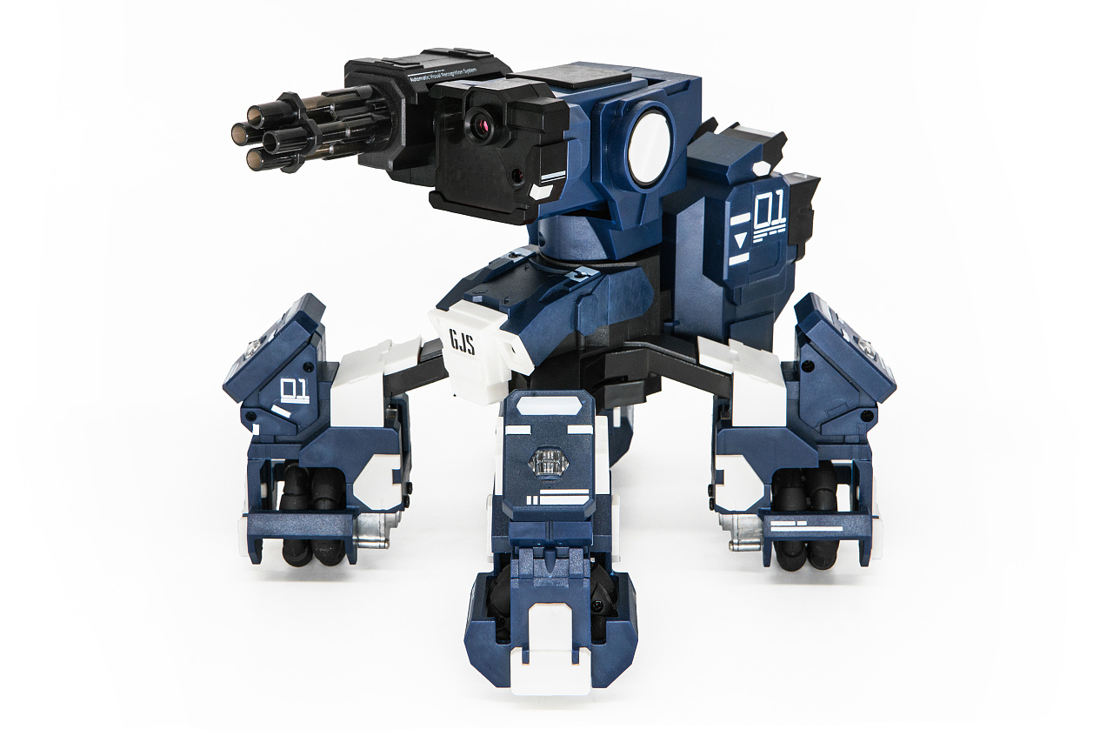
E
D
C
B
A
1
2
3
4
5
6
7
8
We can see from the map that there are 10 covered logos in this area, but only one of them is the right one (House). You mission is to check every covered logo by moving to its square and uncover it (pick it up and let GEIO recognise it). The mission ends once you find the right logo.
Beware! Some of the logos are traps! If the logo you find is “Flame”, you will be harmed by the IED under it (GEIO should gives the scanning noise) and fail the mission! So wisely programme, and get the job done!
You can never find my armoury! After all, I cannot find it myself either…

Slide 15
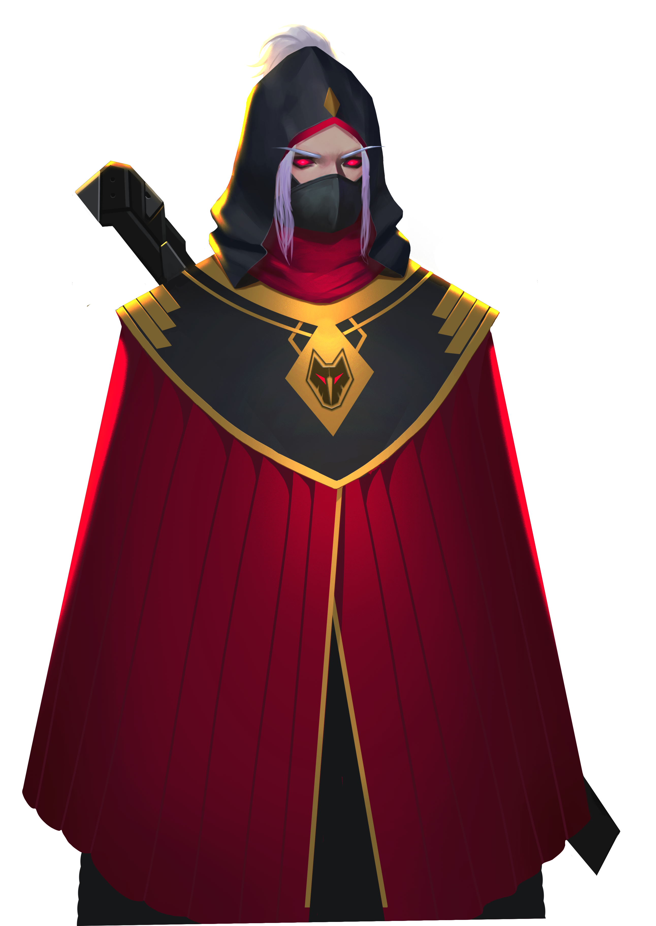
How do we know the result of logo recognition?
How to build a logo recognition system?
What’s the difference between “If” and “If…else”?
What glorious victory we have won here today! The enemy armoury was destroyed!
We are getting very close to the final victory. Come on! Let’s beat them!
I am doomed…I lost my armoury…How can I continue fighting?!
Now it is the time for review. Answer the above questions.

