Slide 1
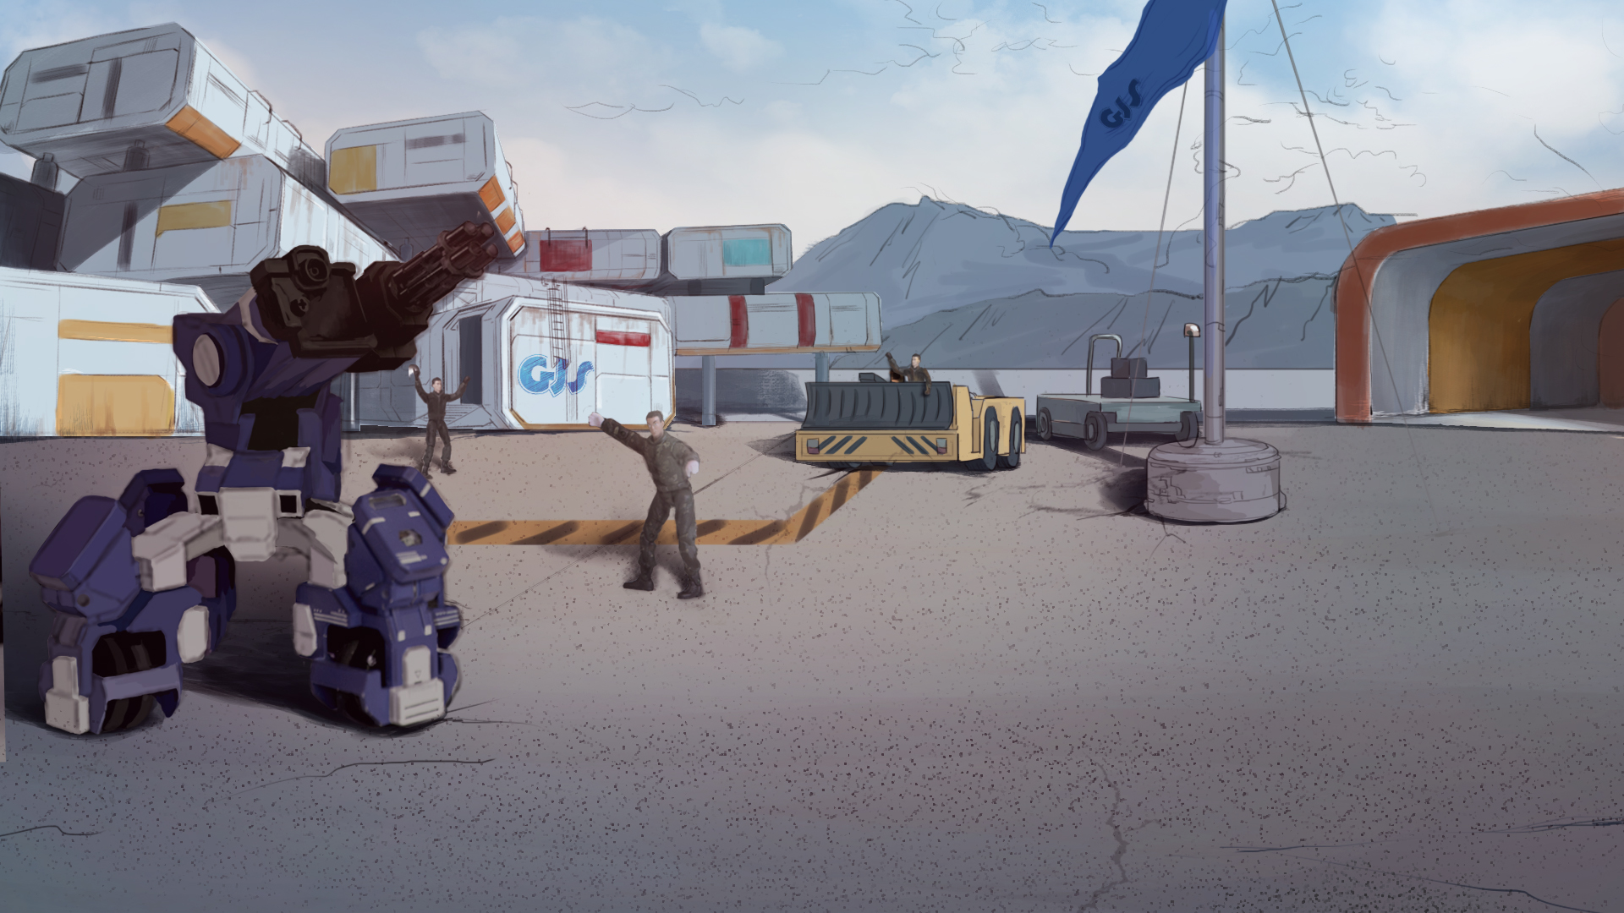
How to Become A GEIO Pilot？
Lesson 14: Take Back the City

Slide 2

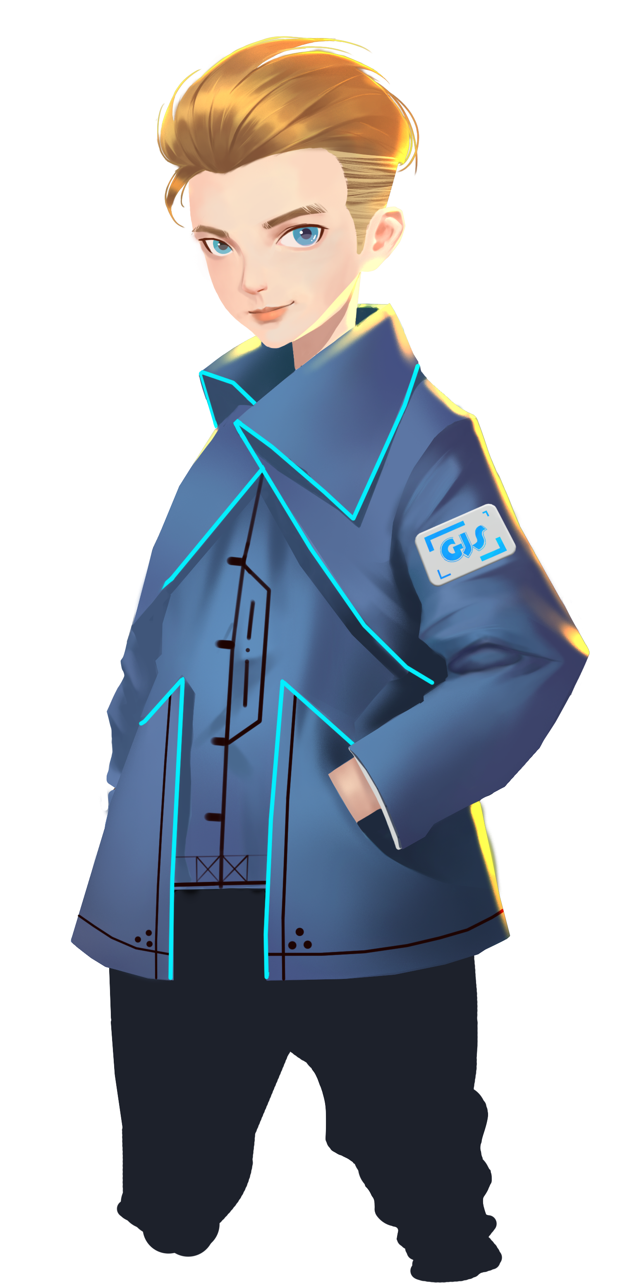

Why do we need the melee ability for GEIO?
How does GEIO commence melee attacks?
What is “Repeat While” code? How do we use it?
Fellows, I have bad news. The great army of Fenrir has just seized one of our cities.
It is our mission to take it back!
Welcome back fellow pilots! I am Sam. Do you still remember what we have learnt last time?

Slide 3
Briefing

Slide 4
Topic
“Take Back the City”
Basic Knowledge
Codes for fighting review
Training
Shooting and melee attack
Challenge
Street battle
In the Briefing section, let’s see what we are going to do today.

Slide 5
Basic Knowledge

Slide 6
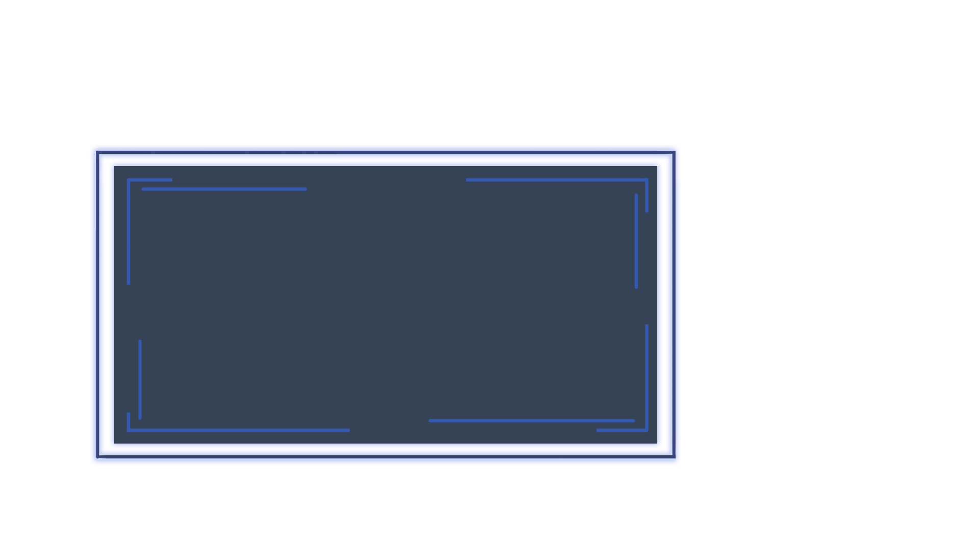
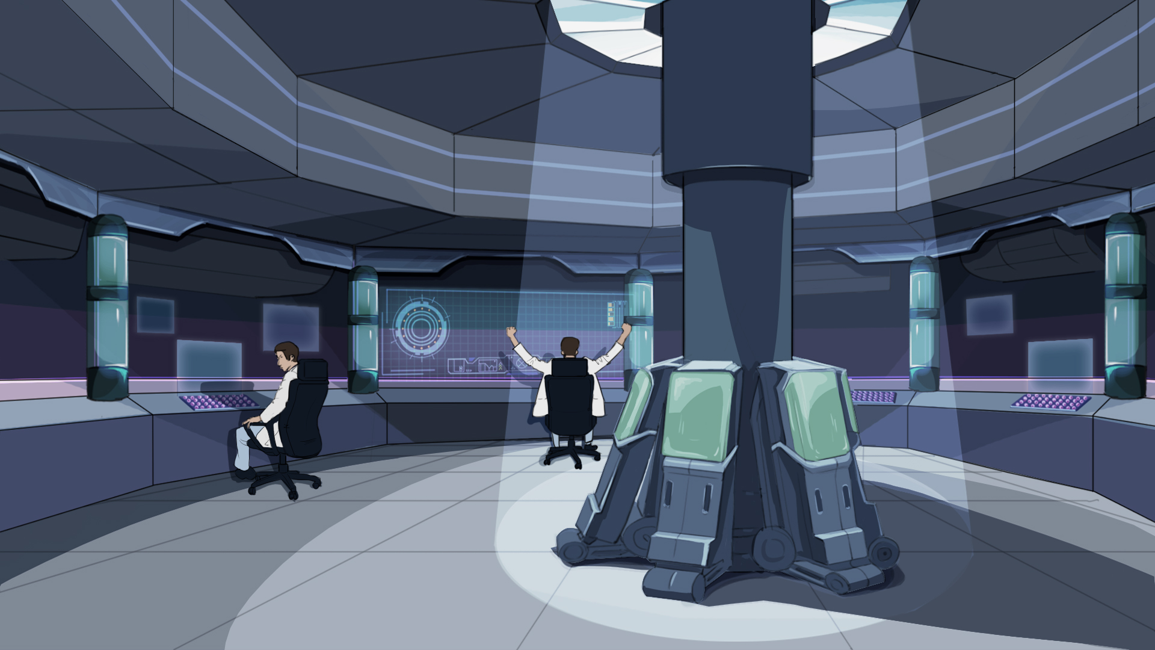
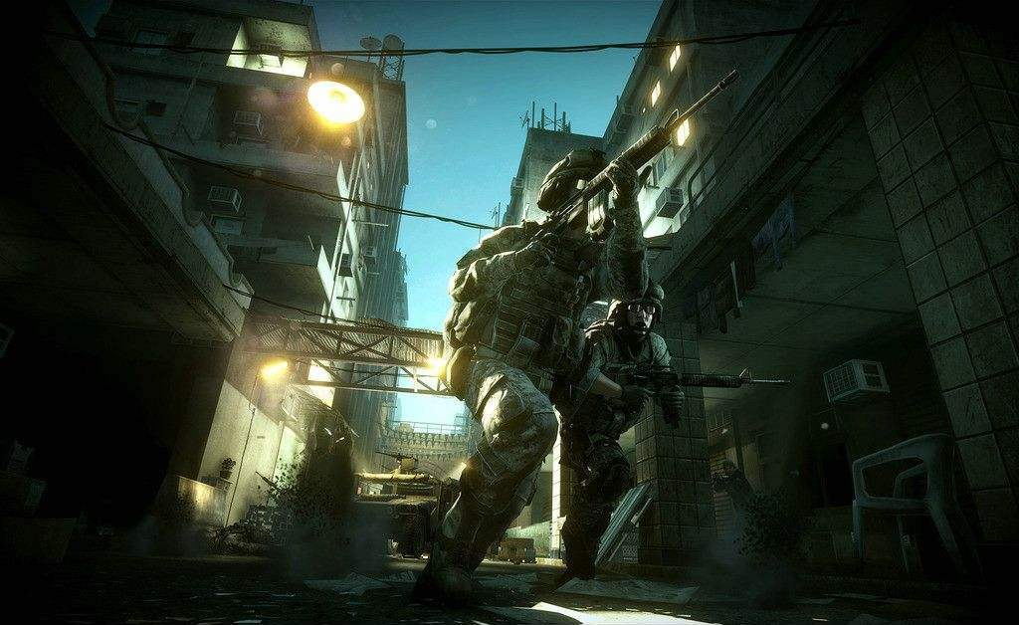
But combat in the city is different from what we did in the past. The buildings and the narrow street have made combat much tougher here. The terrorists may attack you from every window and corner without showing themselves.
Here we are. The occupied city is in front. This time, we will
eliminate those Fenrir soldiers in the city and recover it.
Before we enter the battle field, let’s have a review of GEIO’s fighting skills.

Slide 7
Training

Slide 8
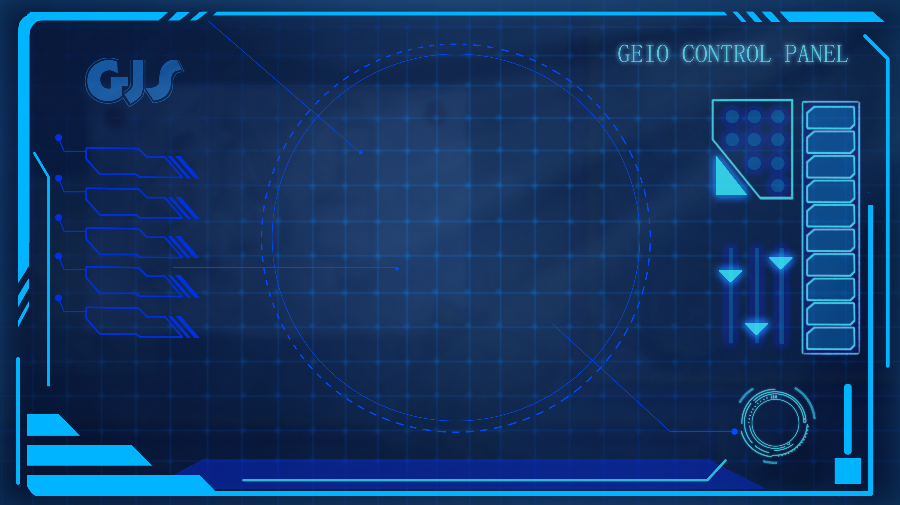
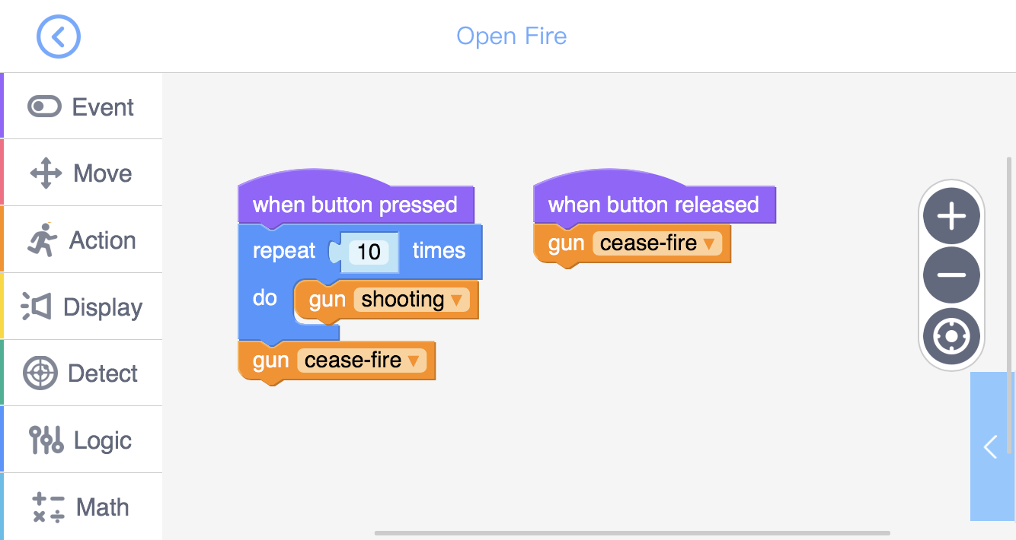
Training task 1: Use “Button” to create a shooting programme,
in which ammunition limitation is applied (repeat 10 times).

Slide 9
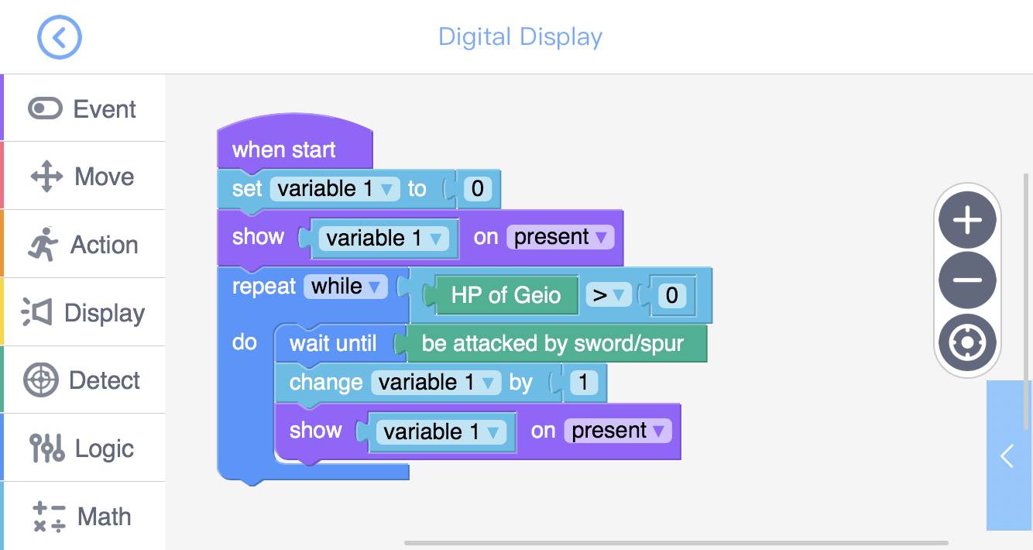
Training task 2: Use “Digital Display” to create a melee damage display system. When the HP of GEIO is greater than 0, the system would keep counting the times of being attacked in melee. When HP=0, stop counting.

Slide 10
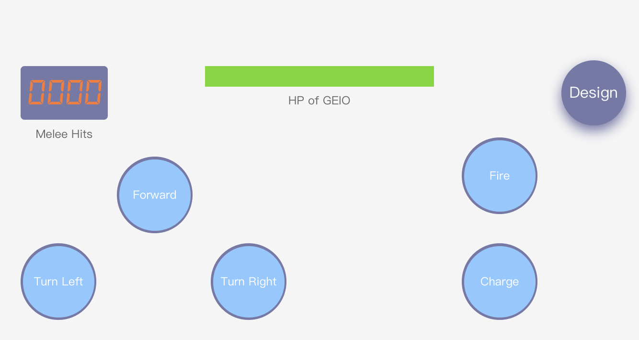
Training task 3: 1. Use “Bar” to display HP; 2. Use “Button” to programme motion control: “Forward” — GEIO moves 30cm forward, “Turn Left/Right” — GEIO turns 90°; 3. Use “Button” to programme melee attack “Charge”: move forward 60cm at the highest speed.

Slide 11
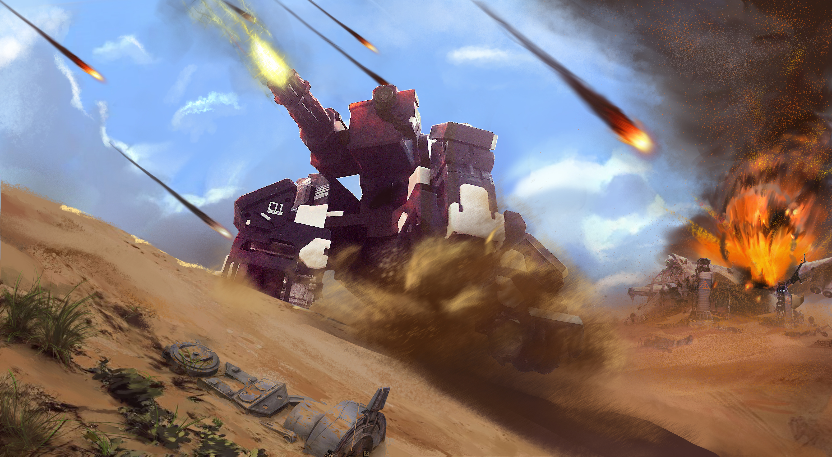
Challenge

Slide 12
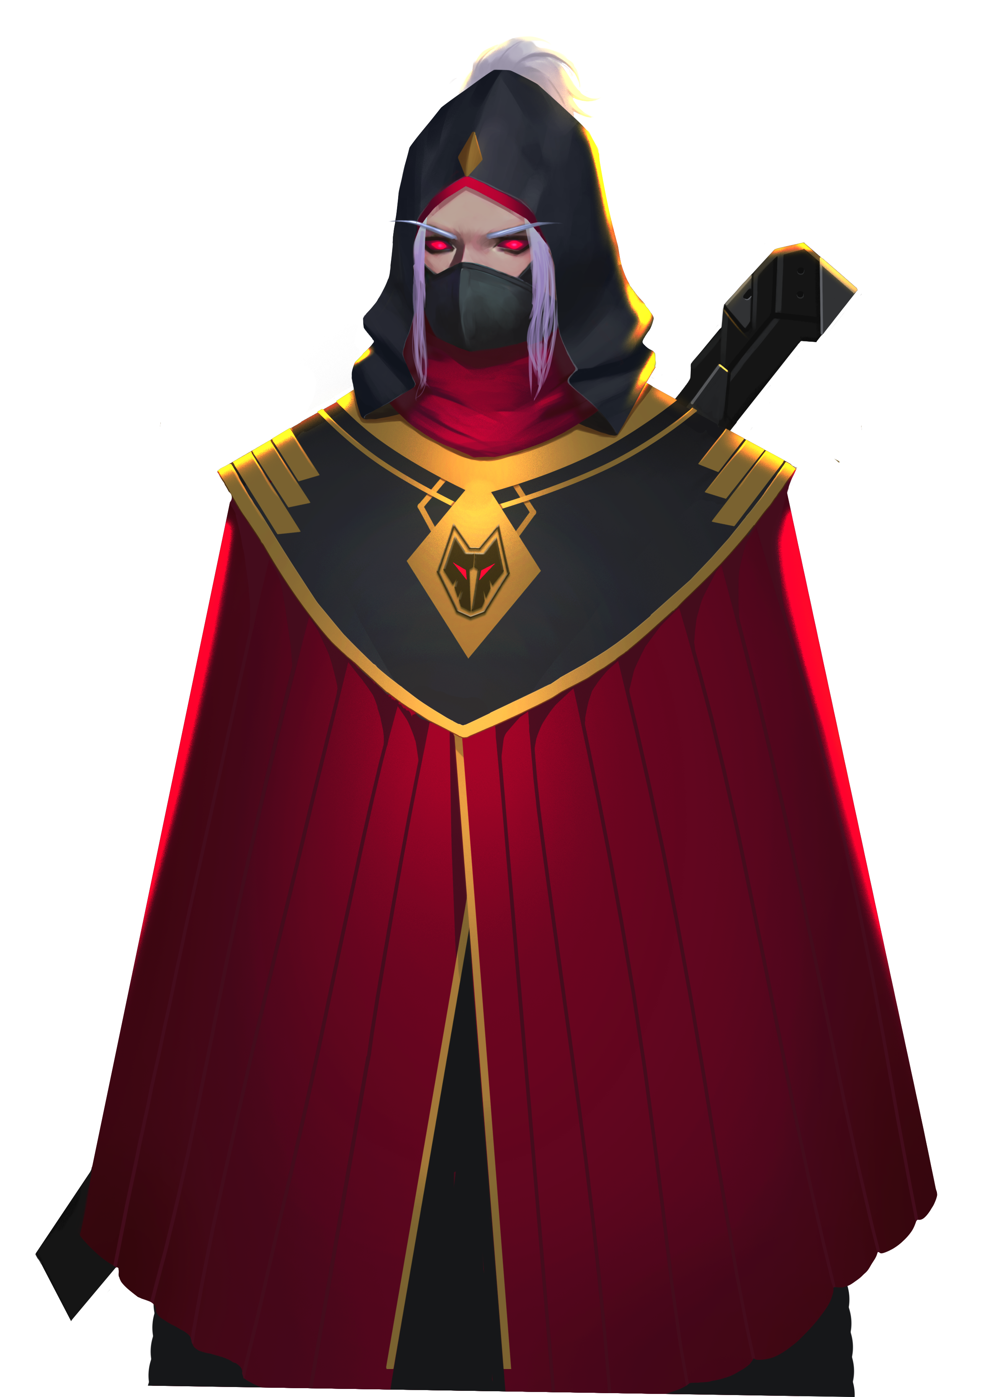
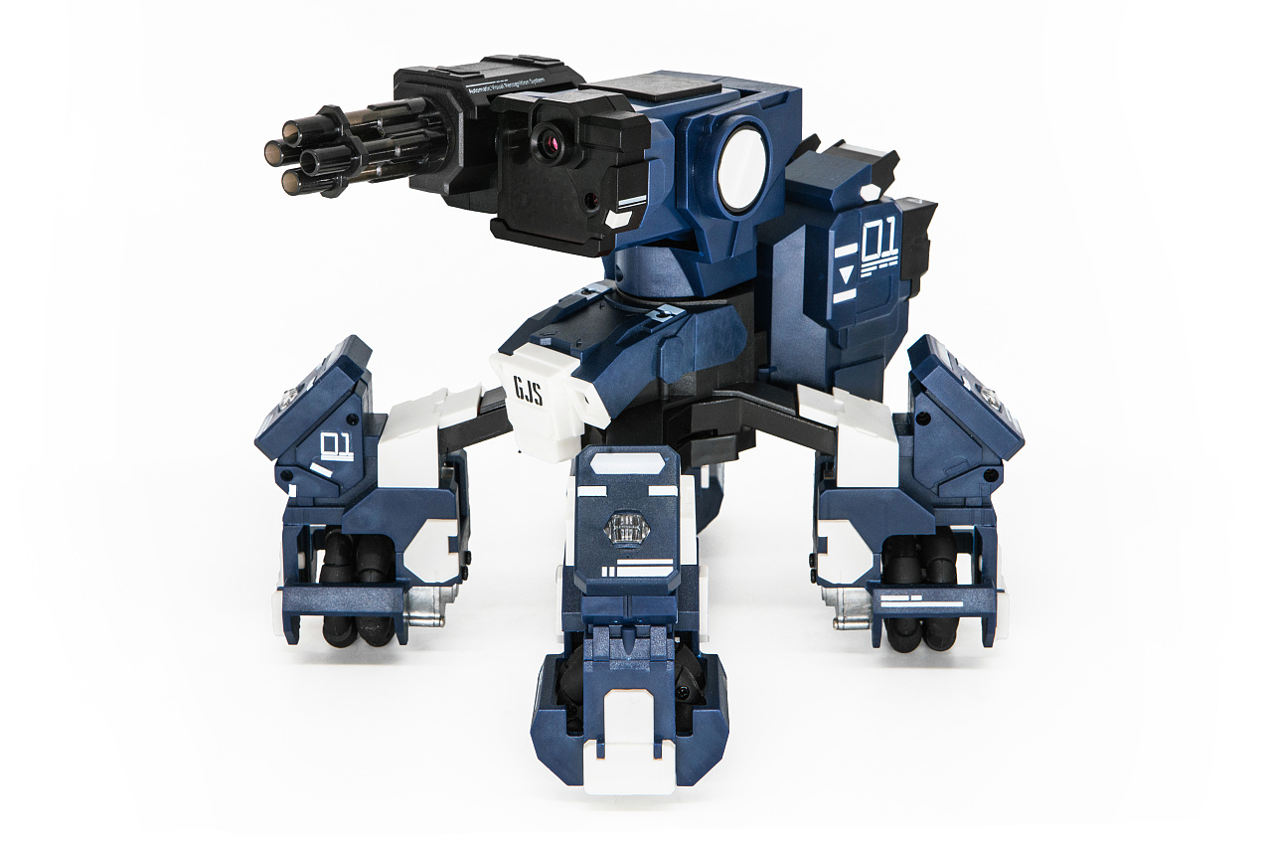
E
D
C
B
A
1
2
3
4
5
6
7
8
Enter the 2v2 turn-based combat. Each player is allowed to perform Forward, Turn and attack (shoot or melee) once per turn, or give this chance to your team mate. You win the combat by eliminating all members of your opponent team.
The objective of this battle is to eliminate the Fenrir soldiers in the city. We can see from the map that the city is full of buildings, and the streets there is narrow. So stay alerted.
Fool GJS soldiers. You have no chance to take this city!

Slide 13
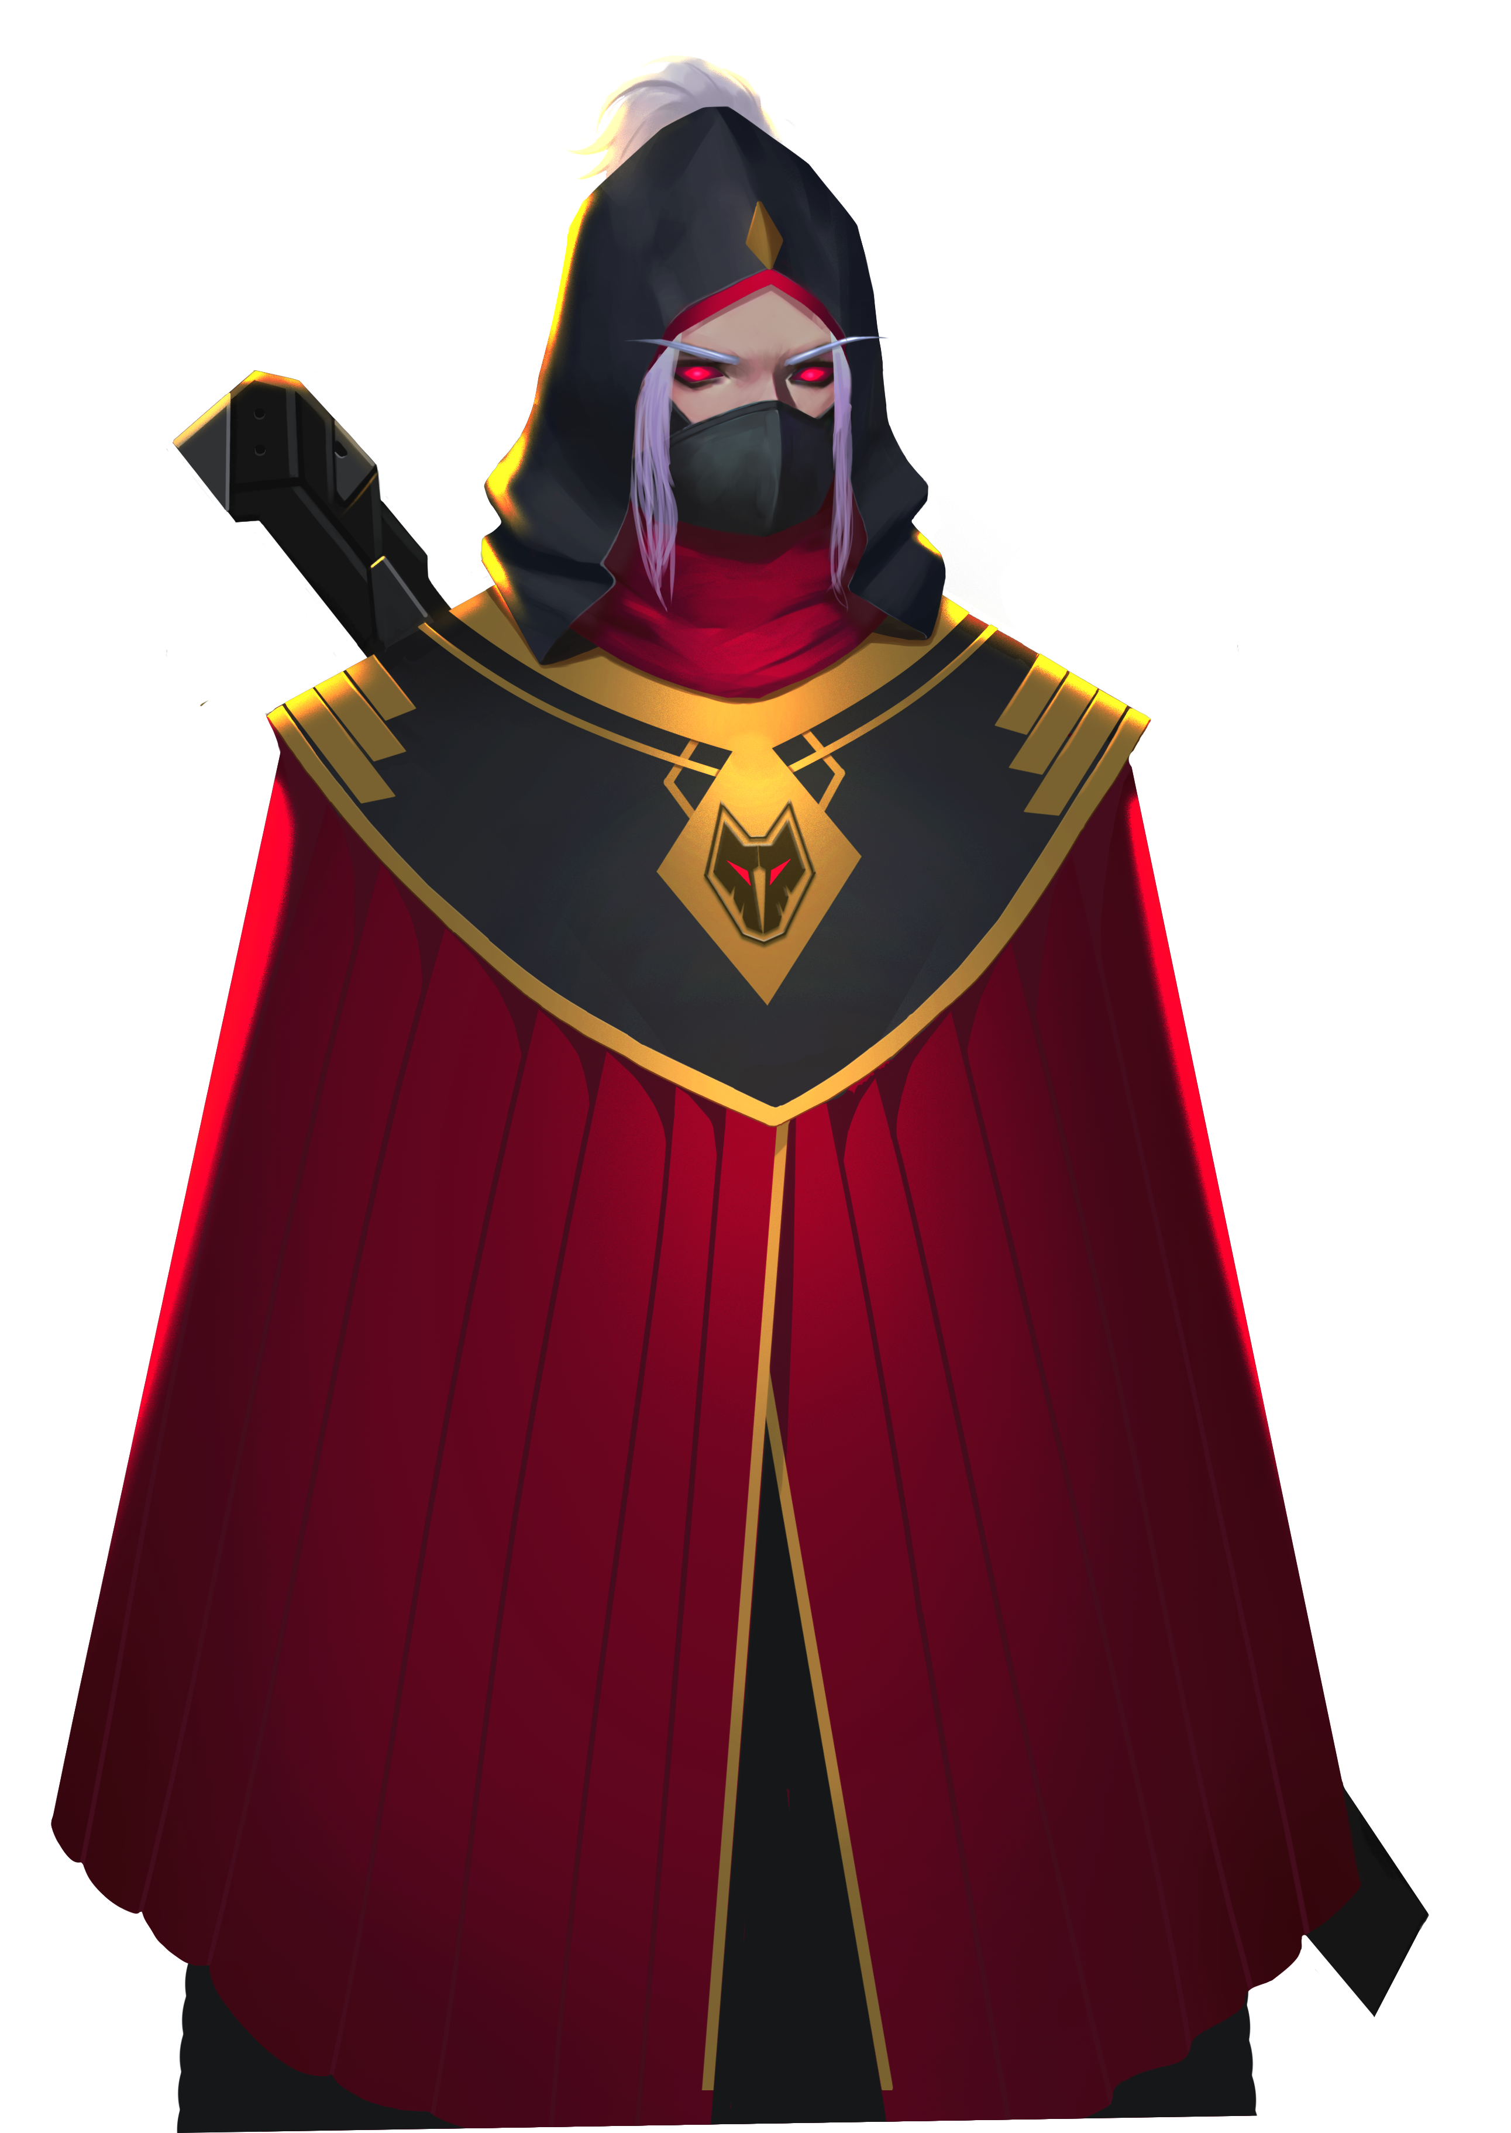
How to limit GEIO’s ammunition?
How to commence melee attacks?
How to accurately control GEIO’s motion?
The war is not over. Hurry up, my fellow pilots! We shall chase them down!
I cannot believe it. You win again?! This is not the end. I will be back!
Now it is the time for review. Answer the above questions.
Huzzah! We successfully recovered the city!

