Slide 1
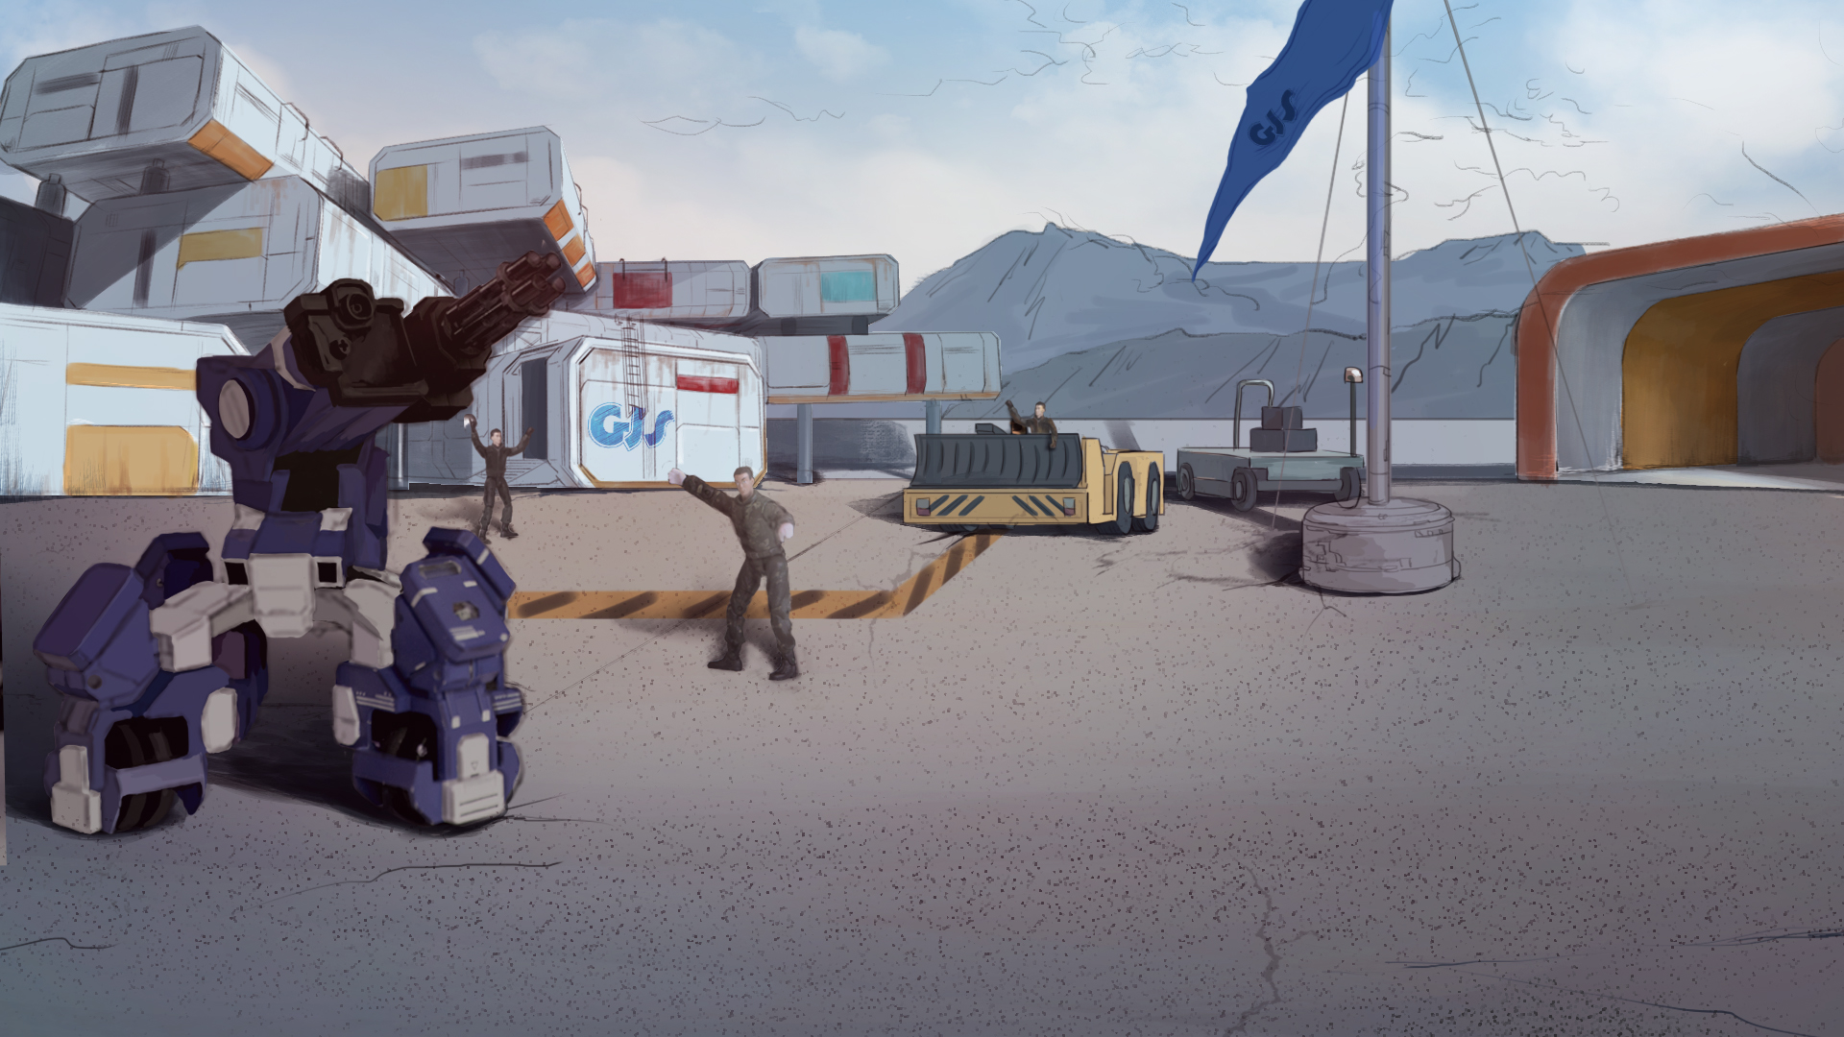
How to Become A GEIO Pilot？
Lesson 13: Melee Attack

Slide 2

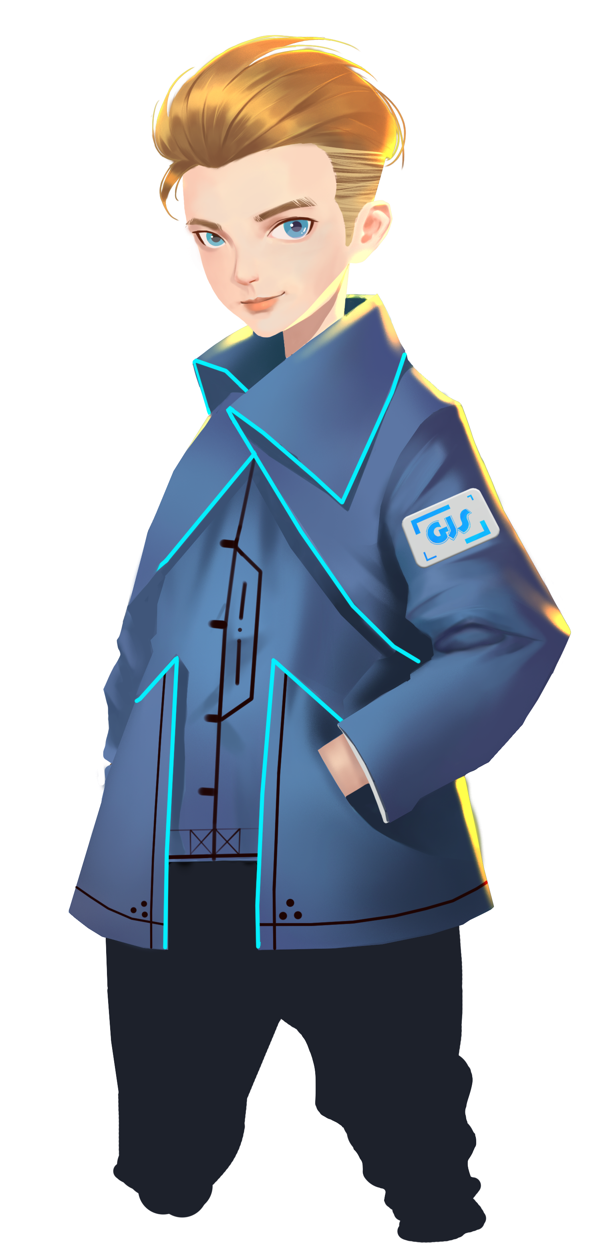
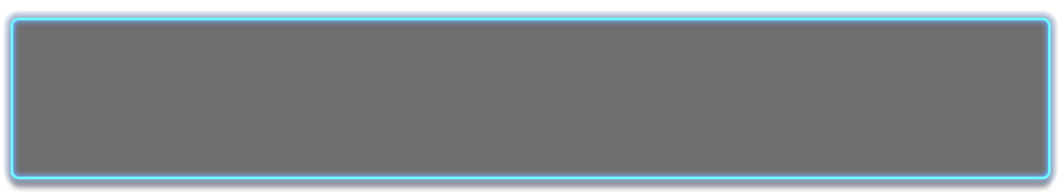
What is turn-based strategy games?
What are the common turn-based strategy games?
Why do we use turn-based strategy?
Last time, we successfully defended our mines and protected our ore resources.
Now we are ready to ready to strike our enemy. Pilots, let’s go!
Welcome back fellow pilots! I am Sam. Do you still remember what we have learnt last time?

Slide 3
Briefing

Slide 4
Topic
“Melee Attack”
Basic Knowledge
Melee attack and defence
Training
Charging and crashing
Challenge
Who’s the bravest soldier
In the Briefing section, let’s see what we are going to do today.

Slide 5
Basic Knowledge

Slide 6
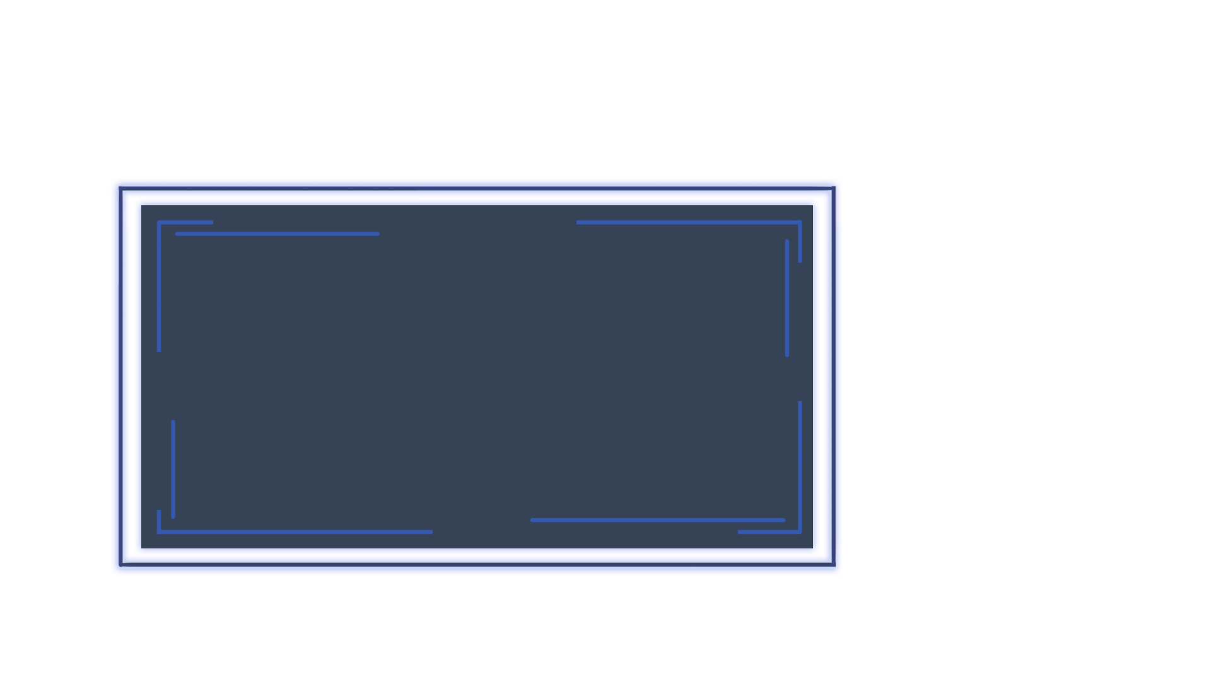
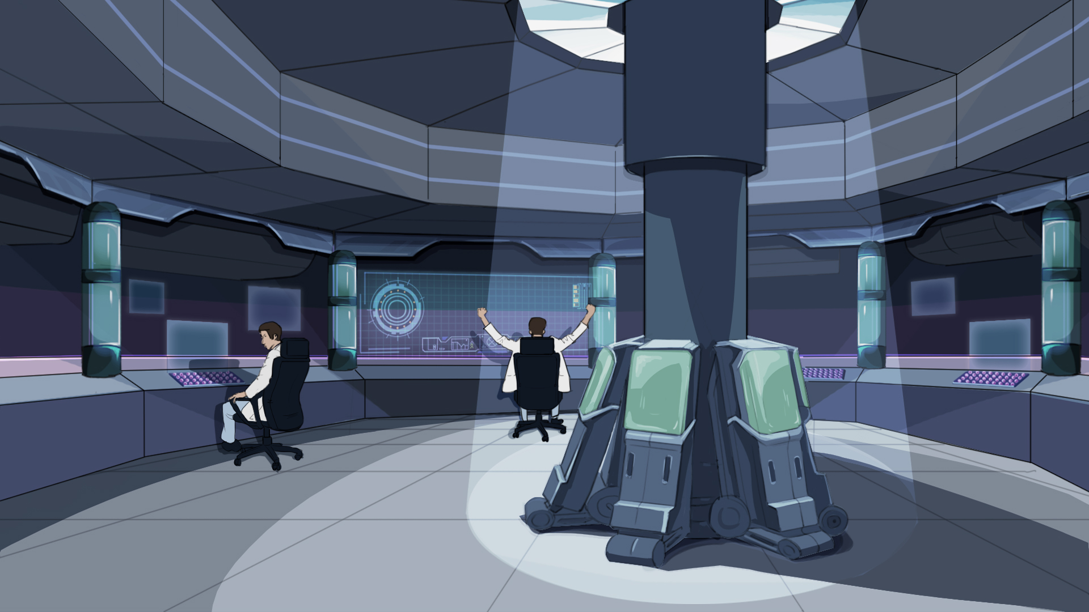
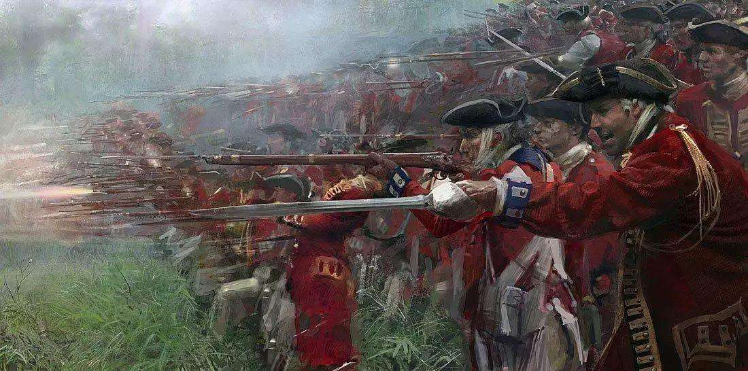
When the ammunition is out, or a close contact occurs, an experienced soldier would use the bayonet to attack the enemy. We call this the melee attack. GEIO also possesses such ability.
We know that during the practical battle, our ammunition is limited.
What if our ammunition is used up?
How can GEIO commence a melee attack?

Slide 7
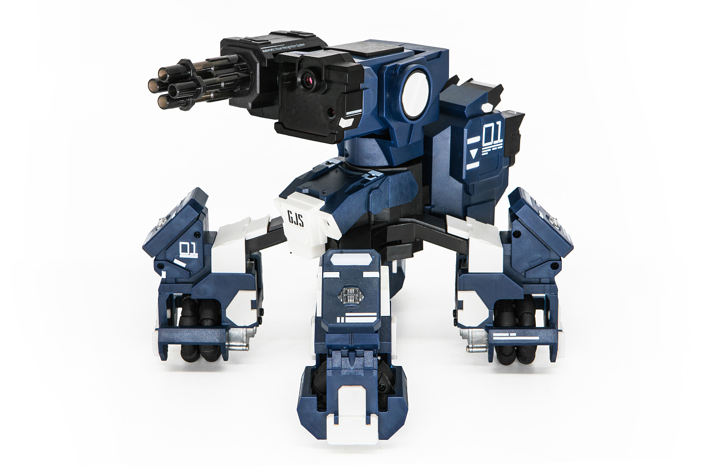
The infrared receivers on GEIO’s legs are used to detect attacks from the opponent’s gun fire. Meanwhile they can also detect attacks from crashing, but only the two in the front.
Which means that only by crashing in the front could we do damage to the enemy.
Now let’s do some practice to see what the melee attack really is.

Slide 8
Training

Slide 9
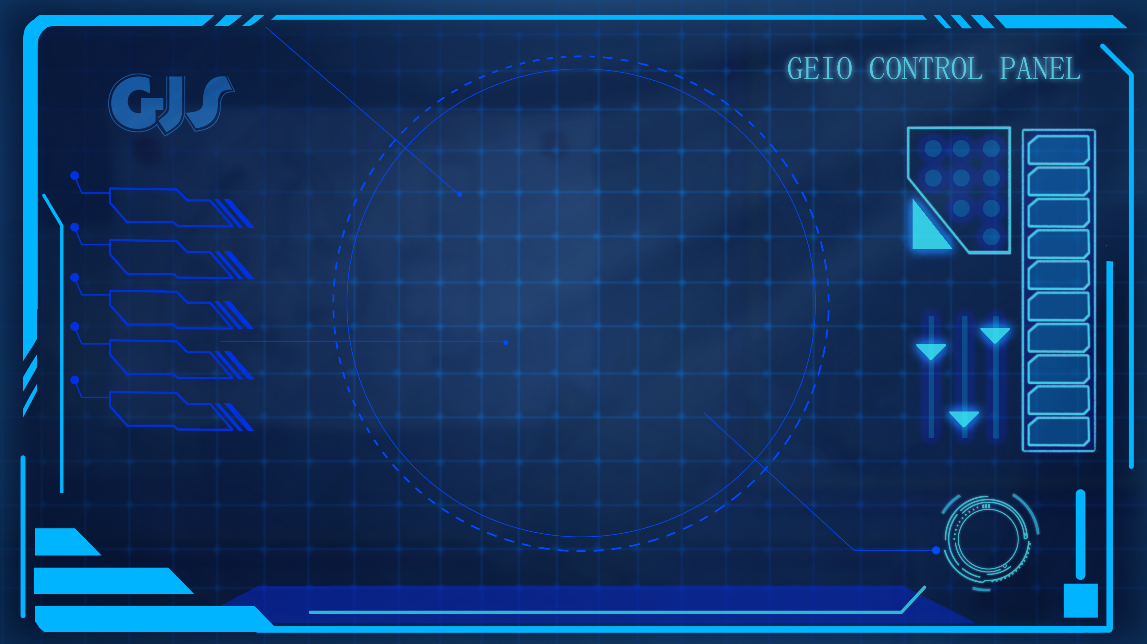
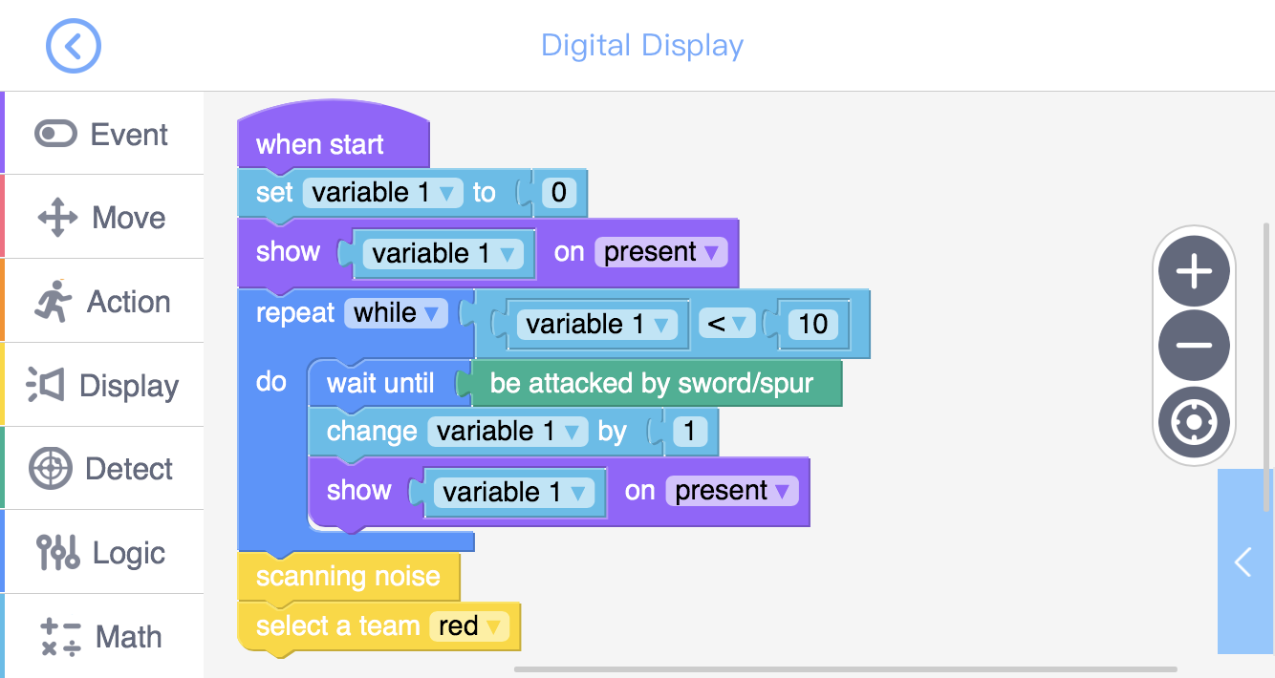
Training task 1: Use “Digital Display” to build a scoring system. When GEIO is attacked once in the melee, the displayed score would increase by 1. When the score reaches 10, GEIO would give the scanning noise and flash the red lights.
We set the condition as “variable 1 less than 10”, so the scoring system would continue working before the score (variable 1) reaches 10. Question: Why the condition is “variable 1 less than 10”?
Let’s take a look at the above programme. Here we used a new code which is called “Repeat While”. This code can repeatedly execute the codes contained while the pre-set condition is fulfilled.

Slide 10
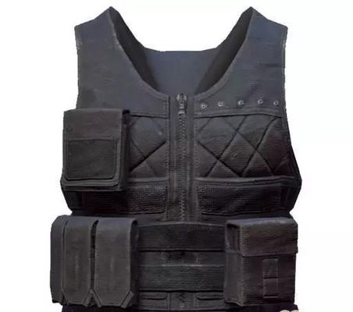
Training task 2: Commence melee attacks on your team mates’ GEIO. Attack front the front, the back, the left side and the right side to see the outcome of the attacks.
The melee attacks happen when one GEIO crash one another in the front.
What if we cover the front two infrared receivers?
Training task 3: Make a stab vest for GEIO using cardboard, so that GEIO is able to defend melee attacks.

Slide 11
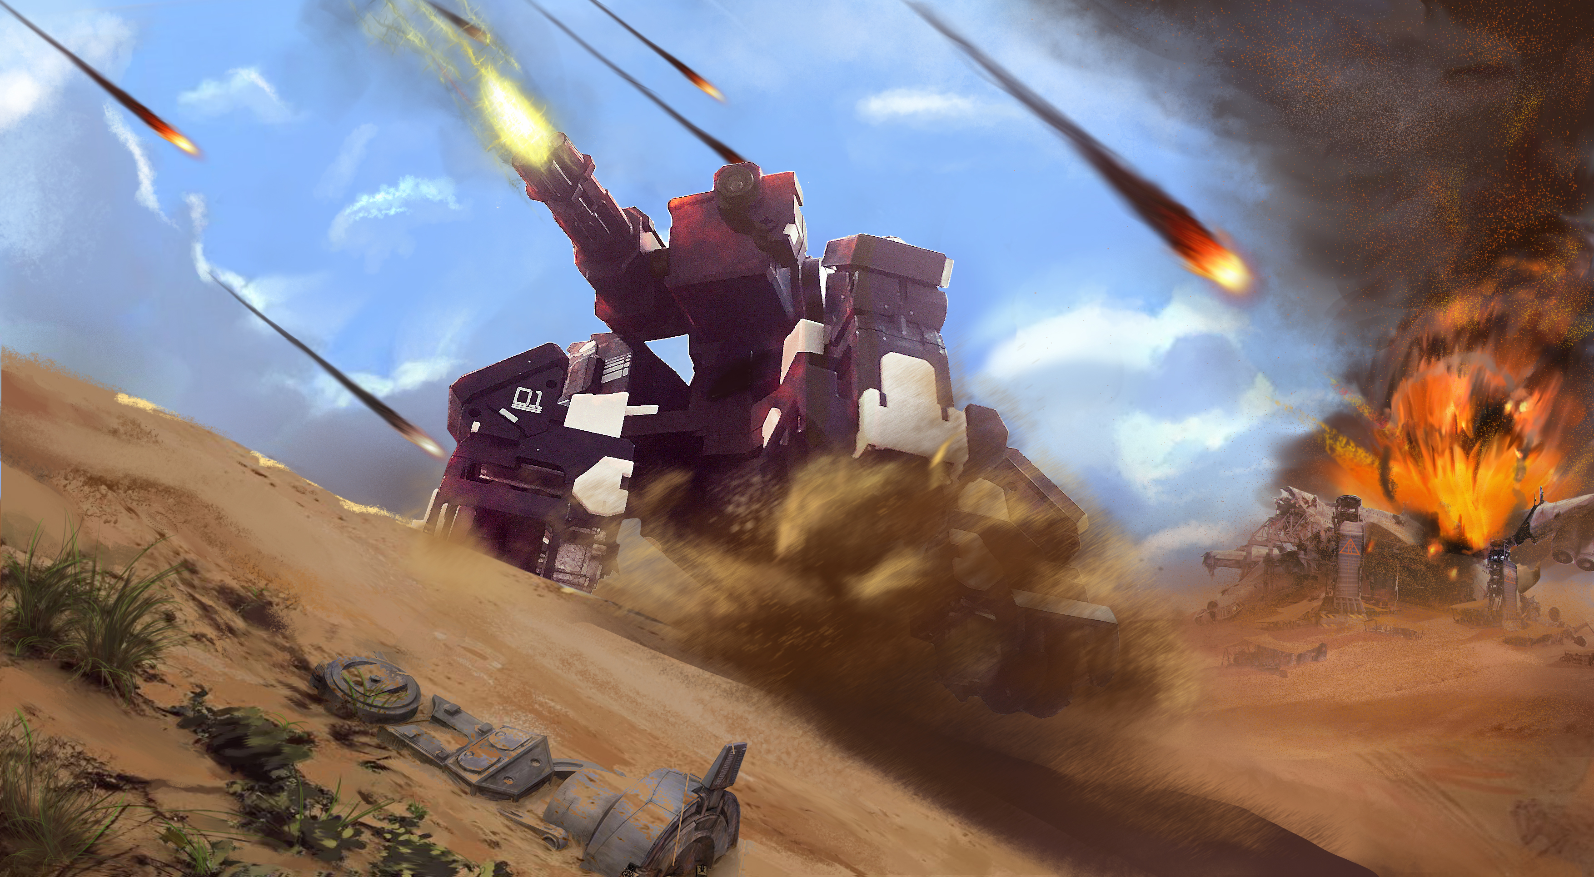
Challenge

Slide 12
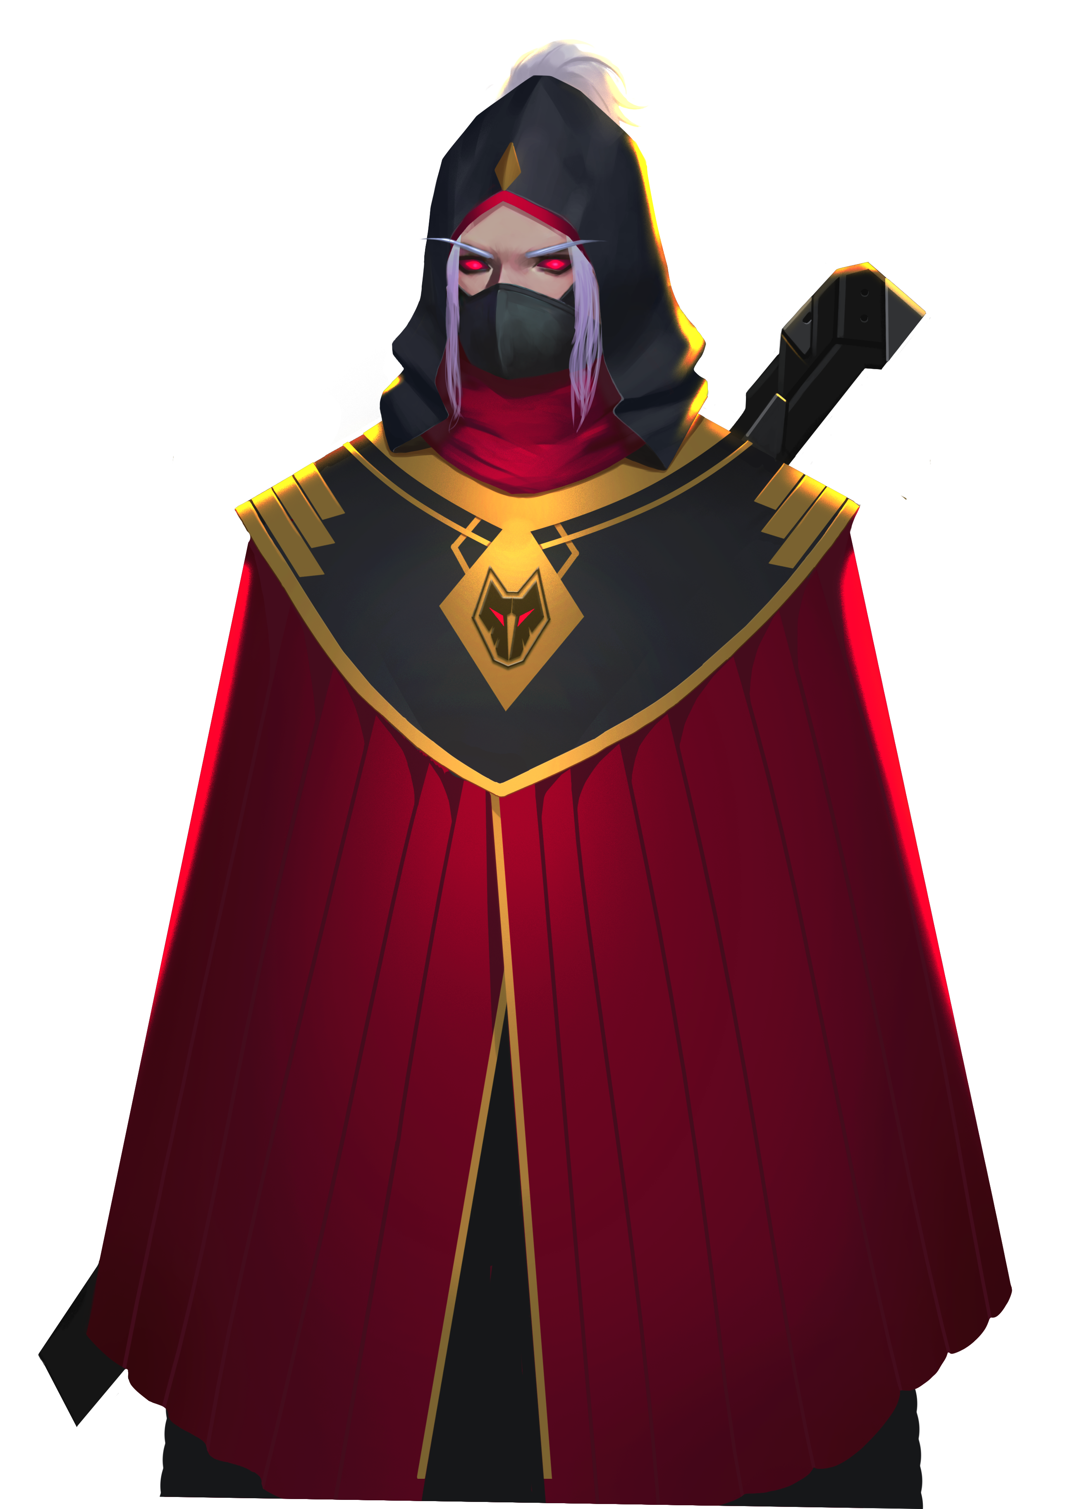
E
D
C
B
A
1
2
3
4
5
6
7
8
Except for the stab vest, is there any other way to defend the melee attacks? There is a simple way to defend. When the enemy is charging towards you, you can simply turn GEIO round. If the enemy fails to crash you in the front, the melee attack fails.
Every two of you should form a team, and defeat your opponent team only by
melee attacks. Use the scoring system to count the times of being attacked.
Now it is the time to attack. Crash the enemies and win this battle!
You fool! You will no win this time!

Slide 13
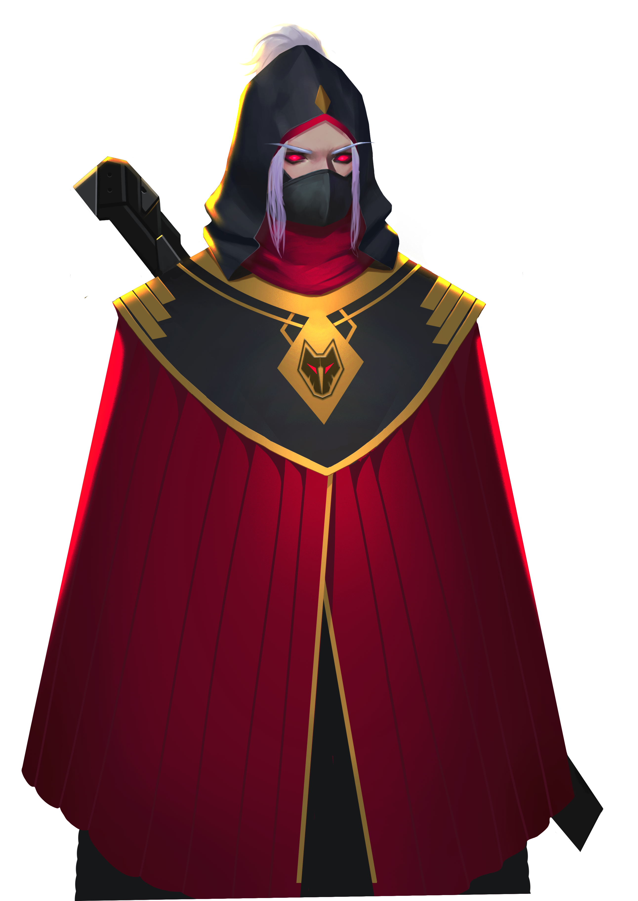
Why do we need the melee ability for GEIO?
How does GEIO commence melee attacks?
What is “Repeat While” code? How do we use it?
Next time we shall enter the enemy zone, and more fights are ahead. Be prepared, pilots!
We have triumphed! This is a milestone on our way to the final victory!
Now it is the time for review. Answer the above questions.
Oh no! My scout team is destroyed! I will revenge!

