Slide 1
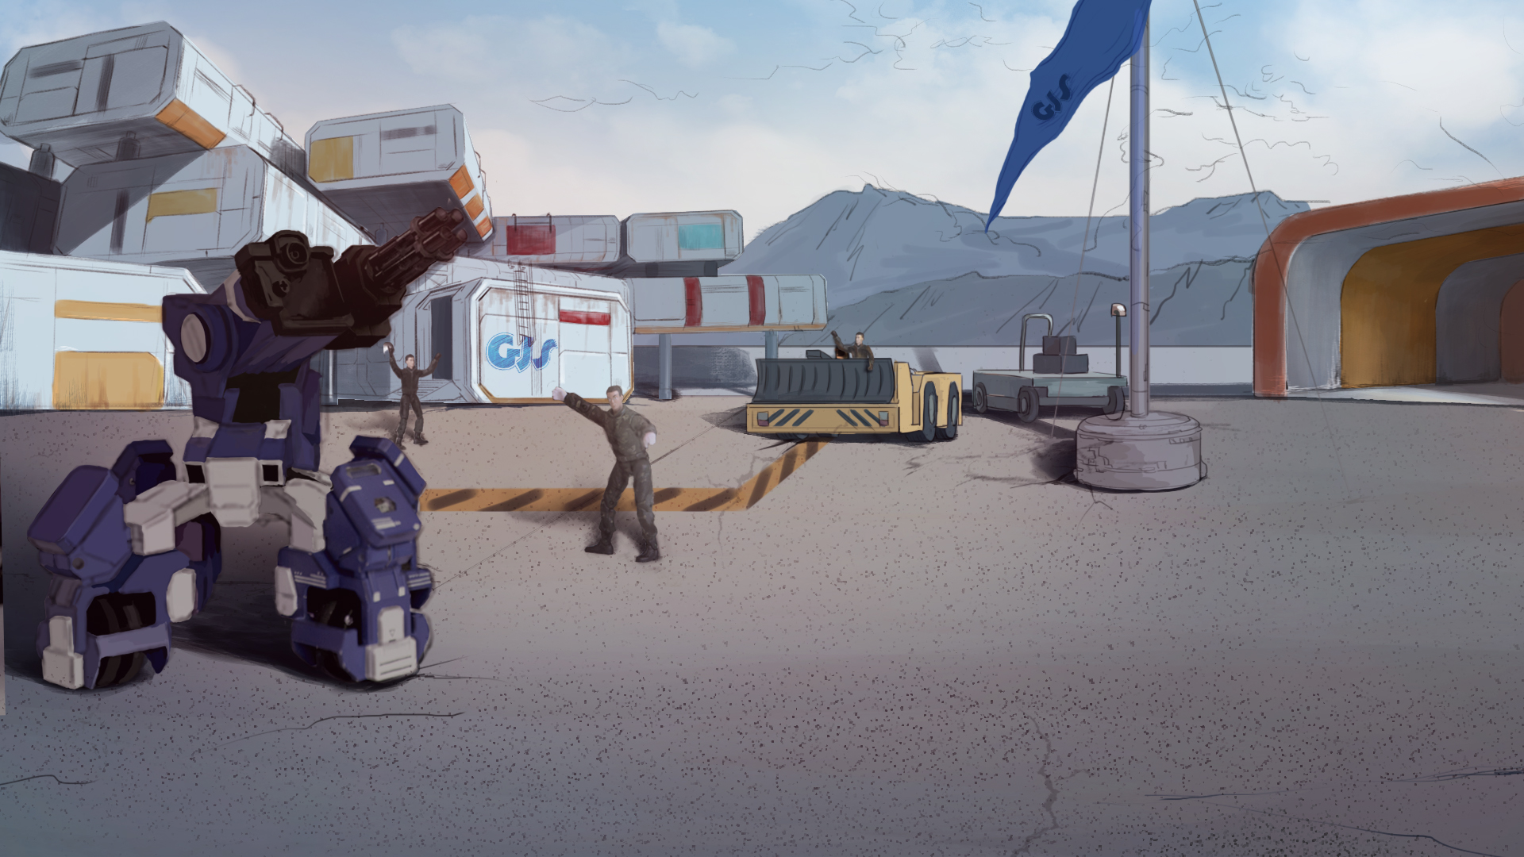

How to Become A GEIO Pilot？
Lesson 12: Protect the Mine

Slide 2

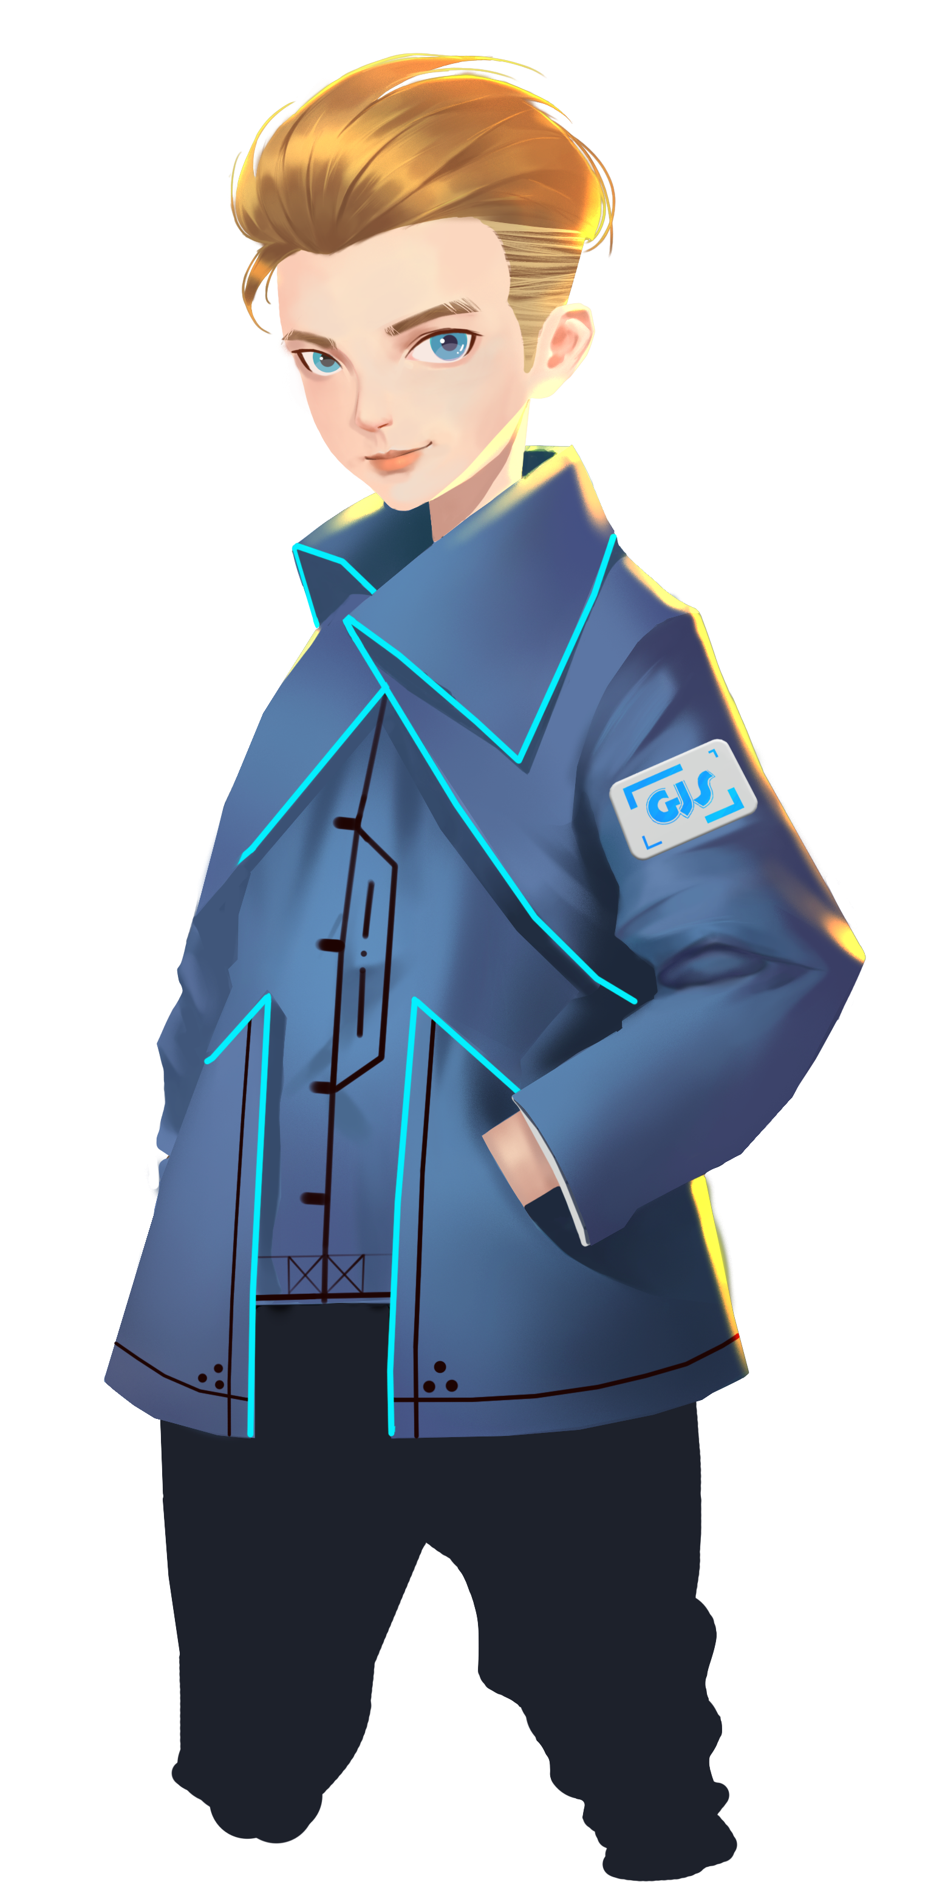
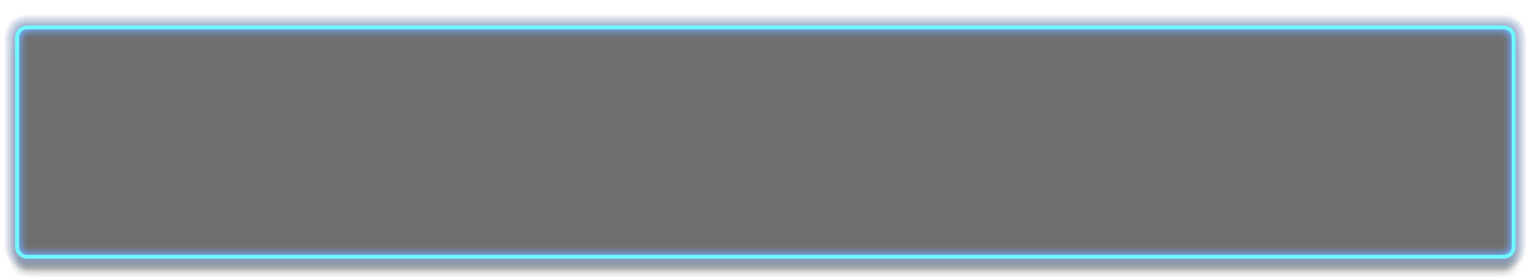
How many logos can be recognised by GEIO?
How does GEIO recognise a logo?
What else can we do with the logos?
Last time we successfully restored our highway. But the terrorists will not stop. Our latest
intelligence shows that they are about to commence new attacks. So be prepared, pilots!
Welcome back fellow pilots! I am Sam. Do you still remember what we have learnt last time?

Slide 3
Briefing

Slide 4

Topic
“Protect the Mine”
Basic Knowledge
Turn-based strategy
Training
Turn-based moving
Challenge
Collect ores
In the Briefing section, let’s see what we are going to do today.

Slide 5
Basic Knowledge

Slide 6
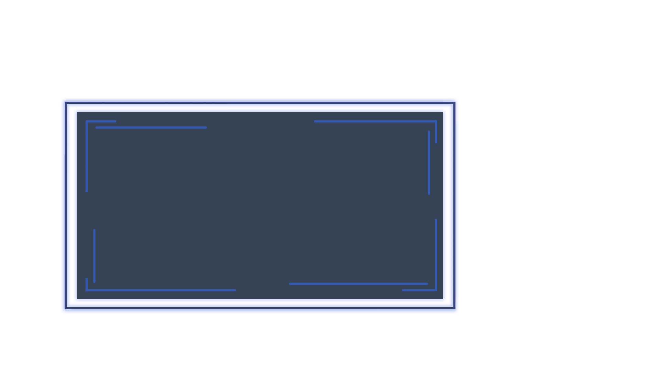
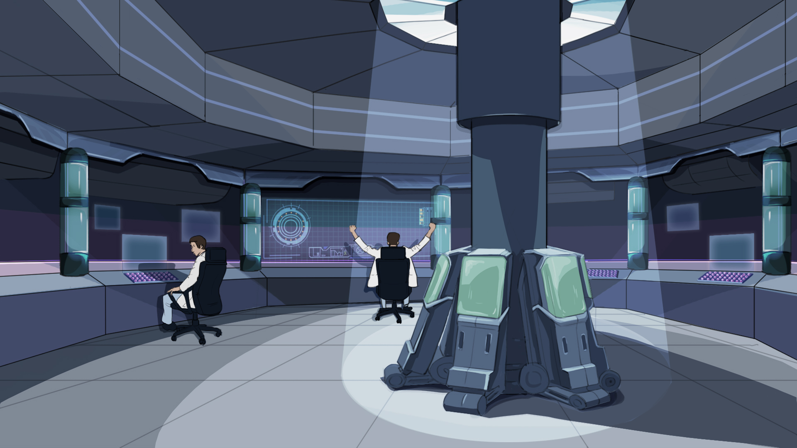
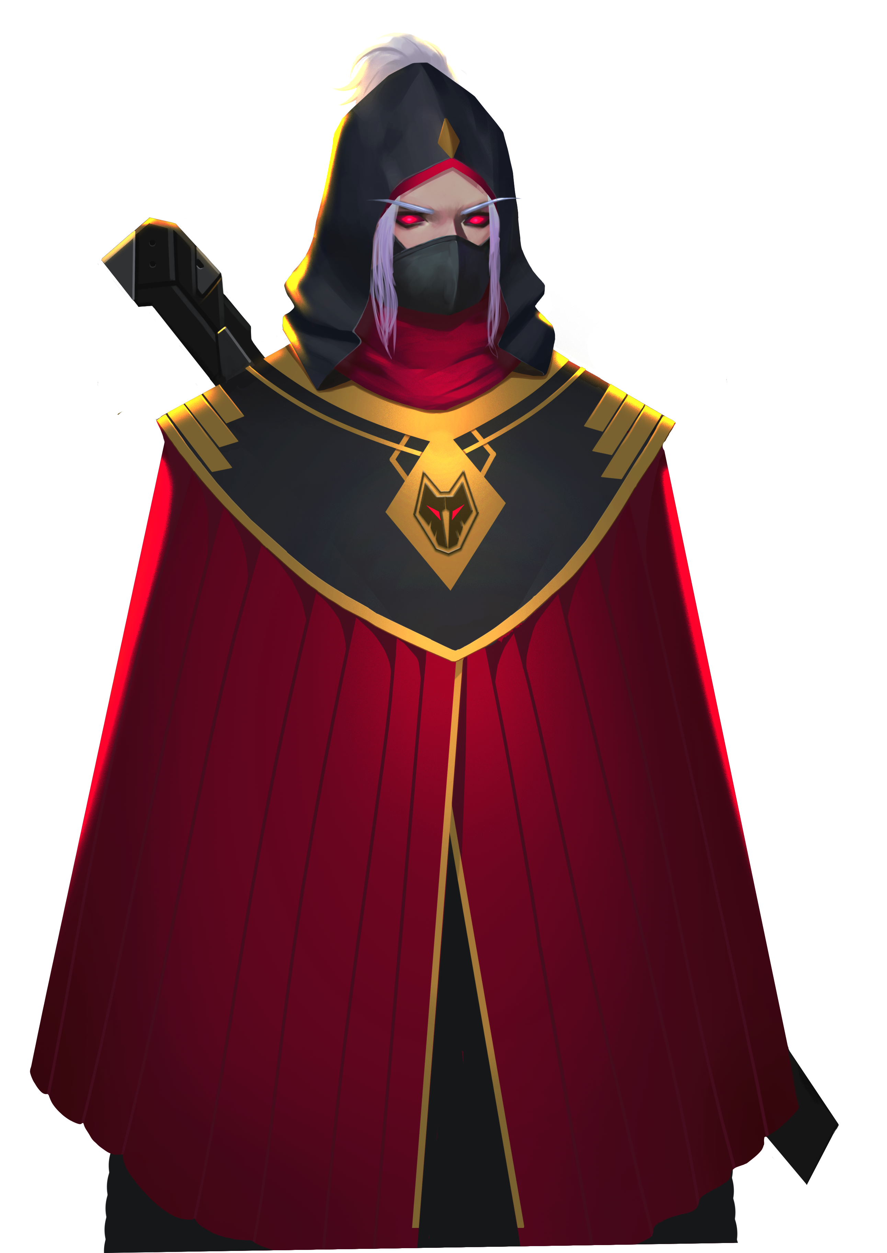
ENEMY DETAILS
Name：Fenrir
Type：Terrorism
Purpose：Breach peace, destroy the world
Fenrir, the most notorious terrorist organisation that is responsible for dozens of terrorist attacks on civilians and non-military targets. They wish to destroy our long kept peace and seize the world. That is the most vicious idea and we cannot let that happen!
Our intelligent agents have revealed the real face of those terrorists.
This time, they plan to seize our mines and take all the ores.

Slide 7
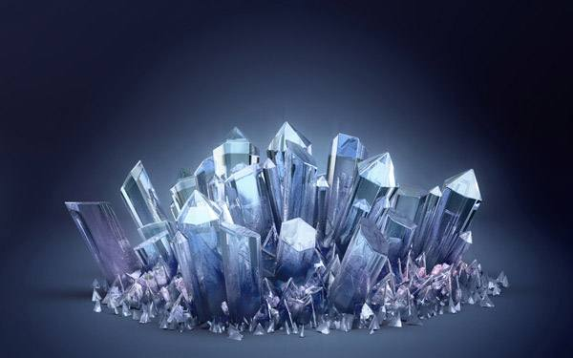
The ores produced in our mine is of great importance to us. Since the ores contain huge energy,
it is the most important source of power that support the operation of our robots and the whole base camp. If we lose the mine, we lose our power, and thus may lose the war against Fenrir!
Hence, we must protect our mines, or at least protect the ores.

Slide 8
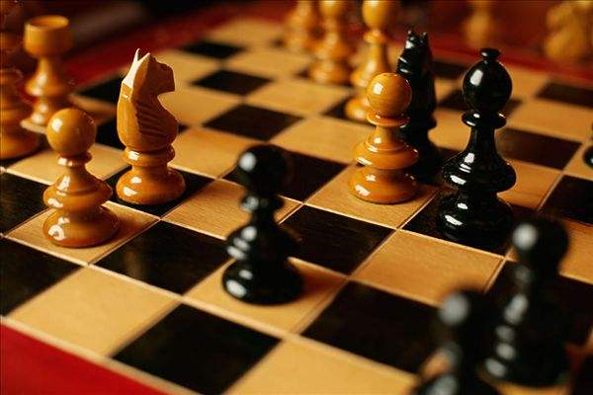
Have you ever played chess? In a chess game, the two opponents make their moves in turns. When one is making the move, the other one could analyse the opponent’s intention, and decide what to do next.
This time, we must be clear of what our enemy do, and prepare our next move accordingly.
As a result, a turn-based strategy should be applied.
The situation is urgent. But what should we do?
Before we set out, let’s learn about turn-based strategy.
Let’s do some practice.

Slide 9
Training

Slide 10
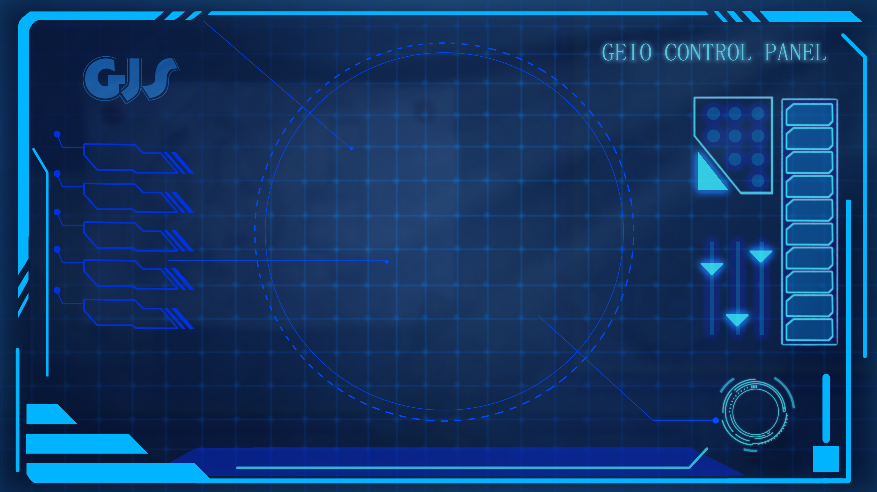
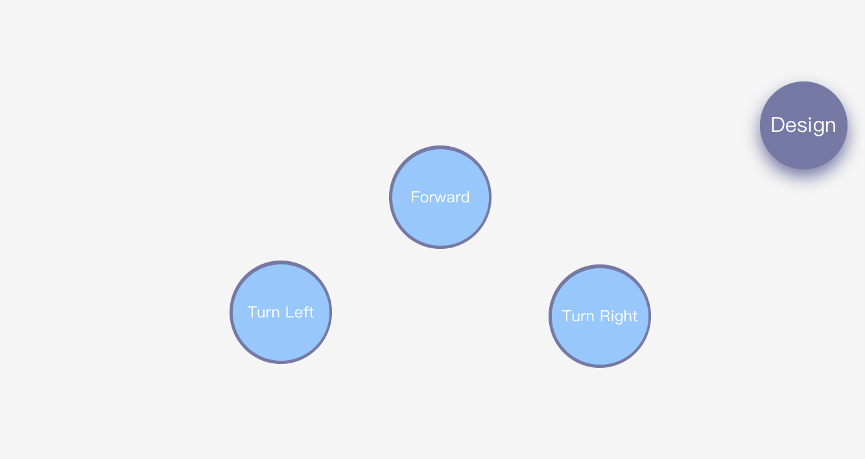
Training task 1: build the control panel as shown above. when press the button, GEIO would move correspondingly. Forward: move forward 30cm; Turn Left: turn left 90°; Turn Right: turn right 90°.

Slide 11
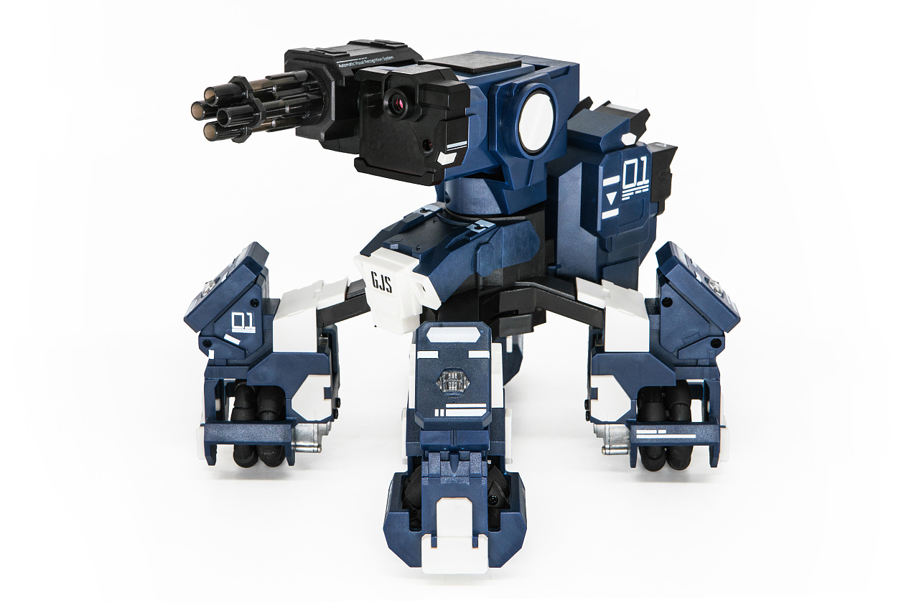
E
D
C
B
A
1
2
3
4
5
6
7
8
Training task 2: Place GEIO at A1, and use the control panel created in the last task
to control GEIO. Starts from A1, move to B2, then C4 and D6, and finally reaches E8.
Question: How many times do we need to press the buttons?

Slide 12
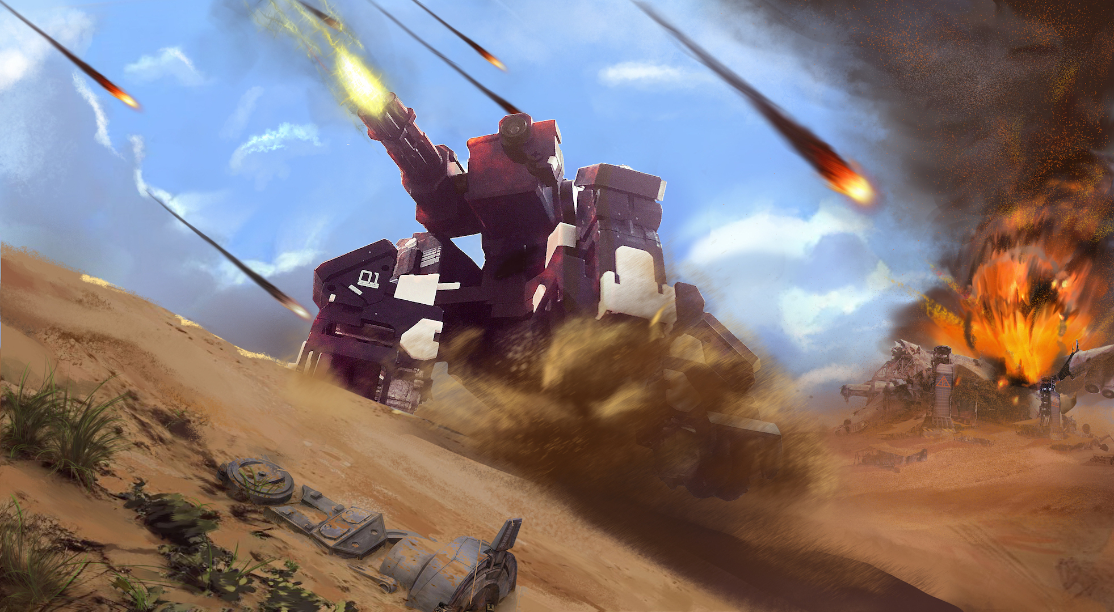
Challenge

Slide 13
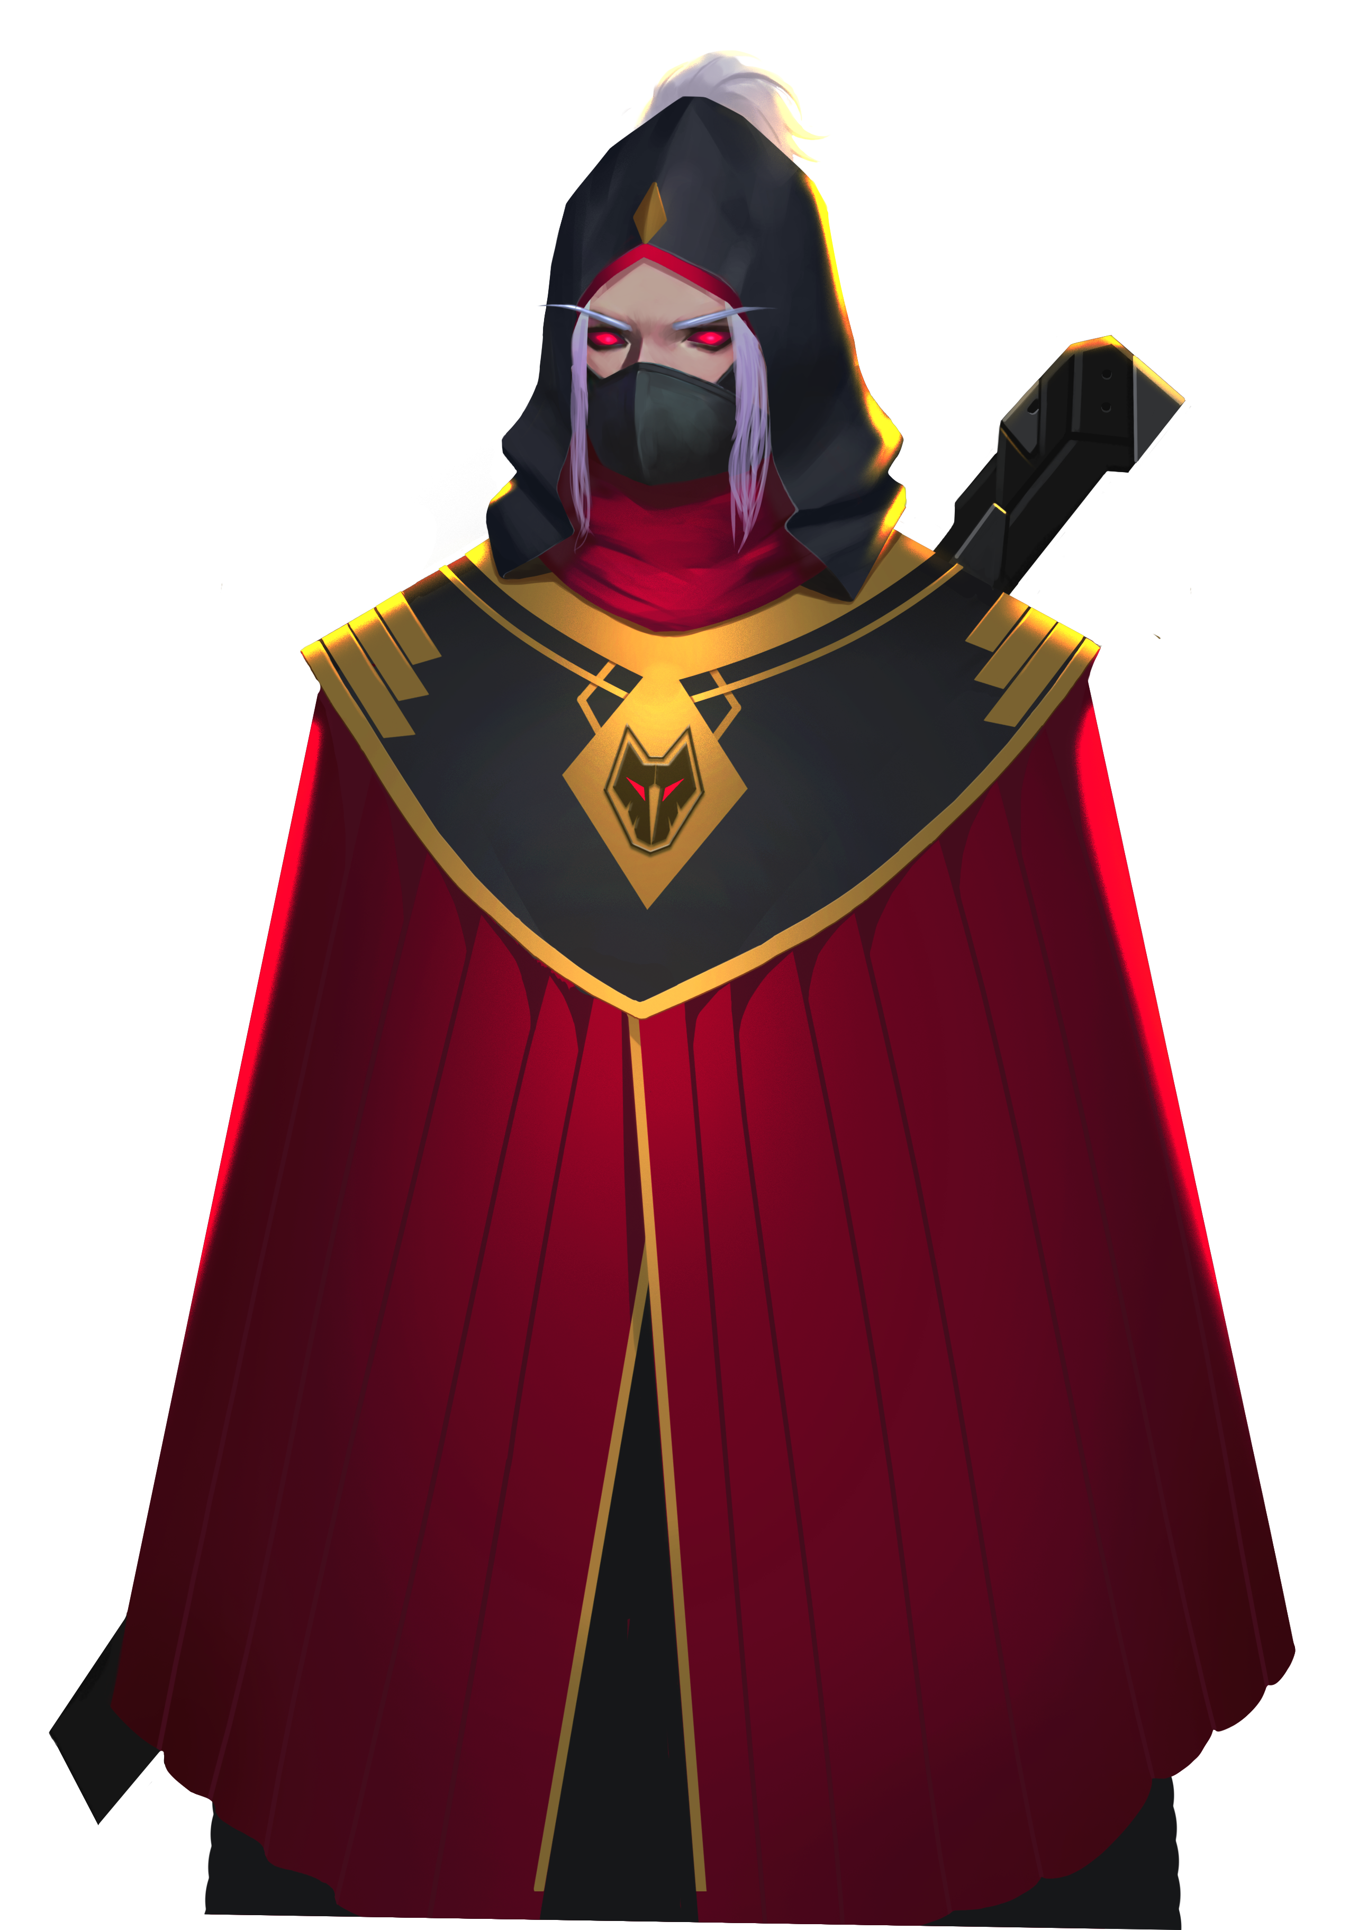
6 | 8 |  | 5 | 7 |  | 8 | 6
2 |  | 9 | 7 | 4 | 5 |  | 2
 | 3 | 4 |  |  | 4 | 3
2 |  | 5 | 4 | 7 | 9 |  | 2
6 | 8 |  | 7 | 5 |  | 8 | 6
E
D
C
B
A
1
2
3
4
5
6
7
8
From the above map, we can see that there are a lot of huge rocks in the mine area. Every other square is filled with a number (written on a card). The number represents the amount of ores under this square area.
This is a turn-based strategy game. Each player could control GEIO to move forward once, or turn left/right once. When first reach a new square, all the ores under this square is collected (card gained).
Once you have collected enough ores (30, no more, no less), return to the starting point. The one who finishes the task with the least number of turns wins the game!
I am the leader of Fenrir. I will lead my man myself this time. The ores will all be mine!
Alarm! Fenrir is here! The race begins!

Slide 14
What is turn-based strategy games?
Why do we use turn-based strategy today?
What strategies did you use during today’s combat?
That’s the end of today’s class. Next time we will strike the enemy
forces. Have a good rest, and be prepared for the next combat!
Excellent! We have secured our precious power source！
Impossible… I lost… doesn’t matter, I have a better plan. I will be back!
Now it is the time for review. Answer the above questions.

