Slide 1
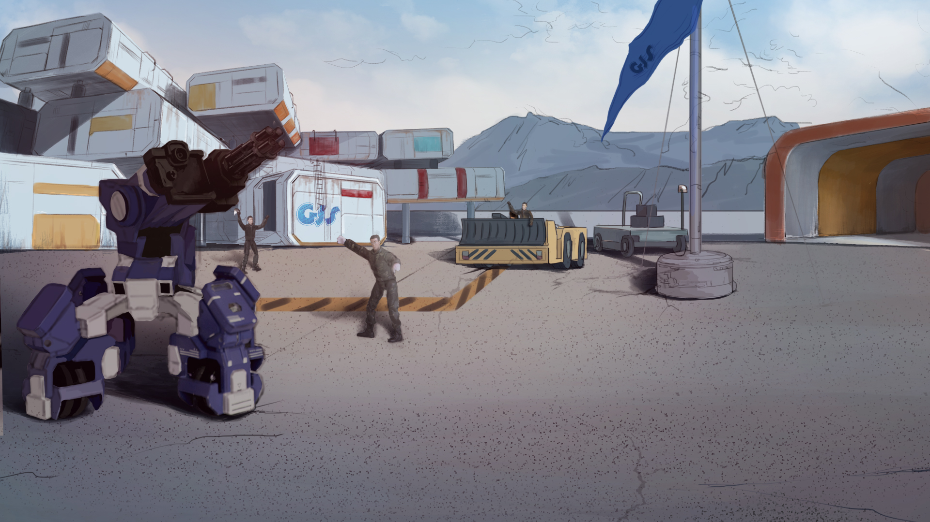

How to Become A GEIO Pilot？
Lesson 7: Reload

Slide 2

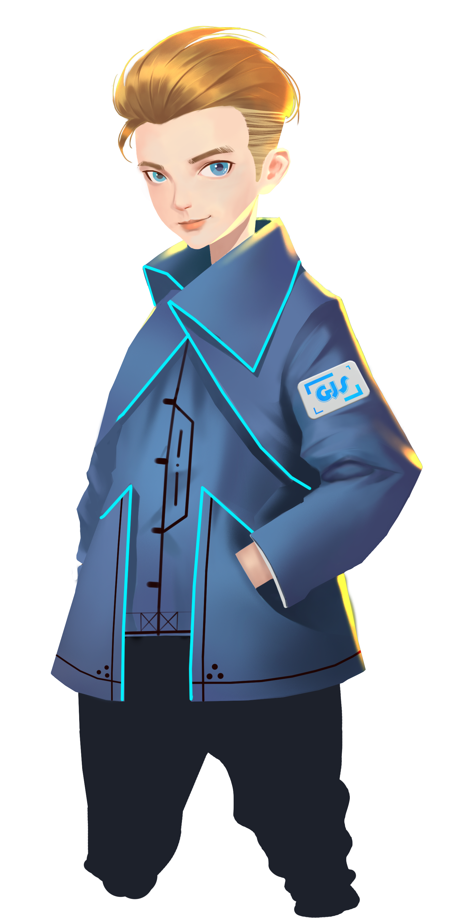

What are the main categories of military robots?
How does GEIO attack and how does it know
if it is under attack?
Is there other way to aim at the target?
Last time, we learned how to shoot at the target using GEIO’s laser gun.
Today, we are going to learn the way of reloading GEIO’s weapon. So here we go!
Welcome back fellow pilots! I am Sam. Do you still remember what we have learnt last time?

Slide 3
Briefing

Slide 4

Topic
“Reload”
Basic Knowledge
Logic control codes
Training
Limited ammunition and reloading
Challenge
Keep firing
In the Briefing section, let’s see what we are going to learn today.

Slide 5
Basic Knowledge

Slide 6

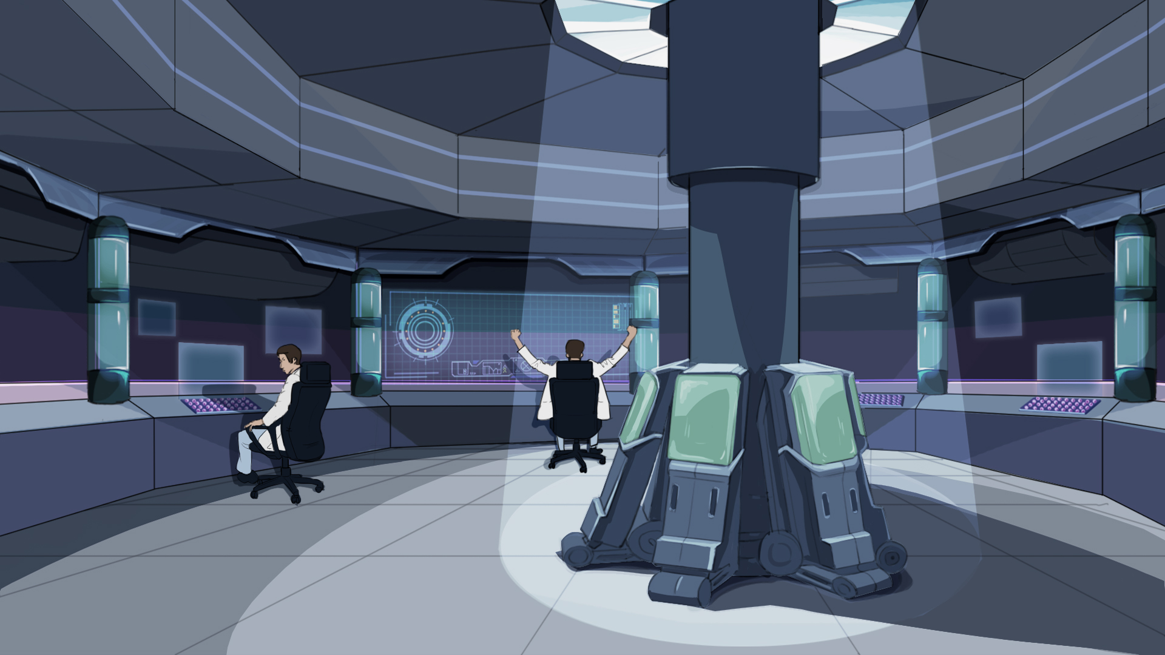
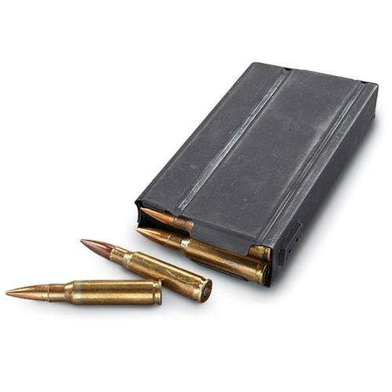
Now I can tell you that this situation would only happen during our training here.
In actual combat, the ammunition is limited. When you have fired all the ammunition
in your gun, you will have to reload it before you could fire again.
In the last class, we learned the way to control GEIO’s weapon, the laser gun.
But the funny thing is that this gun has unlimited ammunition. That’s weird.
Here we encounter two questions: 1. How to limit the ammunition? 2. How to reload?

Slide 7
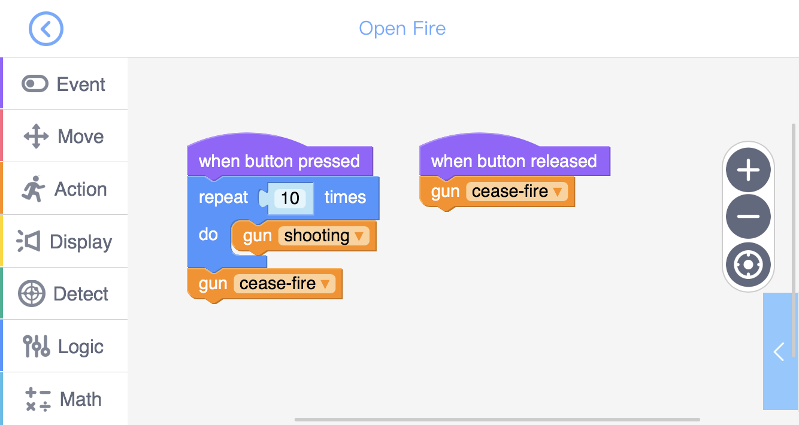
When we press the button, GEIO will open fire. But after a certain time period, the shooting
stops. If you want to fire again, you have to release the button and press again. This means
that firing will consume ammunition, and releasing the button will automatically reload.
When firing, all we need is the code “gun (shoot)”. But as we know, this code has
nothing to do with ammunition. Thus we need new codes to help us limit the ammunition.
Here we use a new code “Repeat…times”. This is a logic control code.
It would repeat executing the contained codes for a number of times.
Let’s first talk about the ammunition limitation.
Let’s try and analyse this programme.

Slide 8
Start
Condition
Yes?
No?
Action
End
Above is a typical flow chart used to help us understand the logics of a programme.
As we can see, after start, the programme will tell if the pre-set condition is fulfilled.
If yes, do “Action” before “End”, otherwise go straightly to “End”.
What is logic control codes? They are used to tell the circumstance
under which the programme is running and determine what to do next.
Can you draw the flow chart of the last programme?

Slide 9
When button pressed
Times repeated <10?
Yes?
Gun shooting
No?
Stop shooting
Different from the sequential structure we have learnt before, when using “Repeat” codes,
we create a new structure — loops. When the condition for “Repeat” is fulfilled, the
programme will keep repeating the certain codes until the condition is no longer fulfilled.
The above shows the flow chart of the shooting programme. When the times repeated is
less than 10, the programme will repeatedly execute the “Gun shooting” code; and after
10 times, the programme will stop repeating and execute the code below “Repeat”.
Except for “Repeat”, there are other kinds of logic control codes in the “Logic” toolkit.
Let’s learn more about them.

Slide 10
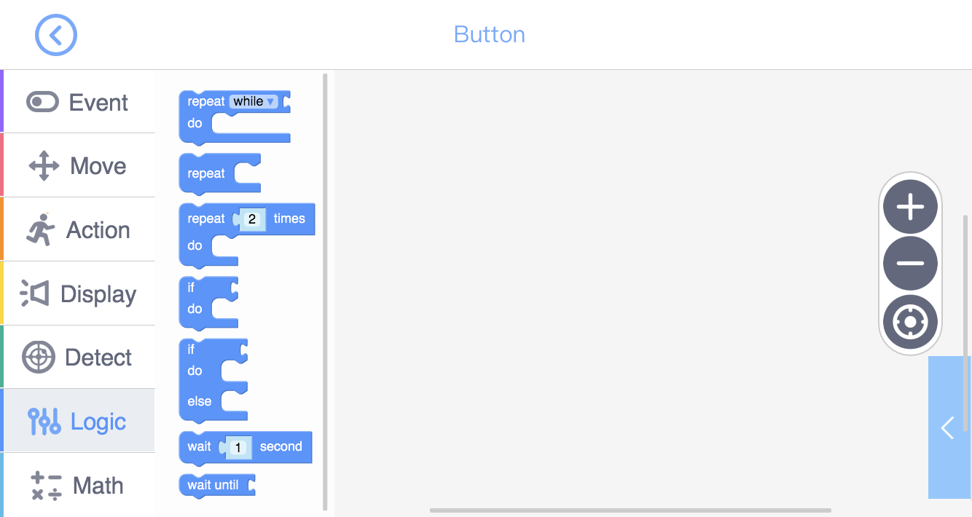
Repeat when condition is fulfilled
Repeat unconditionally
Repeat certain times
If condition fulfilled, do (otherwise skip)
If condition fulfilled, do upper code; otherwise do lower code
Wait for some time before going into the next step
Wait for the condition to be fulfilled

Slide 11
Training

Slide 12
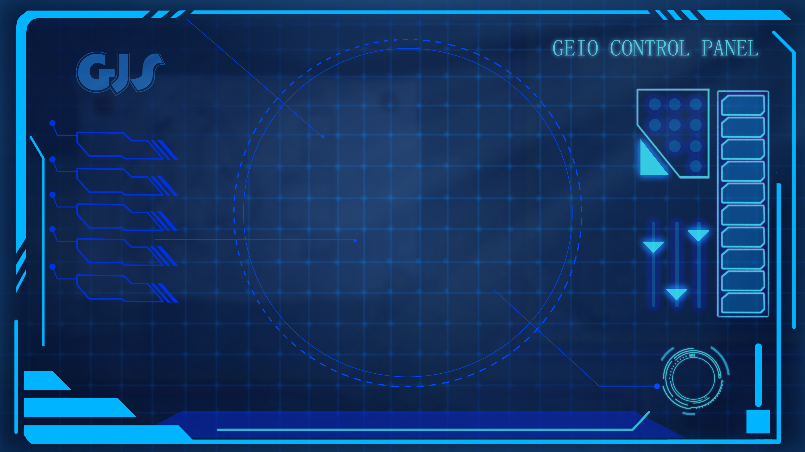
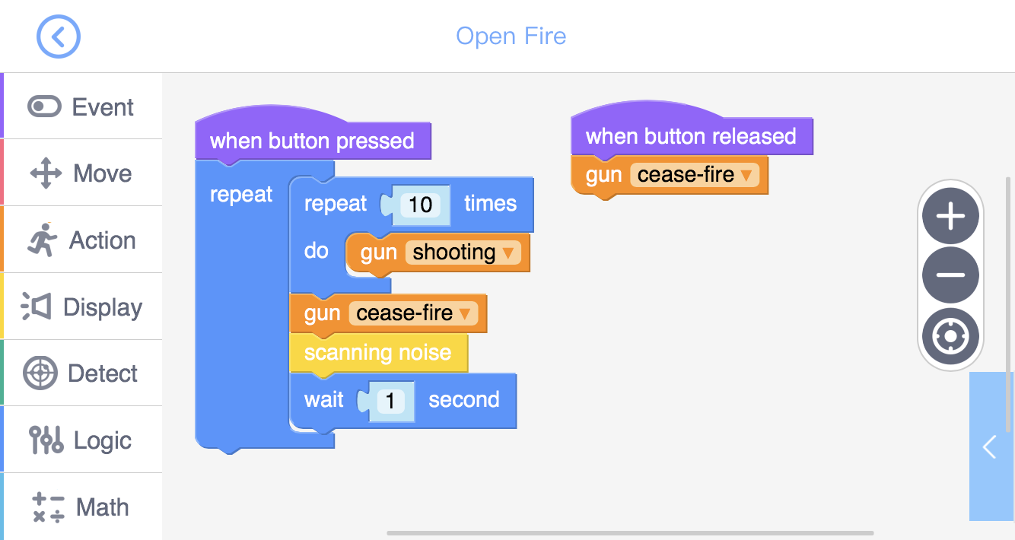
Training task 1: Make the laser gun auto-reload. Programme and draw the flow chart.
Try the above programme. The “Scanning noise” is to simulate the sound of reloading,
and can be found in the “Display” toolkit.

Slide 13
Sometimes, the auto-reload system may be out of work due to possible damage caused during the battle. In case of that, we should also prepare the manual reload system.
How to quickly reload? We are going to use the detecting system.

Slide 14
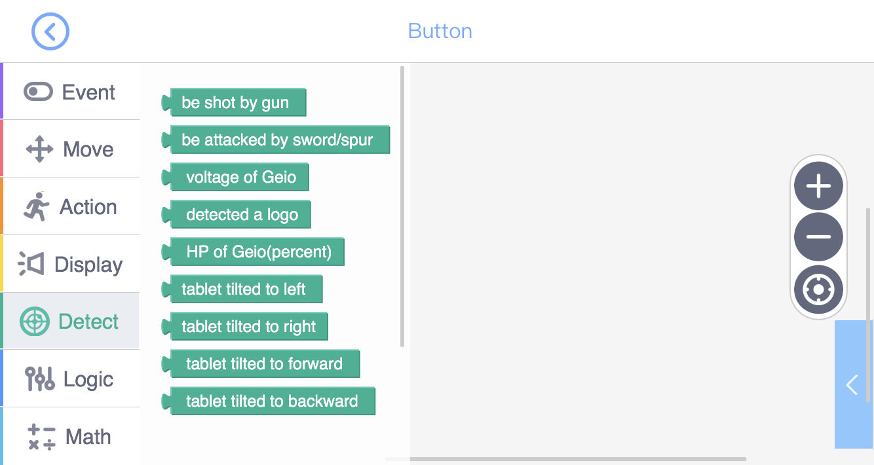
To detect tablet tilting

Slide 15
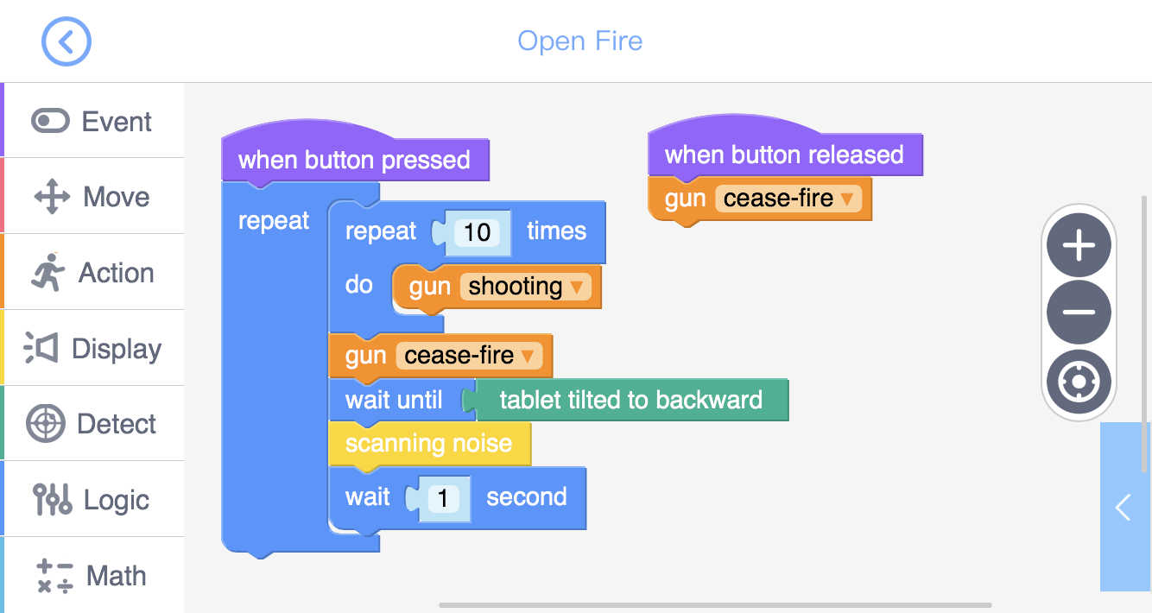
Sometimes the auto-reload system may be damaged during the combat.
In such cases, we shall need to reload the weapon ourselves.
Training task 2: Emergent reload system. Programme and draw the flow chart.
This time we will utilise the gyro sensor embedded in the controller to do the job.
Question: What logic control codes are used in this programme? What can they do?

Slide 16
Challenge

Slide 17
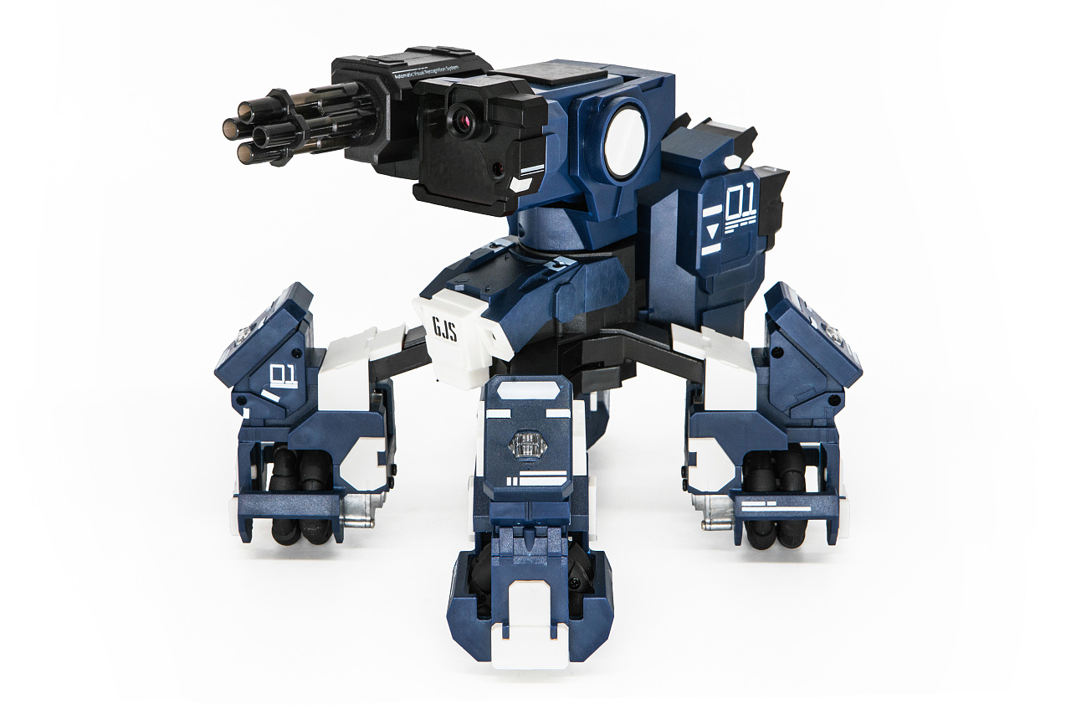
E
D
C
B
A
1
2
3
4
5
6
7
8
Every two of you will be forming a team, and fight against other teams. As shown above, each player will be standing at one of the corners. You can turn the head to aim, but you cannot move.
Besides, you must use ammunition limitation (repeat 10 times) and emergent reload system.
When start, you are free to attack your “enemies”. Those who lose all the HP are out.
Once all the members of your opponent team are out, your team wins.
Here comes today’s challenge. You are going to attend a shooting exercise.

Slide 18
What are logic control codes?
What is flow chart? How to draw a flow chart?
What does the code “repeat times” do?
That’s all for today’s training. Next time we will have a quiz,
in which your fighting skills will be tested. Be prepared, pilots!
Now let’s have a review. Answer the above questions.
Excellent! You are making great progress!

