Slide 1
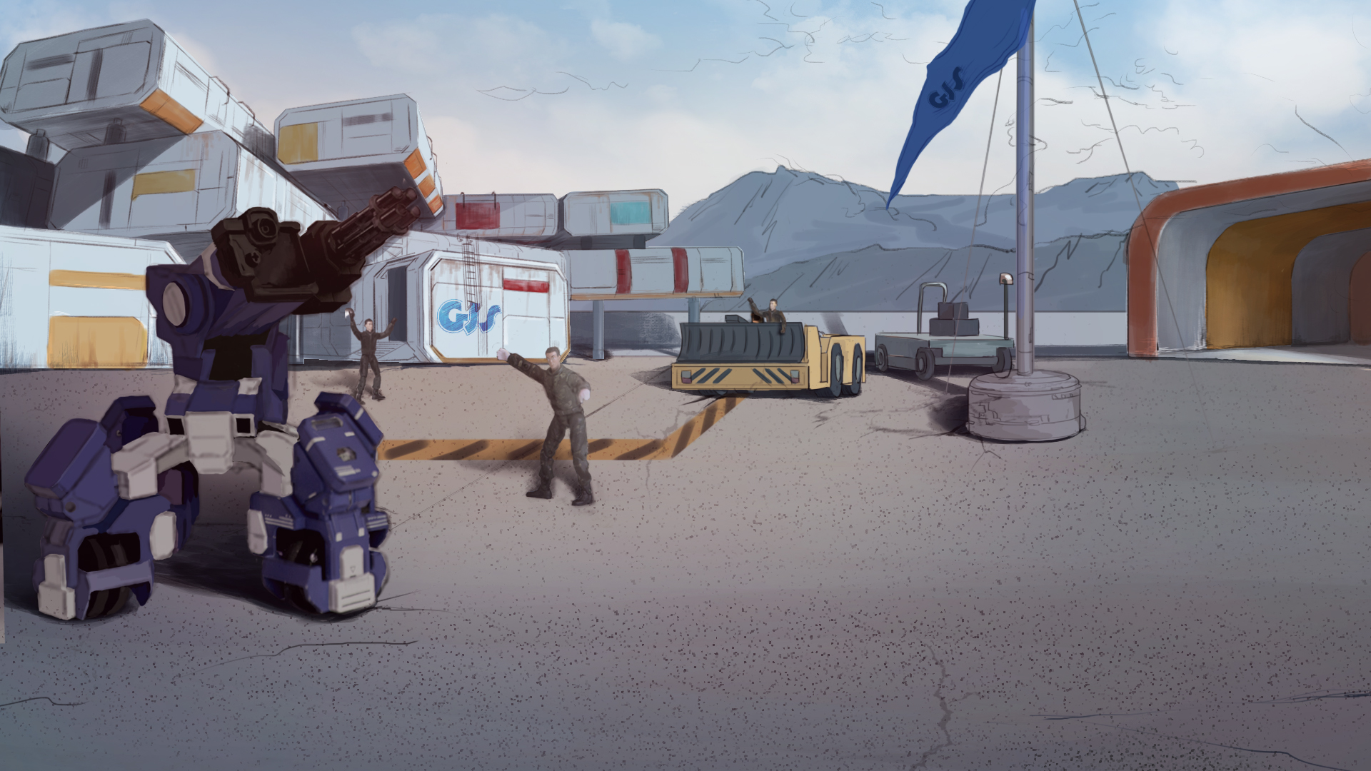

How to Become A GEIO Pilot？
Lesson 6: Open Fire!

Slide 2

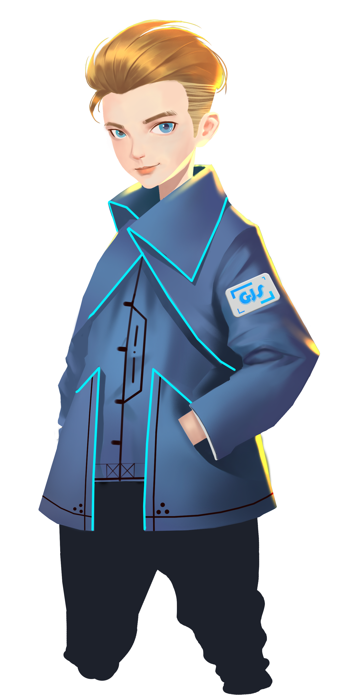

What parameters are needed to make
GEIO move a certain distance?
What is angular speed? How to calculate it?
What other tasks can be done using “accurate control”?
Last time we learned how to accurately control GEIO. This time, we are going to fight!
Are you ready for this class?
Welcome back fellow pilots! I am Sam. Do you still remember what we have learnt last time?

Slide 3
Briefing

Slide 4

Topic
“Open Fire!”
Basic Knowledge
Sensors and Sensing
Training
Aim and shoot
Challenge
Shooting competition
In the Briefing section, let’s see what we are going to learn today.

Slide 5
Basic Knowledge

Slide 6

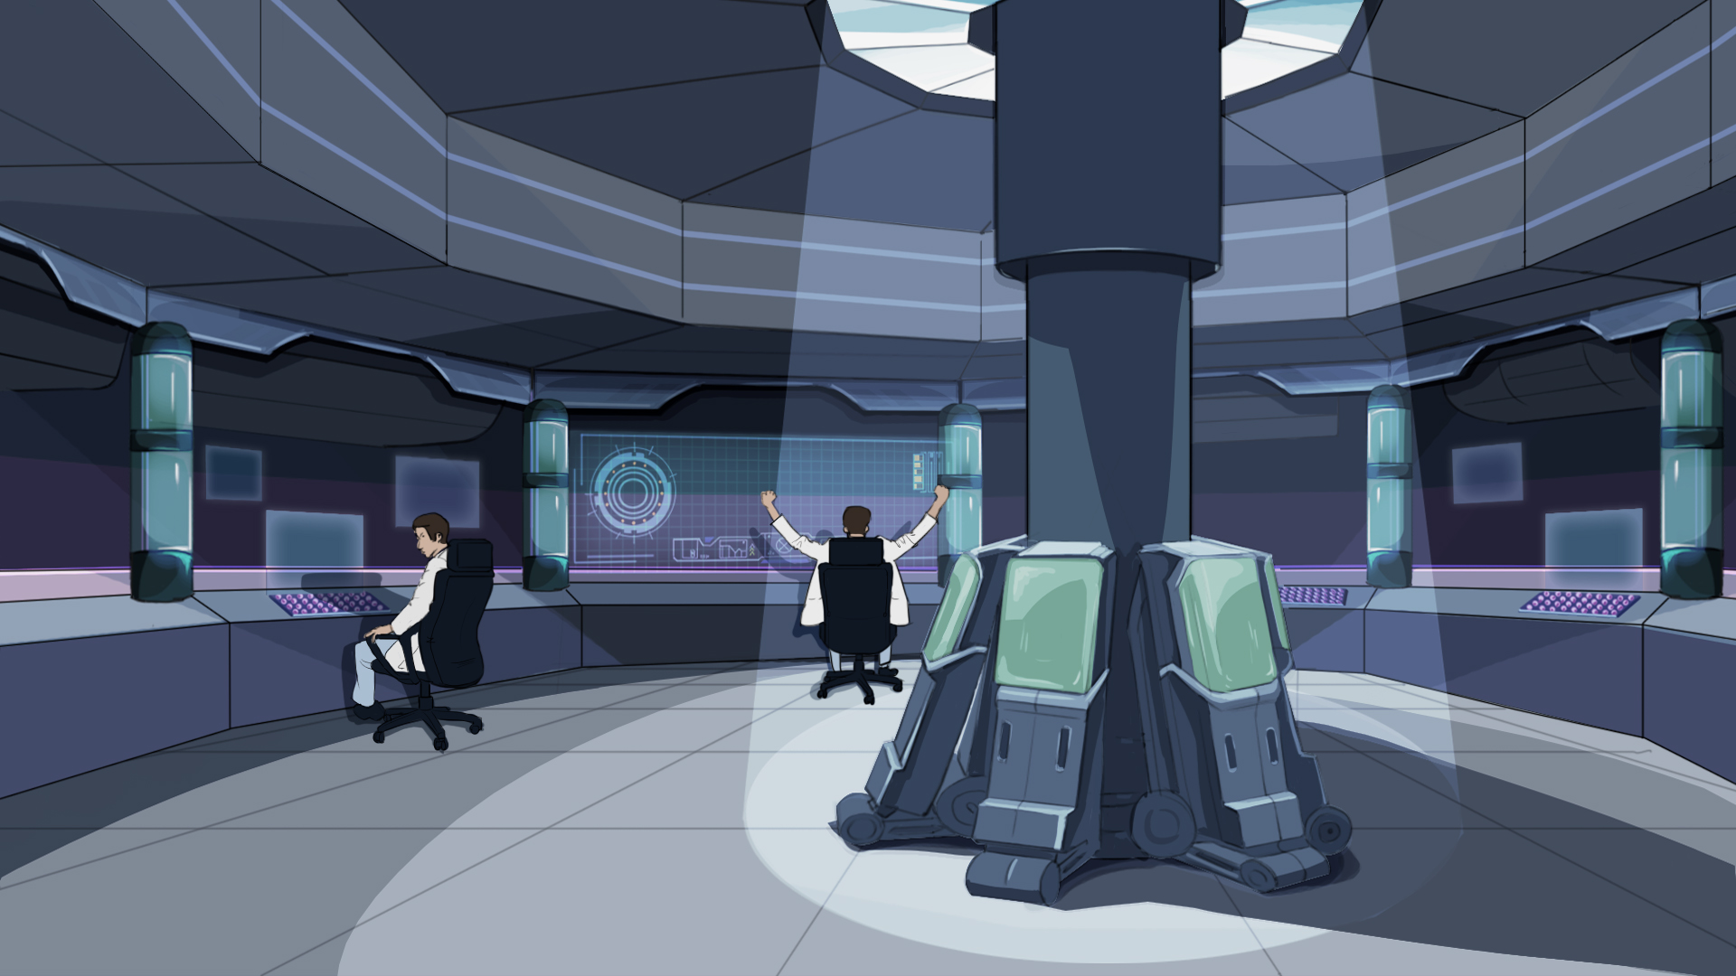
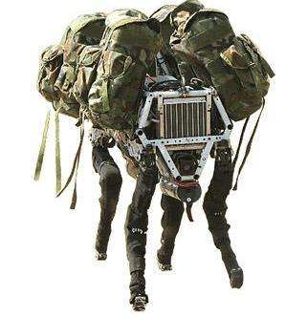
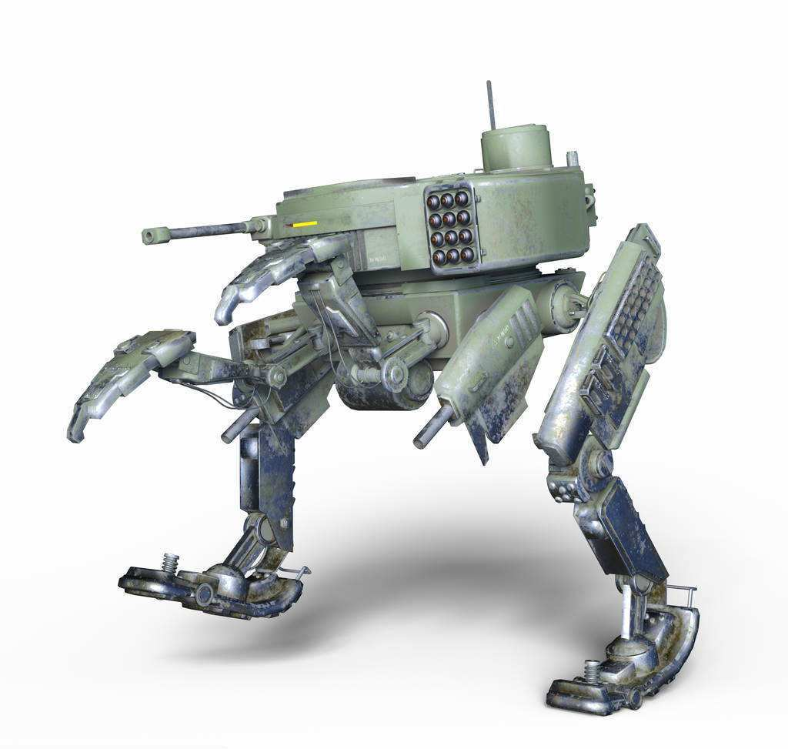
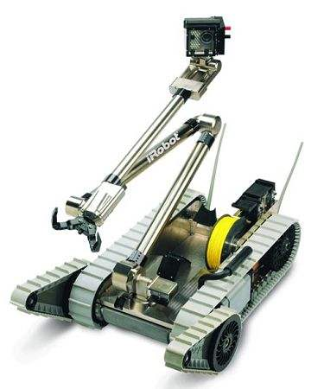
Gear carrier
Assistant
Battle robot
Fighting
Explosive ordnance
disposal (EOD) robot
Special
We know that robots are designed to help people do those most dangerous jobs in many ways.
Among those jobs, serving in military actions and operations is one of the most important.
What can a robot do in military operations? Let’s take a look at the above examples.
OK, which of the above categories does GEIO belong to?

Slide 7
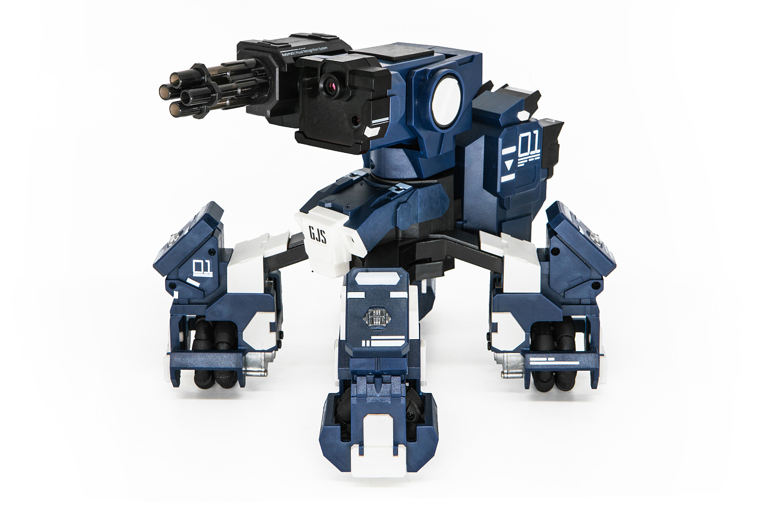
There are also infrared ray receivers on each of the four legs. When
GEIO is targeted and shot, the receiver will receive the infrared ray
from the attacker, and thus determine whether to lose HP.
Take a close look, we can find a small infrared ray emitter. When the gun is firing,
the emitter would keep emitting infrared ray straightly forward.
As a fighting robot, GEIO uses its laser gun to attack. How does the gun work?
How can we control GEIO to fire?

Slide 8
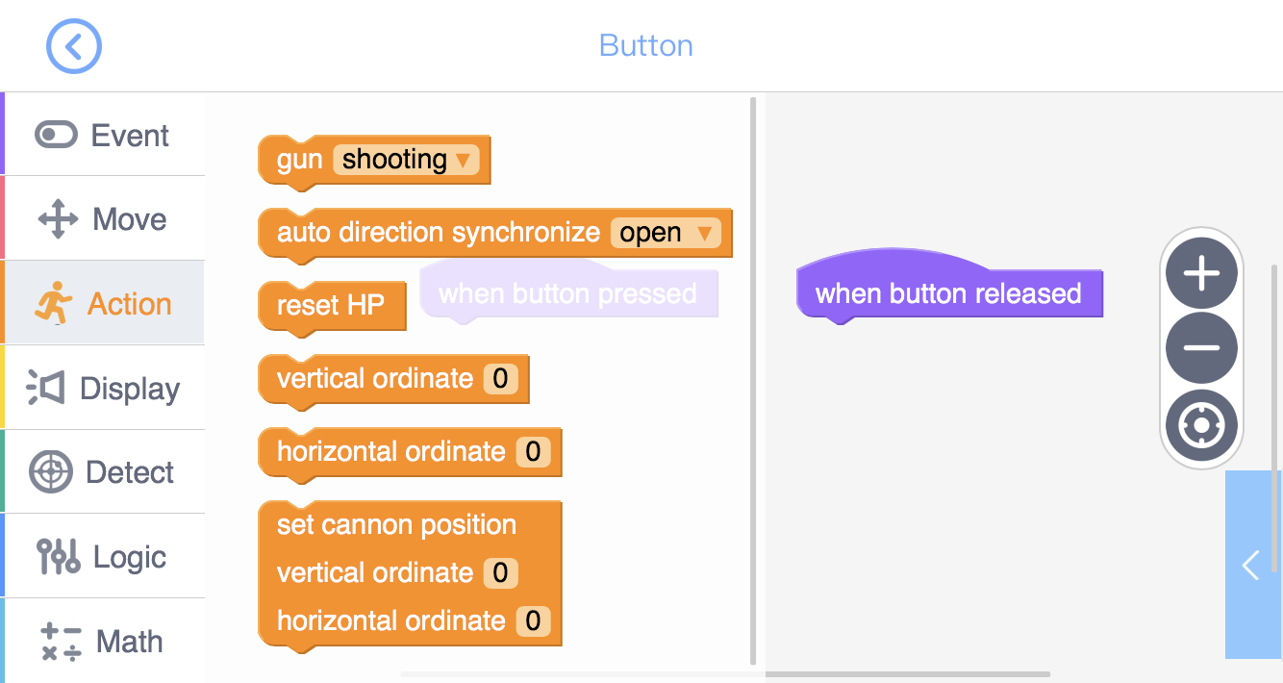
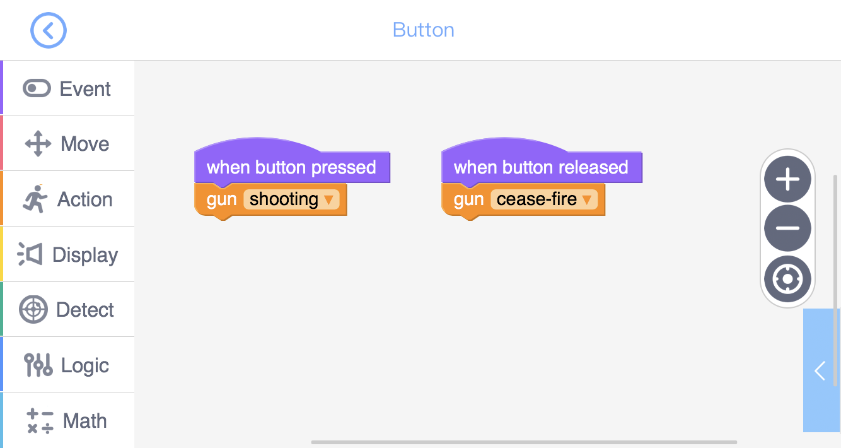
In programming interface, we can find codes for shooting in the “Action” toolkit.
We can use the code “Gun” to control GEIO to shoot or to cease fire.
Write a simple programme as shown in the above image,
and answer the question: what does this programme do?
Great! Let’s go training now.

Slide 9
Training

Slide 10
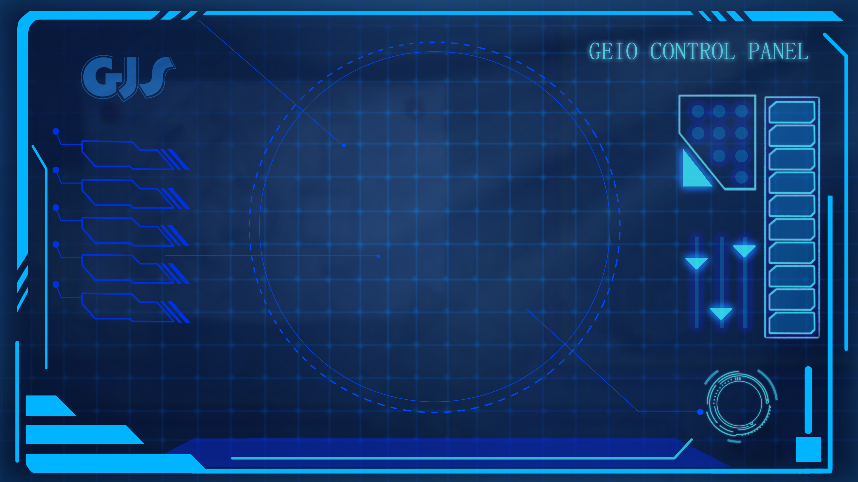
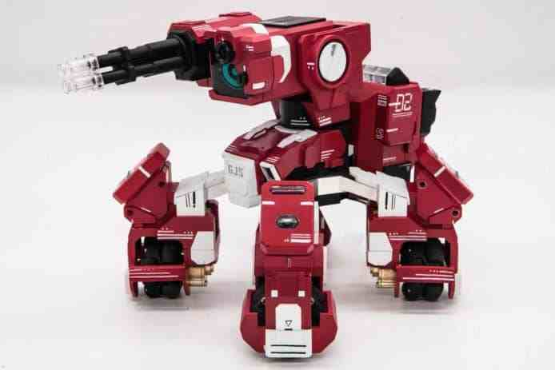
VS
Your first training task is: programme your GEIO, and then control
your GEIO to move (forward, backward, left, right) or turn to aim at
and shoot this “enemy” until it is defeated (HP=0).
There is an “enemy” GEIO in our camp. Don’t worry,
it is not the real enemy, but for training only.

Slide 11
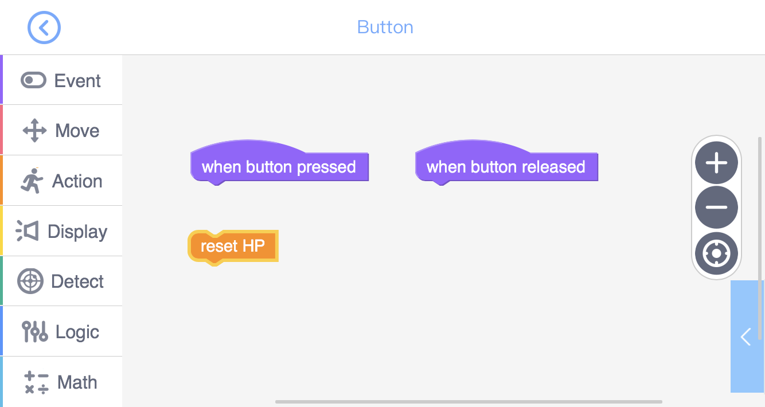
New problem rises. If our GEIO is defeated in the battle, how can we reboot it?
To do this, we need this “reset HP”.

Slide 12
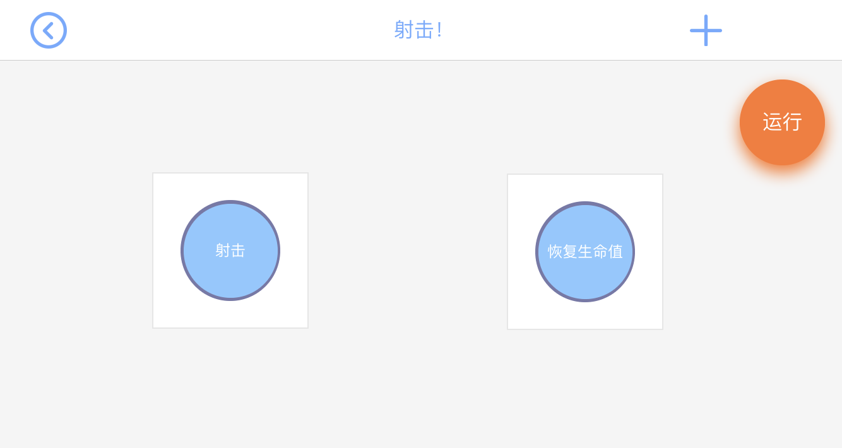
Training task 2: Create a new control panel, and use two buttons to separately control GEIO’s shooting and HP reseting. Then go training with your team mates.

Slide 13
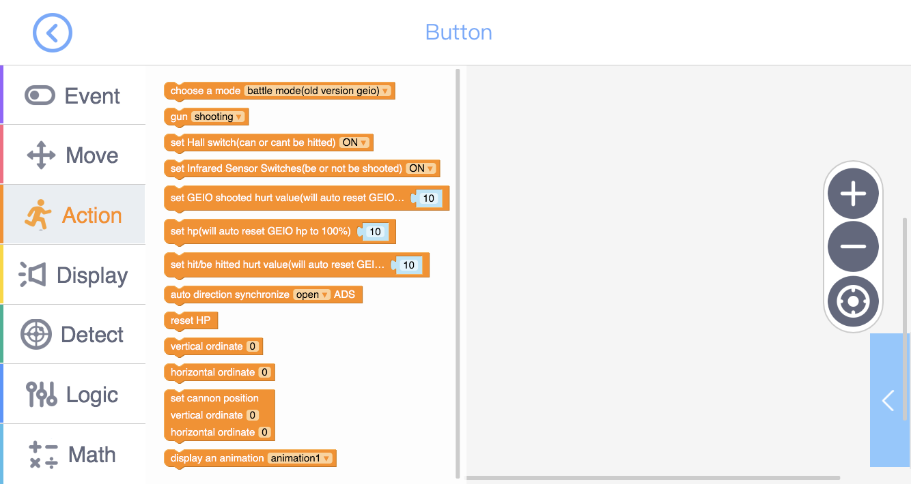
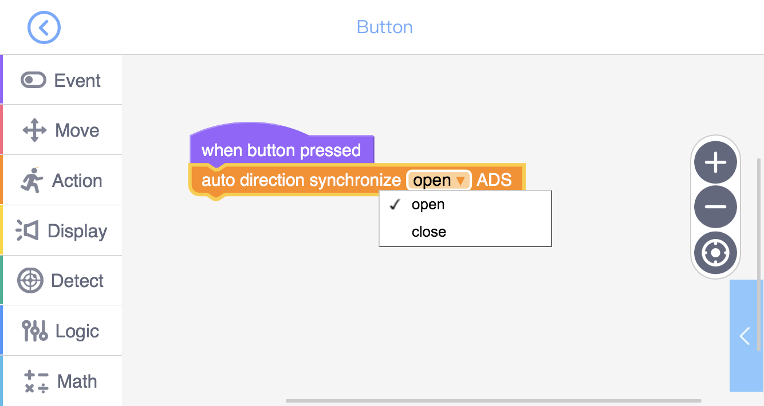
In the “Action” toolkit, there is a code “Auto direction synchronize”. When opened,
we can control our GEIO to turn simply by rotate our handhold control device — the
tablet. And in this way, we can easily control GEIO to aim at the target.
Set up two “button” icons, and place “Synchronize-open” and “Synchronize-close”
to each separately. Then run the programme to see how it works.
Task 3: Quick aim

Slide 14
Challenge

Slide 15
E
D
C
B
A
1
2
3
4
5
6
7
8
There will be several obstacles in the training field (unknown position), and the “enemy”
will enter the field (unknown place and facing direction). Your job is to set out from A1,
search for the “enemy”, and defeat it.
Caution! The “enemy” may not move or turn, but it will attack! So choose
your manoeuvre carefully, destroy the “enemy” and keep yourself alive.
I believe you all know how to fight with GEIO’s laser gun. Now let’s enter the challenge section.

Slide 16
What are the main categories of military robots?
How does GEIO attack and how does it know
if it is under attack?
Is there other way to aim at the target?
Now it is the time to review. Answer the above questions.
This is the end of this class. See you next time!
Excellent! You are making great progress!

