Slide 1
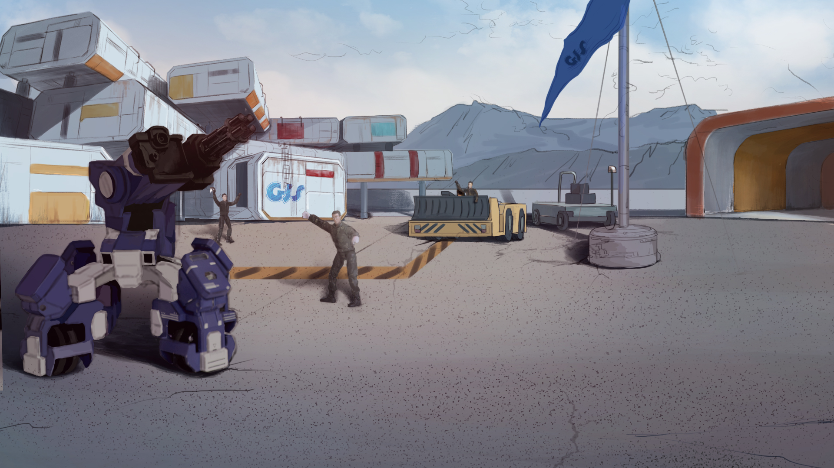
How to Become A GEIO Pilot？
Lesson 5: Accurate Control

Slide 2

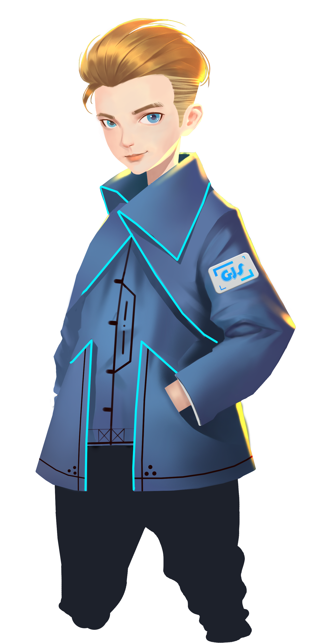

What are the main parts of a robot?
Why is programming important?
What actions can GEIO perform?
In the last four classes, we have mastered the way to control GEIO’s motion.
Now we will begin learn more about GEIO’s high level programming. Pilots, are you ready?
Welcome back fellow pilots! I am Sam. Do you still remember what we have learnt last time?

Slide 3
Briefing

Slide 4
Topic
“Accurate Control”
Basic Knowledge
Speed and distance/angle
Training
Make GEIO to move certain distance
Challenge
Across the front line
In the Briefing section, let’s see what we are going to learn today.

Slide 5
Basic Knowledge

Slide 6
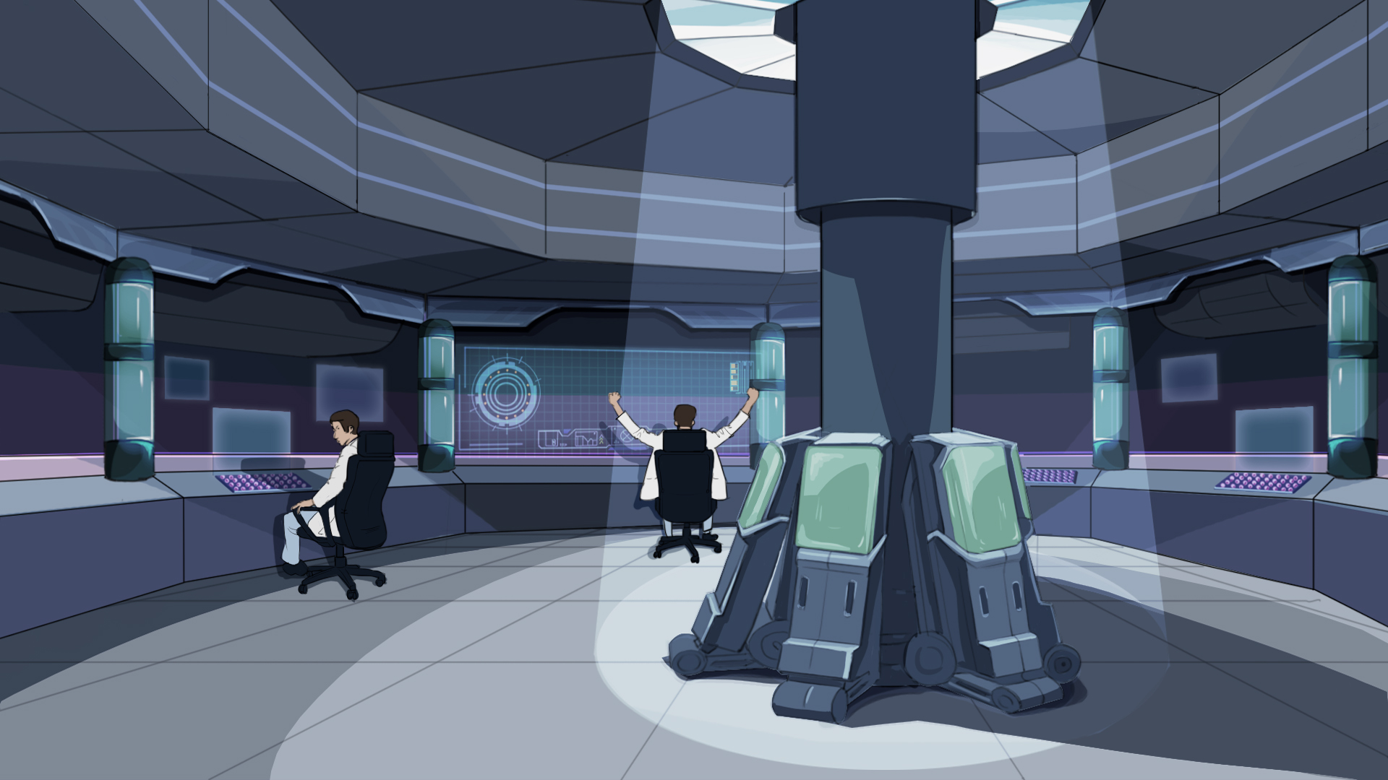
Welcome to the GJS control centre. This is the place
where we can programme and control GEIO remotely.
Before we begin, we should look back again to the way of GEIO’s programming.

Slide 7

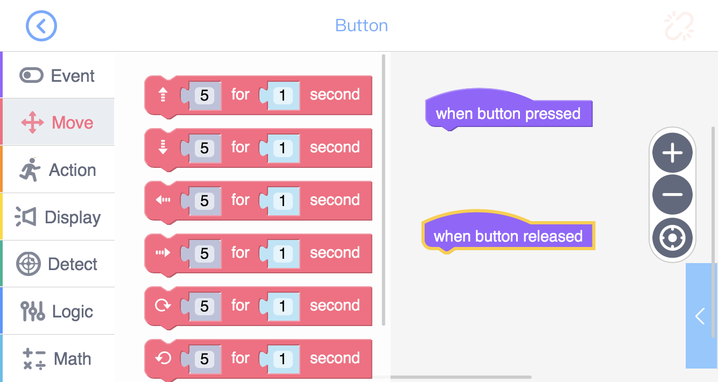
In the programming interface, we can find the code library on the left.
There are seven different toolkits — Event, Move, Action, Display, Detect,
Logic and Math — each contains several codes.
But the Move codes here can only control GEIO’s speed and time of moving.
What if we want it to move a specific distance?

Slide 8
v-speed S-distance t-time
v=S/t
The speed of an object is the distance travelled by the object in a certain time interval.
With the above equation, we can easily calculate the speed
if we know the distance and time of moving.
On the other hand, if we know the speed, and the distance, can we calculate the time needed?
We have already learned how to calculate the speed.
For that, we need to accurately control GEIO.

Slide 9
Training

Slide 10
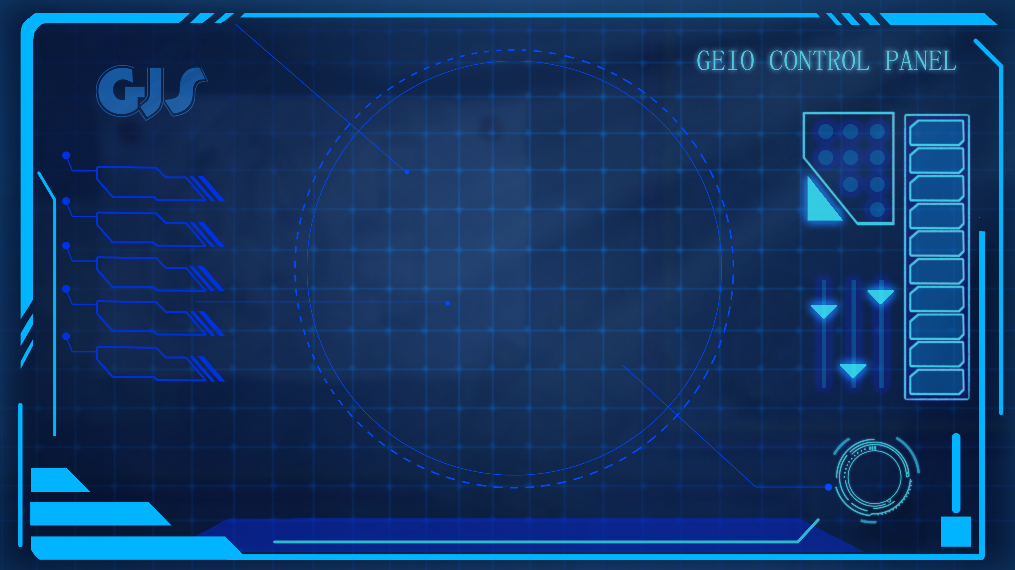
GEIO
|<————Distance S————>|
Training task 1: programme and control GEIO to move
forward 30cm, 60cm and 90cm separately.
Bravo! Then try these directions: left, right, backward.

Slide 11
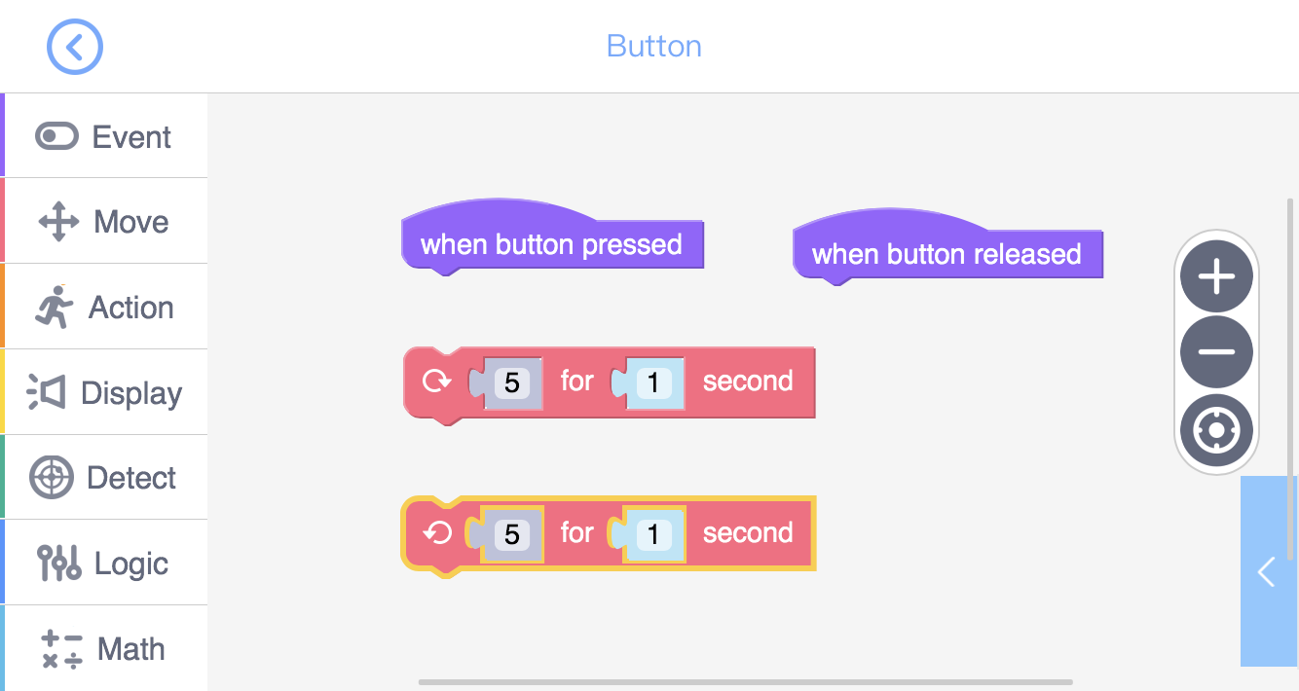
There are two codes that controls the turning of GEIO, as shown above. Similar to other
move codes, these two codes make GEIO turn at a certain speed for a certain time period.
What if we want GEIO to turn a certain angle? To do that, first learn about “angle”.
Now we know how to make GEIO move a certain distance. How about turning?

Slide 12
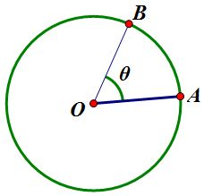
ω-angular speed Ч-degree of angle t-time
ω=Ч/t
The angular velocity of a particle is the rate at which it rotates around a chosen centre point.
When GEIO is turning, we consider that it is drawing a circle. In the above image, we assume that GEIO is standing at point O, and facing point A. Then it begins to turn left and finally stops when facing point B. Here line OA and OB forms an angle θ.
The angle of a full circle is 360 degrees. Thus the range of GEIO turning/rotation is 0-360 degrees.
To turn specific angle, take a look at the above equation.

Slide 13
ω-angular speed Ч-degree of angle t-time
ω=Ч/t
The angular velocity of a particle is the rate at which it rotates around a chosen center point.
Training task 2: calculate the speed of turning/rotation of GEIO. Programme and control GEIO to keep spinning, and record the time for turning one full circle. The calculate the angular speed using the above equation.
Training task 3: turn a certain angle. With the actual angular speed, you should
now programme GEIO to make it turn 45, 90 and 180 degrees separately.

Slide 14
Challenge

Slide 15
 | E2
 |  |  |  |  | C6
 |  | B3
A1
E
D
C
B
A
1
2
3
4
5
6
7
8
Place GEIO at A1, and make one programme for it. When the button is pressed (and held),
GEIO should move to B3, and then C6, and finally E2. The one that uses the shortest time
to accomplish this task will be rewarded!
Now we know how to make GEIO move a specific distance or turn a specific angle.
We should then enter the challenge section.

Slide 16
What parameters are needed to make
GEIO move a certain distance?
What is angular speed? How to calculate it?
What other tasks can be done using “accurate control”?
Next time we will learn some fighting skills. Are you looking forward to it?
See you next time and let’s do it!
Now it is time to review. Answer the above questions.
Bravo! You are making great progress!

