Slide 1
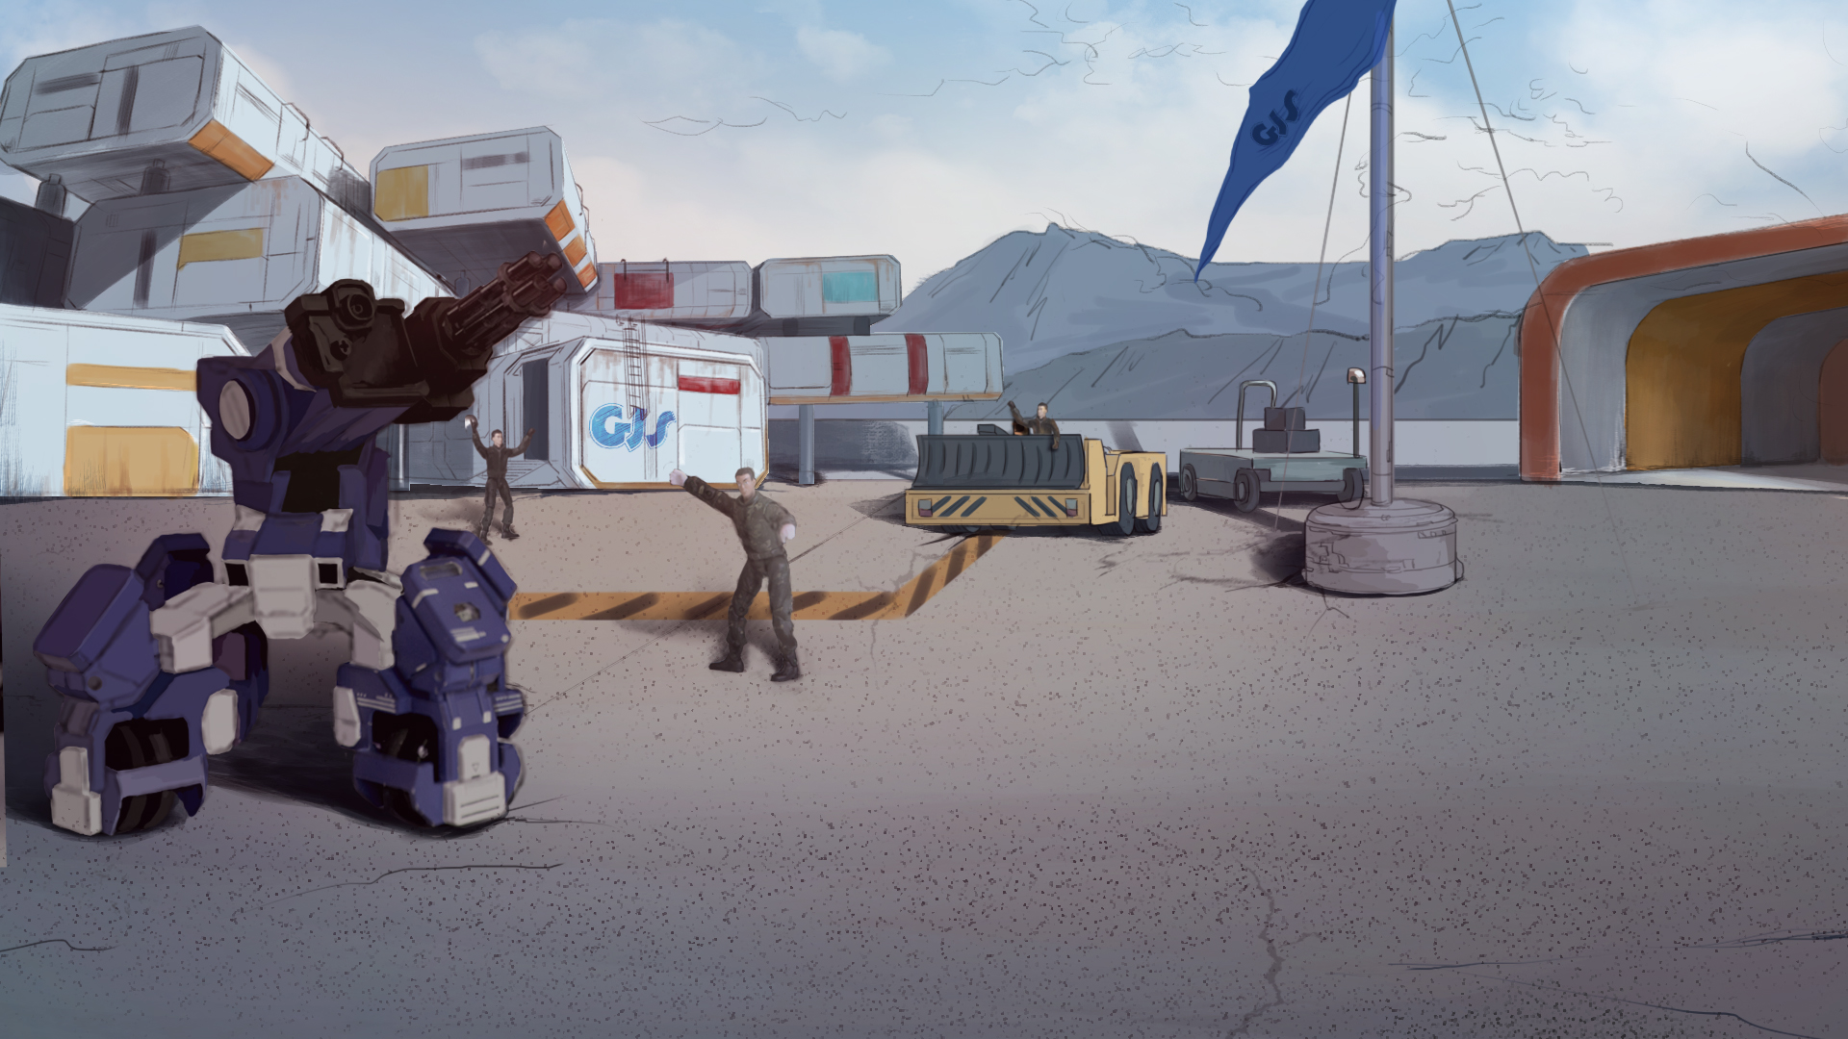

How to Become A GEIO Pilot？
Lesson 3: Take Aim

Slide 2



What is inertia?
What is friction? What features does it have?
How to prevent things from falling over
when GEIO is moving?
Welcome back fellow pilots! I am Sam. Do you still remember what we have learnt last time?
Good! Let’s continue our training.

Slide 3
Briefing

Slide 4

Topic
“Take Aim”
Basic Knowledge
Degree of freedom and coordinate system
Training
Practice of GEIO’s head motion
Challenge
Parcel Delivery Level 2
In the Briefing section, let’s see what we are going to learn today.

Slide 5
Basic Knowledge

Slide 6
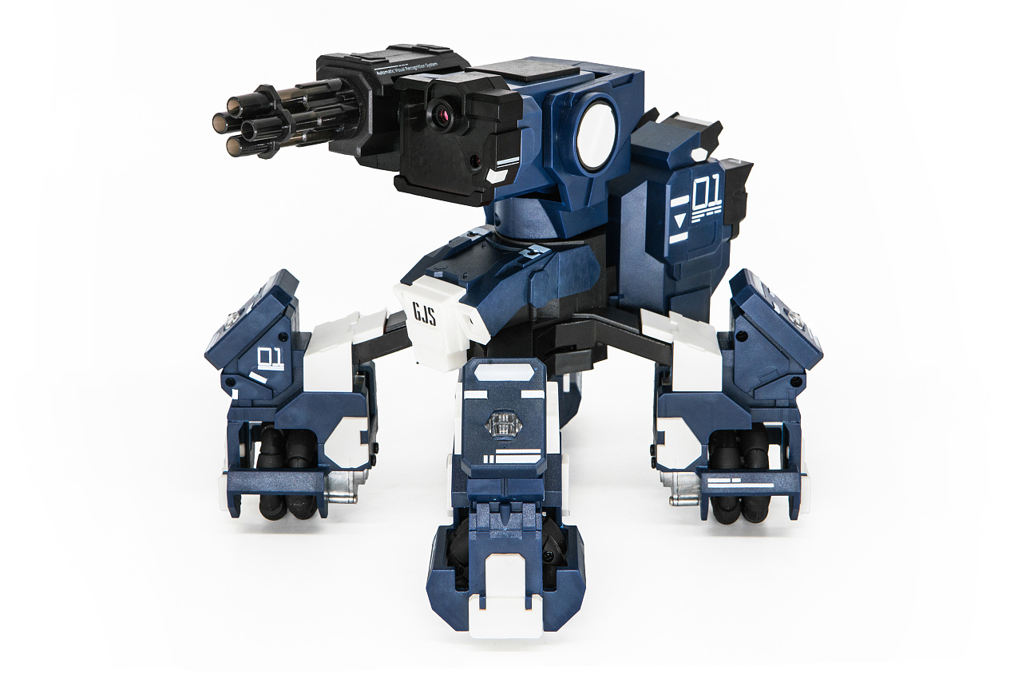
As a robot, GEIO is expected to do multiple tasks except for just moving around.
Image that GEIO as a sniper, it would be required to stay hide (cannot move) and
search around for the target. This could be done by simply turning its head.
We have already learnt about the way to make GEIO move. We also know that
GEIO is able to move with the motor-driven wheels equipped on its legs.
But is GEIO able to perform other actions? If we look close to it, it is easy
to find that GEIO’s head is able to turn either vertically or horizontally.
So today, we are going to learn the programming for GEIO’s head motion.

Slide 7
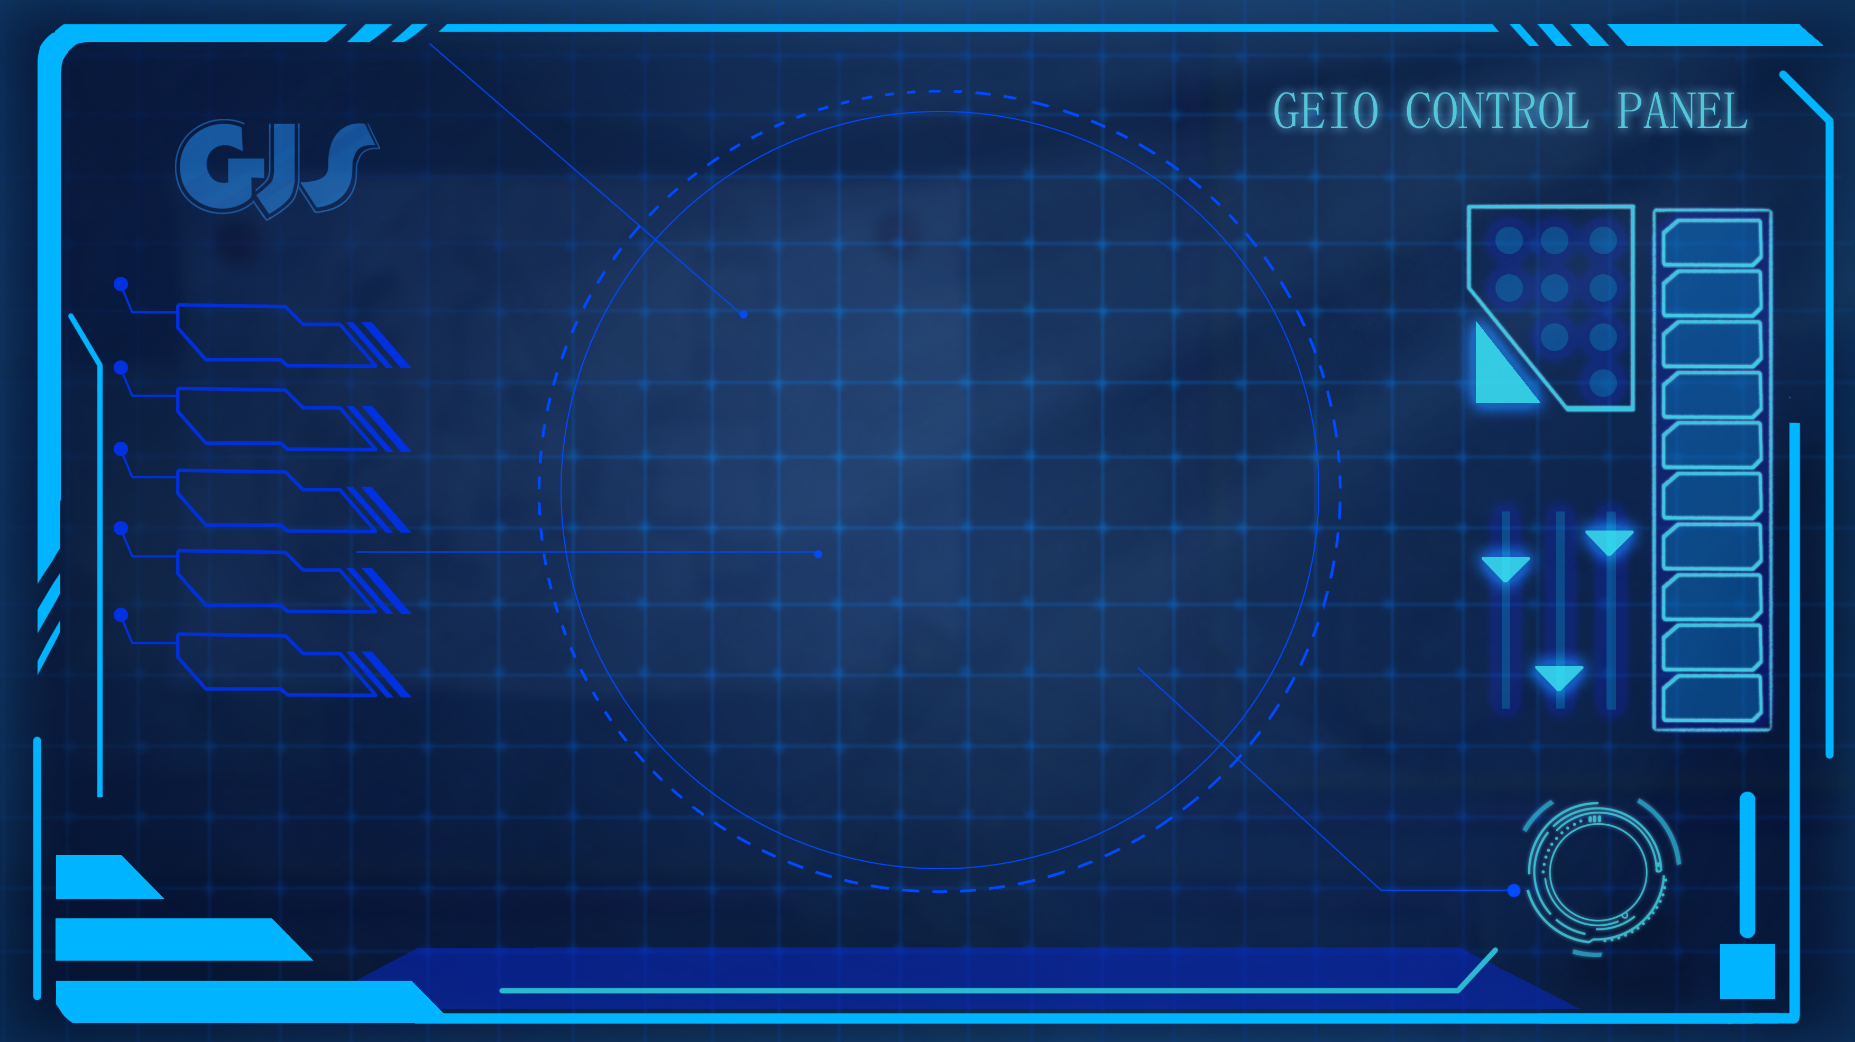
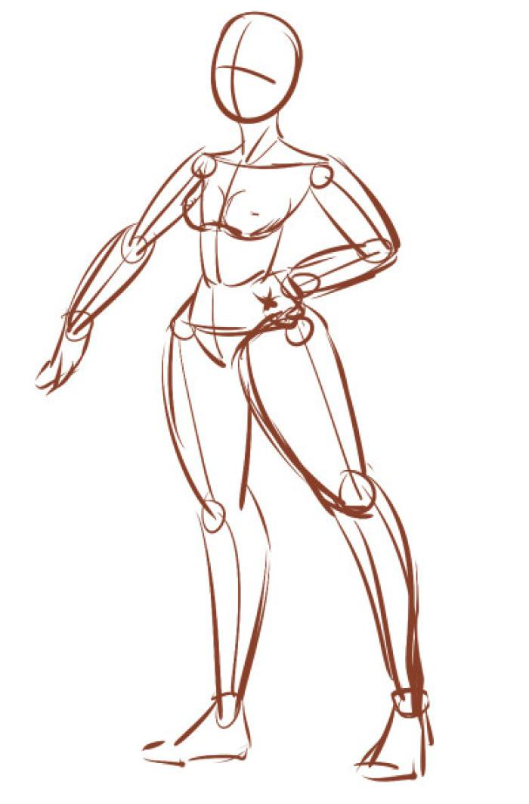
Let’s take GEIO as an example. We know that GEIO is able to move along the two axes shown in the above picture, and turn around the axis orthogonal to the other axes. Thus GEIO is able to perform three different actions using its wheels. For this part, there are 3 degrees of freedom.
Degree of freedom indicates the number of parameters needed to perform a certain action.
Specifically, degree of freedom can be considered as the number of joints of a robot. The
more joints the robot has, the more complicated action the robot is able to perform.
On the other hand, GEIO’s head is able to turn up or down, left or right (around
2 orthogonal axes). So for this part, there are 2 degrees of freedom for GEIO’s head.
Before we proceed to programming, let’s get to know about the degree of freedom.
But how to determine the number of degrees of freedom of a robot?

Slide 8
z axis
A
y axis
Origin
x axis
The world we live in is a three-dimensional space. In order to determine the position of an object, we shall need a coordinate system as the reference.
Here comes an object A. We can determine the spatial position of A by finding the reflections of A to on each axis.
As shown above, a three-dimensional coordinate system consists of a origin, and three orthogonal axes—x, y and z.
Similarly, we can also determine the turning position of GEIO’s head by using such coordinate system.
We just talked about the concept “axis”. What exactly is that?

Slide 9
Training

Slide 10
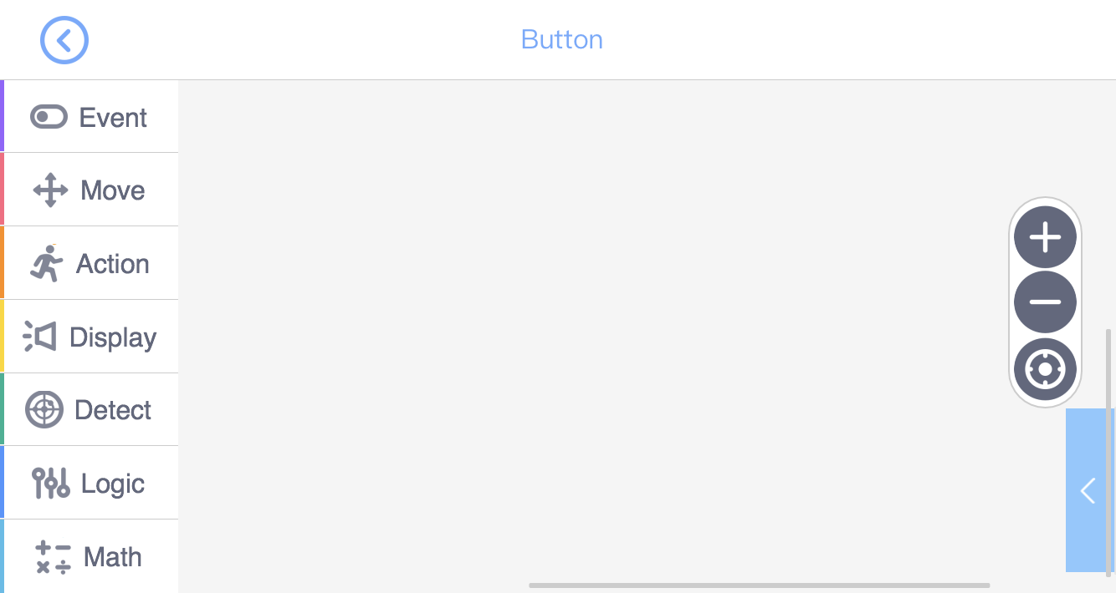
To control the head motion, we need to use the “Action” codes.

Slide 11
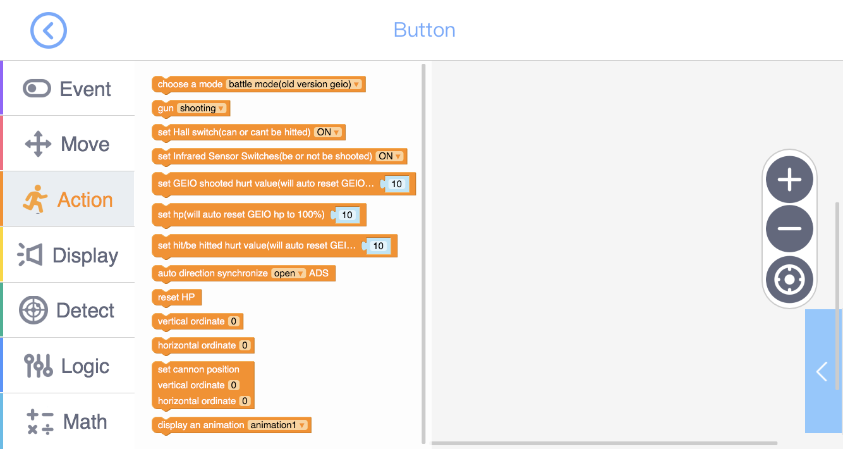
Combat settings
Head motion
Animations display

Slide 12
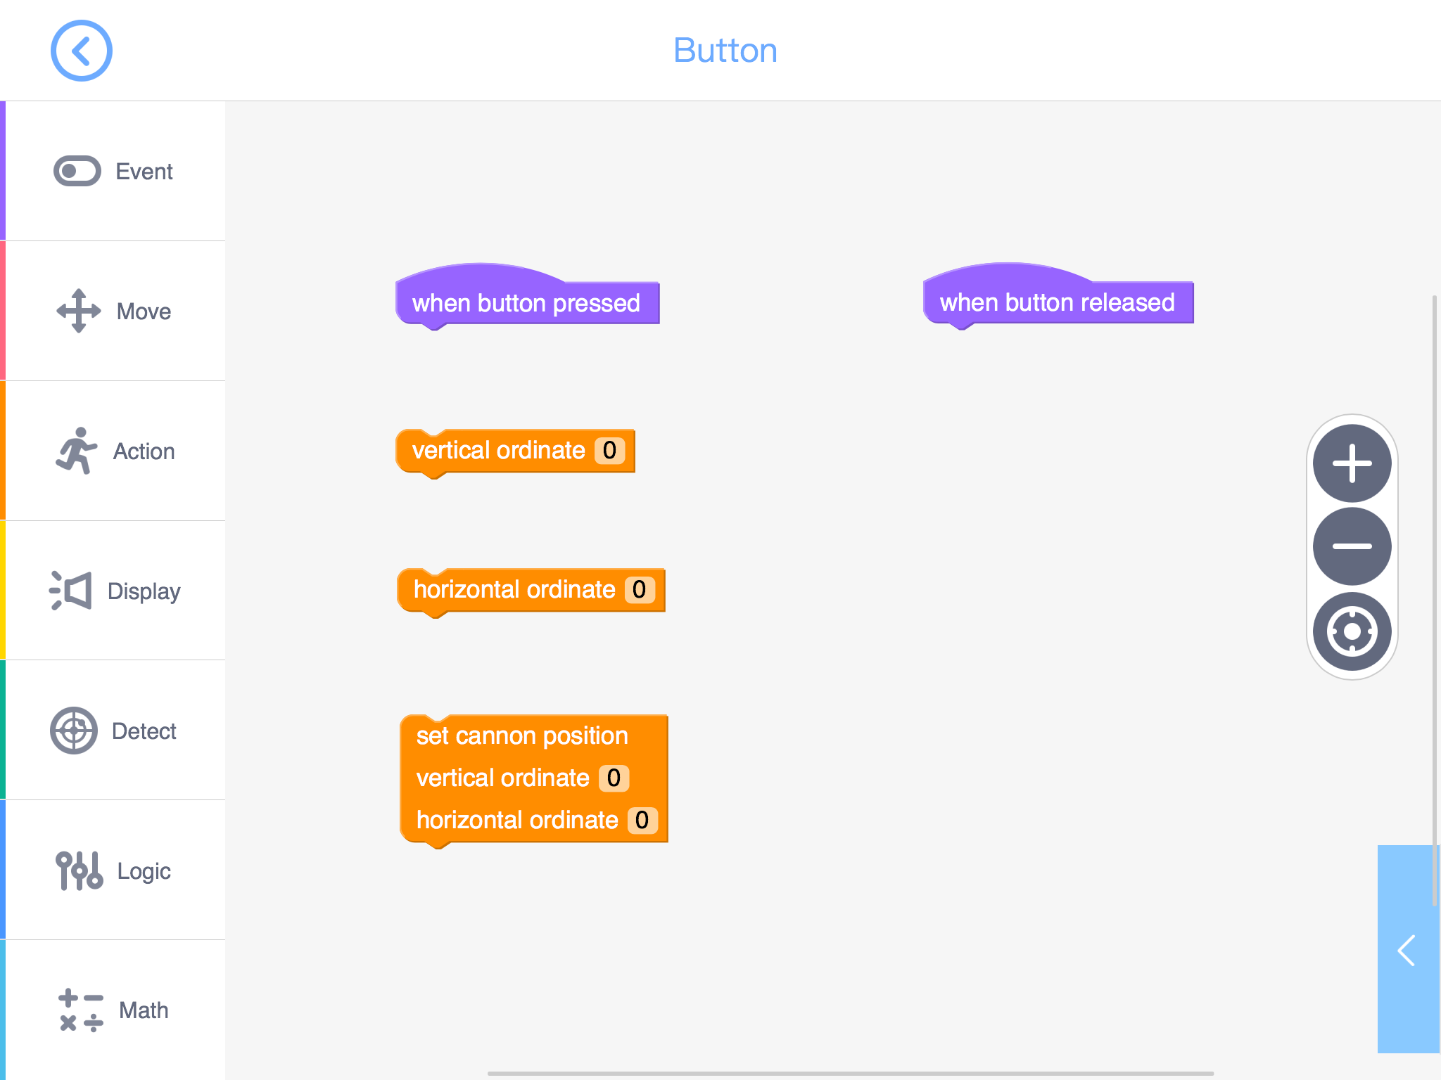
In our programming interface, we can find three codes that control the head of the head.
In these codes, we are able to set the coordinate parameters. The parameter range of the
horizontal axis is -10 to 10, and that of the vertical axis is -5 to 5.
Now let’s continue to the first training task: programme GEIO to control its head motion. When the button is pressed, turn head to the right; when button released, turn head back to the front.

Slide 13
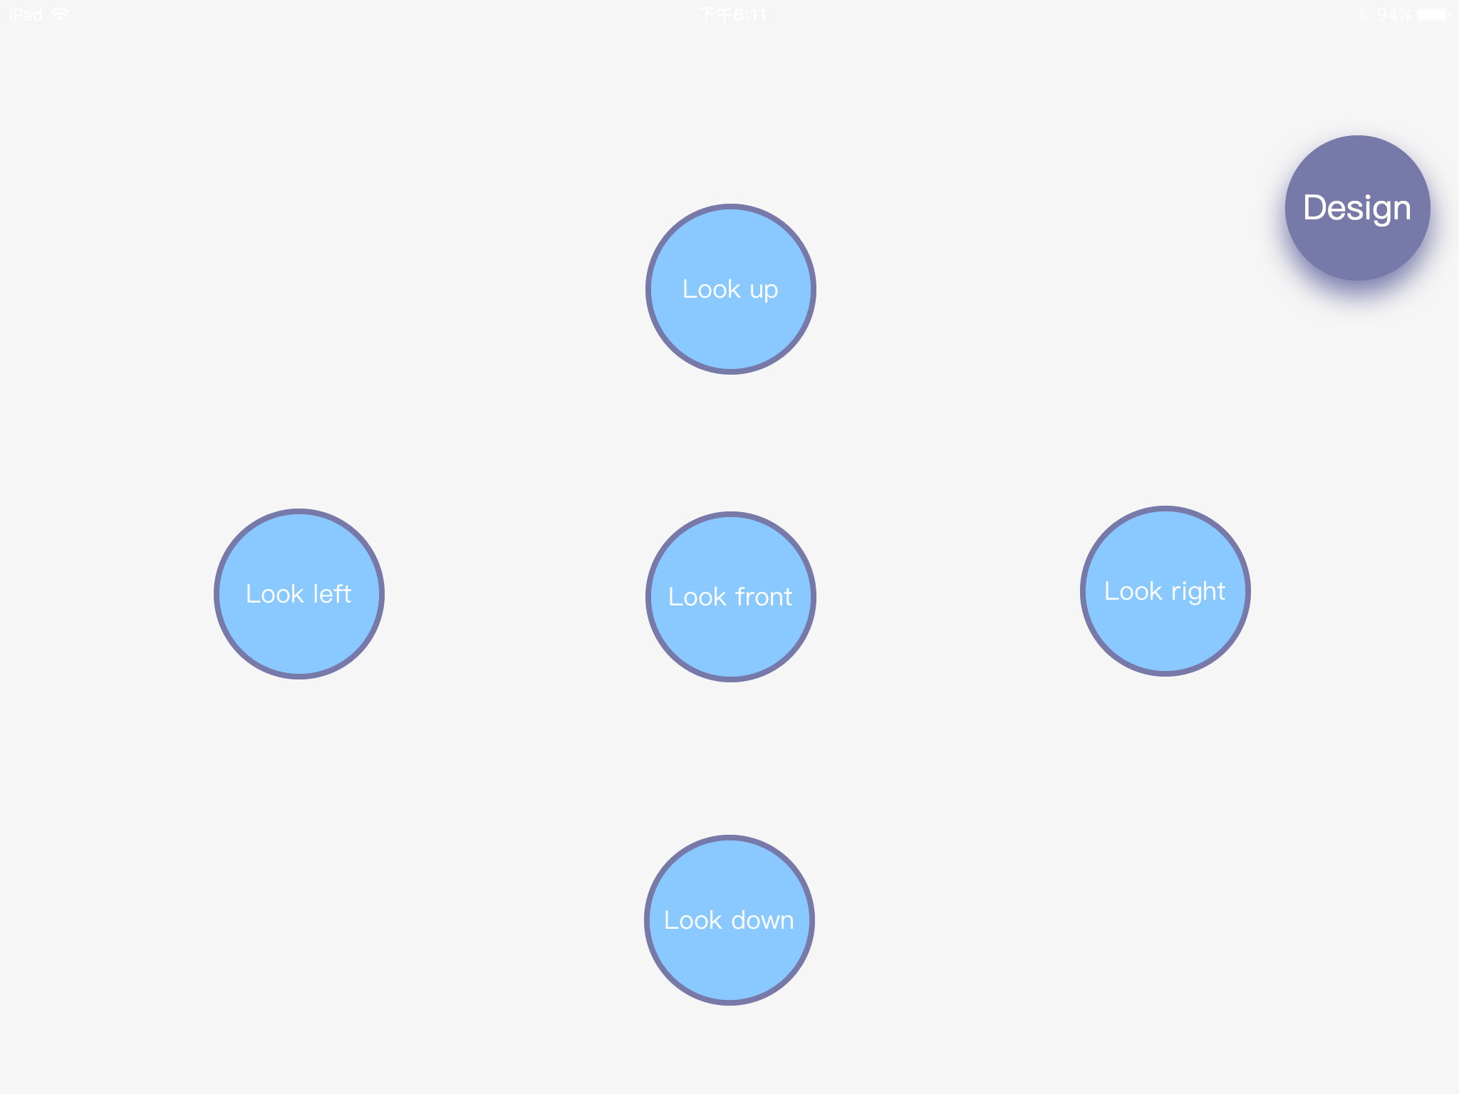
Good! Now let’s create a control panel as shown above. We use five buttons to represent five different turning directions for GEIO’s head, and rename them.
Then programme each button, so that when any button is pressed,
the head would turns to certain direction.

Slide 14
Challenge

Slide 15
It seems that you have acquired the knowledge of coordinate system and programming
for head motion. It is now the time for challenge: parcel delivery level 2!

Slide 16
Here is a simple tip for you. Try to refit GEIO’s laser gun by adding a long hook.
Programme GEIO, let it turn its head in order to aim at the basket’s handle;
then goes forward, let the hook go through the handle, and lift up the basket.
The parcel GEIO need to delivery today is a basket. How can it do this job without a hand?
Pilots, it is your turn now!

Slide 17
What is the degree of freedom?
What is a coordinate system?
How to determine the position of an object in 3-D space?
That’s the end of this class. Next time, there will be a quiz. So prepare yourself.
See you next time!
Last thing to do, can you answer my questions above?
Excellent! You have done the job!

